Slide 1
PHY 711 Classical Mechanics and Mathematical Methods
10-10:50 AM MWF Olin 103
Plan for Lecture 22:
    Read Chapter 7 & Appendices A-D
    Generalization of the one dimensional wave equation ➔ various mathematical problems and techniques including:
            Complex variables
            Contour integrals

Slide 2
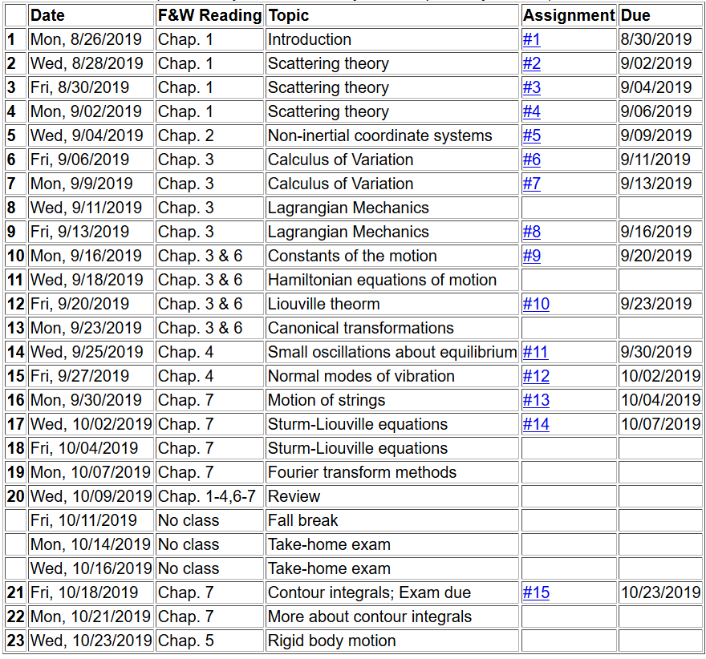

Slide 3
Complex numbers
Functions of complex variables
Derivatives:
Cauchy-Riemann equations

Slide 4

Analytic function
Examples of analytic functions

Slide 5
Examples of non-analytic functions

Slide 6
No contribution
C

Slide 8
Example:
Im(z)
Re(z)
Note:
m=1

Slide 9
Some details:

Slide 10
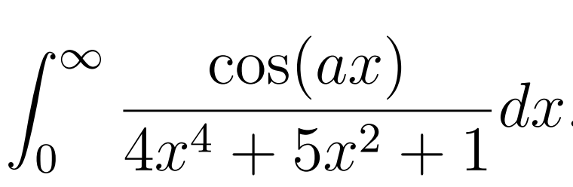
Another example:
Note:
m=1
Im(z)
Re(z)

Slide 12
Another example:
Im(z)
ia
Re(z)
10/30/2017
PHY 711 Fall 2017 -- Lecture 25
12

Slide 14
Im(z)
Re(z)

Slide 16
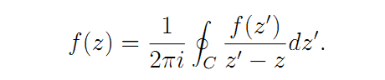
Cauchy integral theorem for analytic function f(z):

Slide 17
Example
Im(z)
Re(z)

Slide 18
Example -- continued
Im(z)
Re(z)

Slide 19
Example -- continued
Im(z’)
x
Re(z’)

Slide 20
Im(z’)
x
Re(z’)

Slide 21
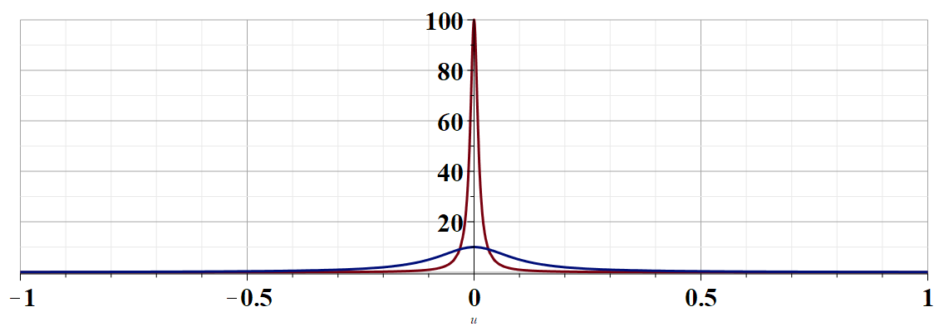
More details --
u

Slide 22
Example -- continued
Kramers-Kronig relationships

Slide 23
Comment on evaluating principal parts integrals
y’
x’

Slide 24
b(x’)
-2L
-L
L
2L
x’

Slide 26
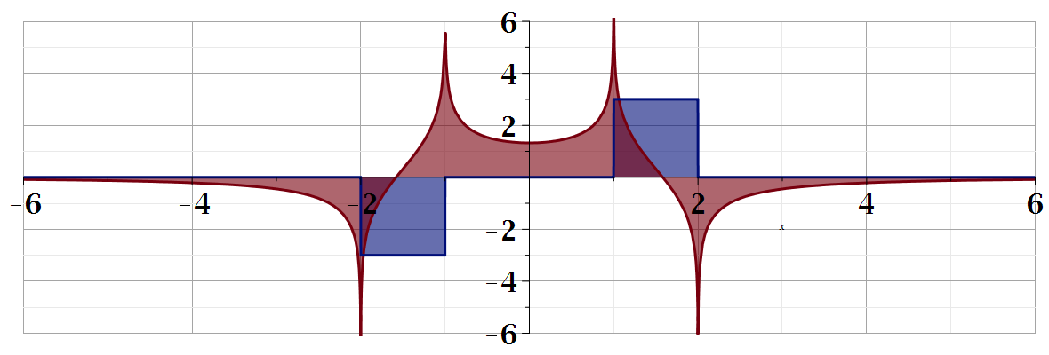
For our example:
b(x)
a(x)

Slide 27
Summary
?

Slide 28
Continued:

