Slide 1
PHY 711 Classical Mechanics and Mathematical Methods
10-10:50 AM MWF Olin 103
Plan for Lecture 24:
Rotational motion (Chapter 5)
Rigid body motion in body fixed frame
Conversion between body and inertial reference frames
Symmetric top motion

Slide 2
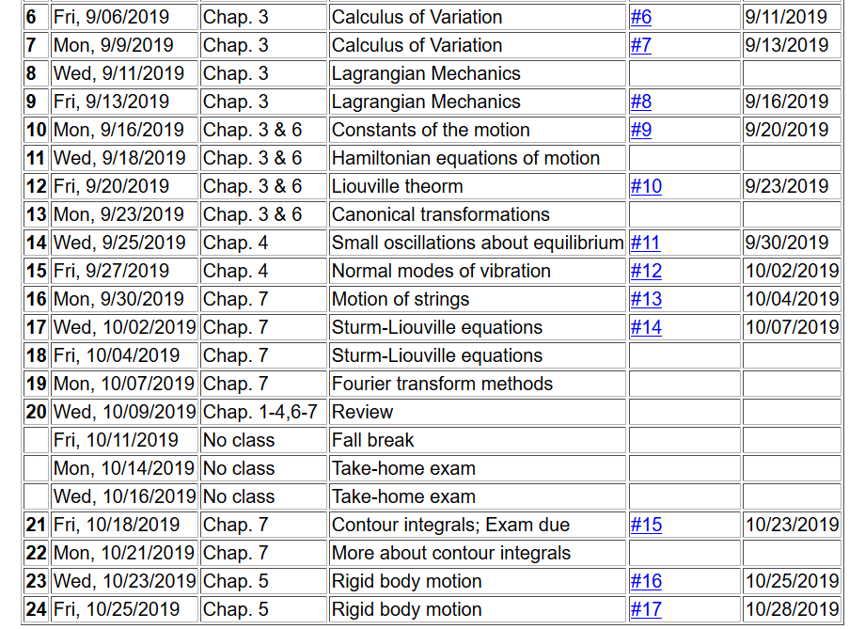

Slide 3
Summary of previous results
describing rigid bodies rotating
about a fixed origin
ω
r

Slide 4
Moment of inertia tensor

Slide 5
Continued -- summary of previous results describing rigid bodies rotating about a fixed origin
ω
r

Slide 6
Descriptions of rotation about a given origin -- continued

Slide 7
Descriptions of rotation about a given origin -- continued

Slide 9
Solution of Euler equations for a symmetric top -- continued

Slide 11
Euler equations for asymmetric top -- continued

Slide 12
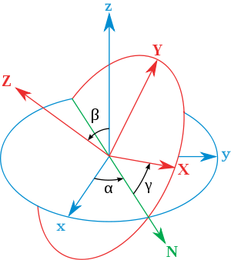
Transformation between body-fixed and inertial coordinate systems – Euler angles
inertial
body
x
y
y
x
http://en.wikipedia.org/wiki/Euler_angles

Slide 13
x
Need to express all components in body-fixed frame:
y
y
x

Slide 14
x
y
y
x

Slide 15
x
y
y
x

Slide 17
x
y
y
x

Slide 18
Rotational kinetic energy

Slide 19
Transformation between body-fixed and inertial coordinate systems – Euler angles
inertial
body
x
y
y
x
http://en.wikipedia.org/wiki/Euler_angles

Slide 20
General transformation between rotated coordinates – Euler angles
inertial
body
x
y
y
x
http://en.wikipedia.org/wiki/Euler_angles

Slide 21
Motion of a symmetric top under the influence of the torque of gravity:
γ
β
Mg
α

Slide 23
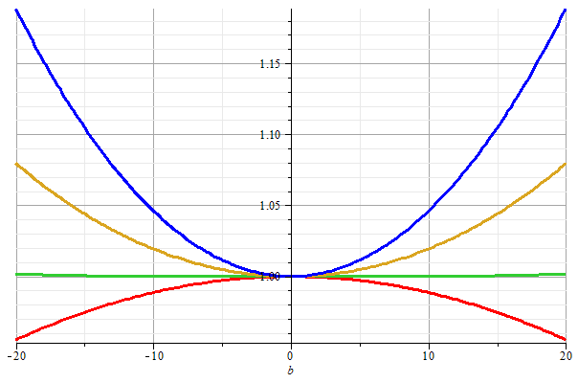
Stable/unstable solutions near
β=0

Slide 25
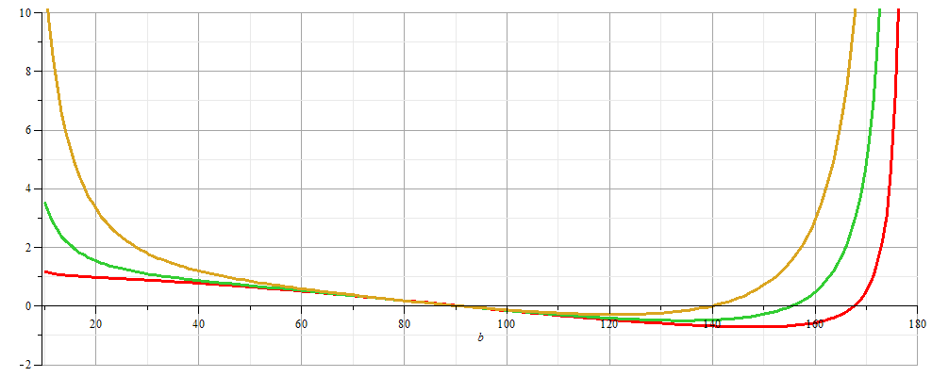
More general case:

Slide 26
β
Mg
α

