Slide 1
PHY 711 Classical Mechanics and Mathematical Methods
10-10:50 AM MWF Olin 103
Plan for Lecture 25:
Motions of elastic membranes (Chap. 8)
Review of standing waves on a string
Standing waves on a two dimensional membrane.
Boundary value problems

Slide 2
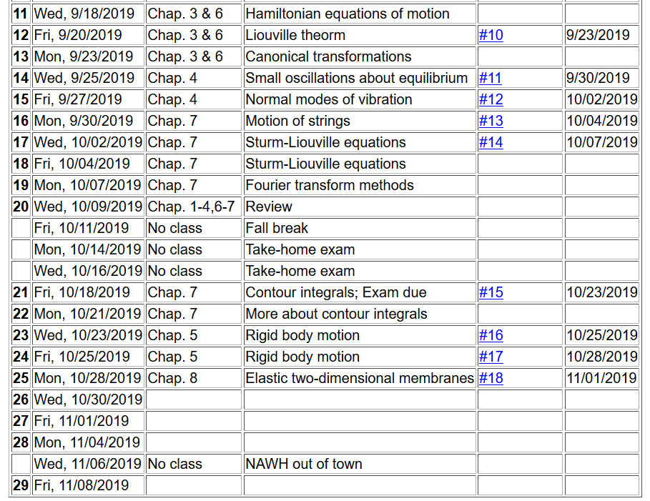

Slide 3
Elastic media in two or more dimensions --
Review of wave equation in one-dimension – here μ(x,t) can describe either a longitudinal or transverse wave.
Traveling wave solutions --

Slide 5
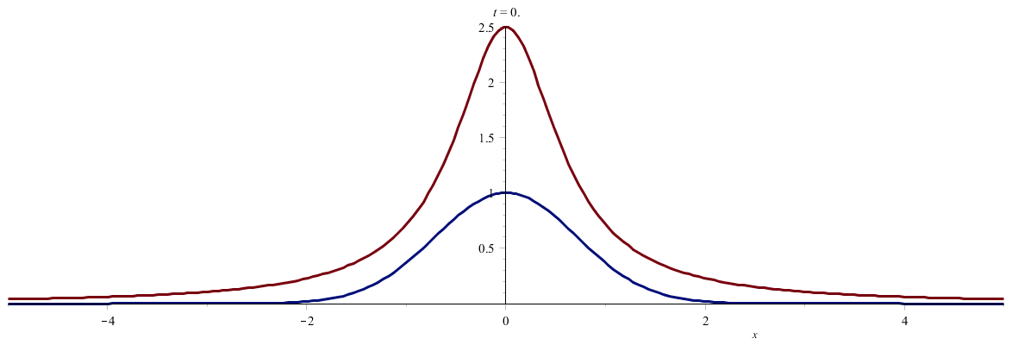

Slide 6
Standing wave solutions of wave equation:

Slide 7
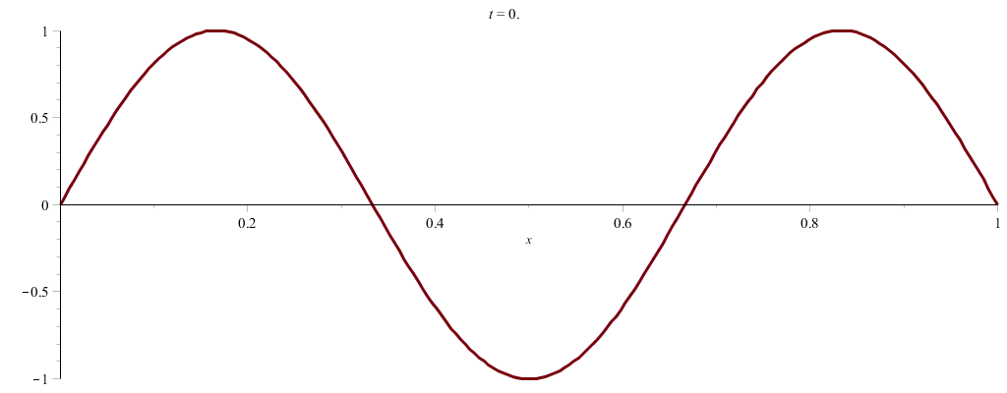

Slide 8
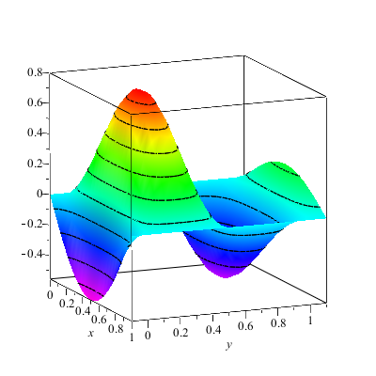
Wave motion on a two-dimensional surface – elastic membrane (transverse wave; linear regime).
u(x,y,t)

Slide 11
Consider a rectangular boundary:
b
a

Slide 12
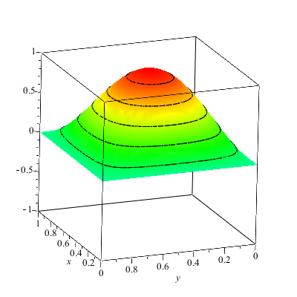
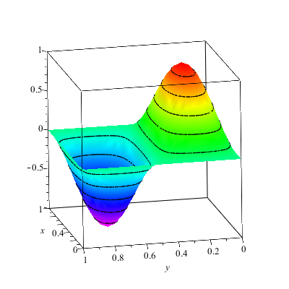
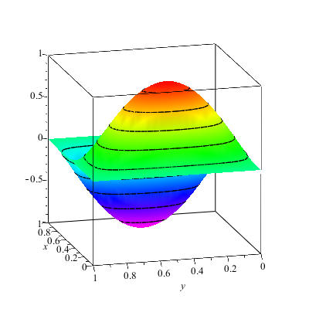
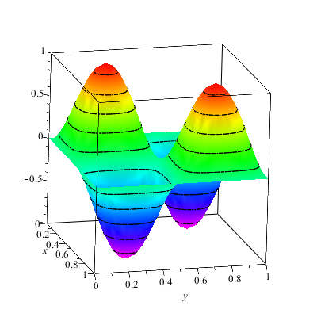

Slide 13
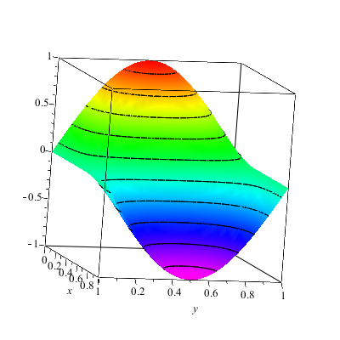
More general boundary conditions:

Slide 14
Consider a circular boundary:
R

Slide 15
Consider circular boundary -- continued

Slide 16
Some properties of Bessel functions

Slide 17
http://dlmf.nist.gov/

Slide 18
Series expansions of Bessel and Neumann functions

Slide 19
Some properties of Bessel functions -- continued

Slide 20
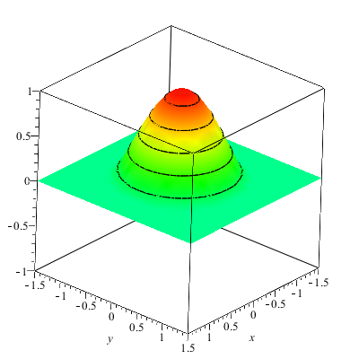
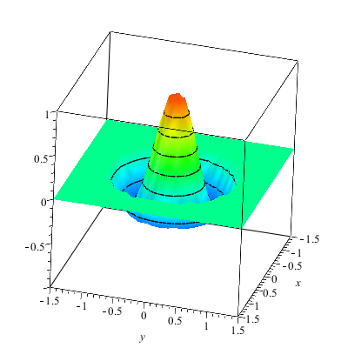

Slide 21
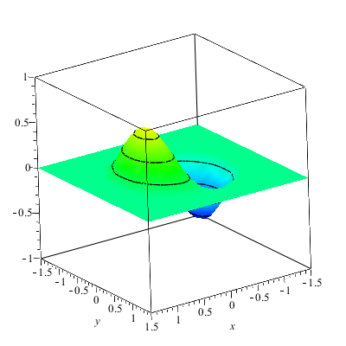
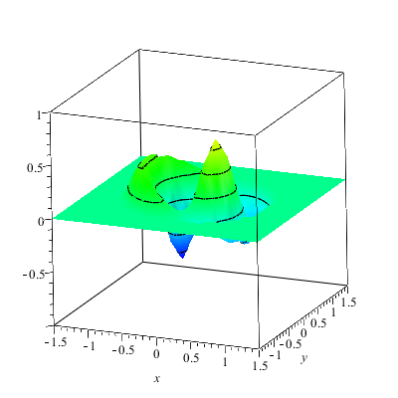

Slide 22
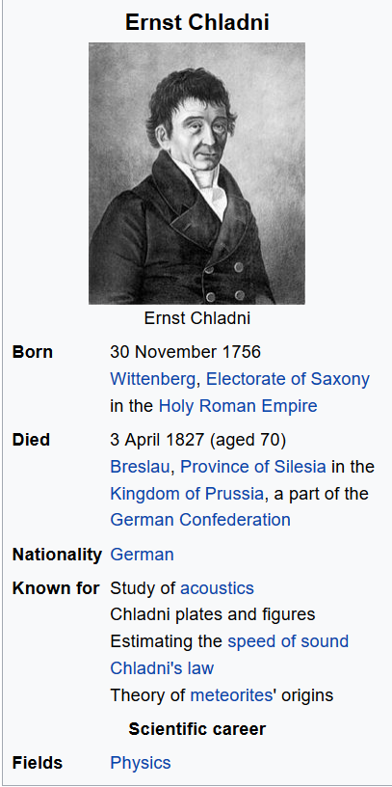
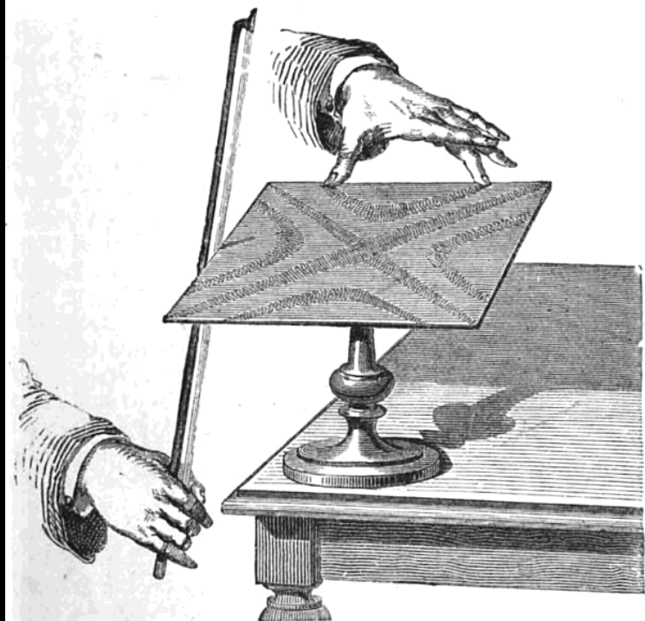

Slide 23
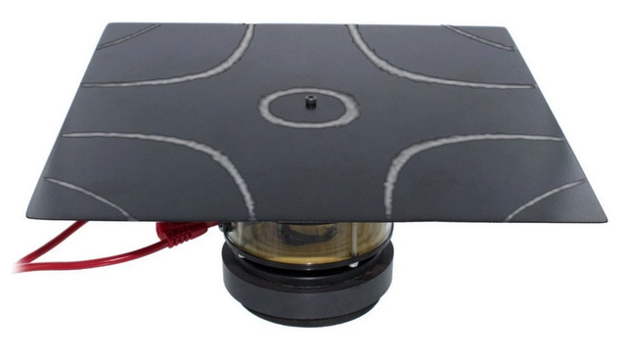
Demonstration with motor in the middle – (PASCO)

Slide 24
More complicated geometry – annular membrane
a
b

Slide 25
Consider circular boundary -- continued

Slide 26
Normal modes of an annular membrane -- continued
a
b

Slide 27
Normal modes of an annular membrane -- continued
a
b

Slide 28
Normal modes of an annular membrane -- continued
a
b

Slide 29
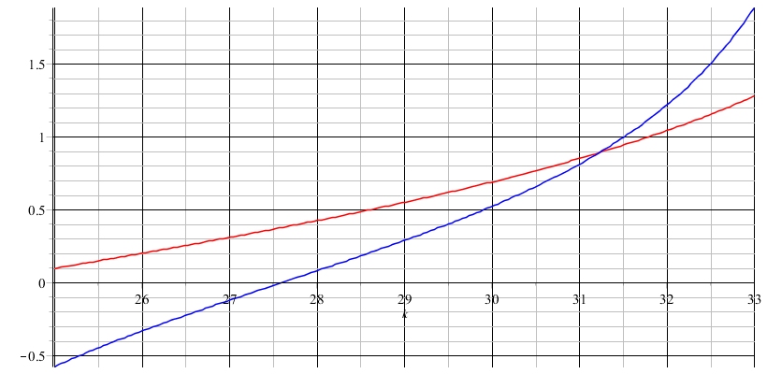
Analysis for m=0 and a=0.1, b=0.2:

Slide 31
a
b

