Slide 1
PHY 711 Classical Mechanics and Mathematical Methods
10-10:50 AM MWF Olin 103
Plan for Lecture 26:
Chap. 8 in F & W: Summary of two-dimensional membrane analysis
Chap. 9 in F & W: Introduction to hydrodynamics
Motivation for topic
Newton’s laws for fluids
Conservation relations

Slide 2
Today!
3 PM in Olin 101

Slide 3
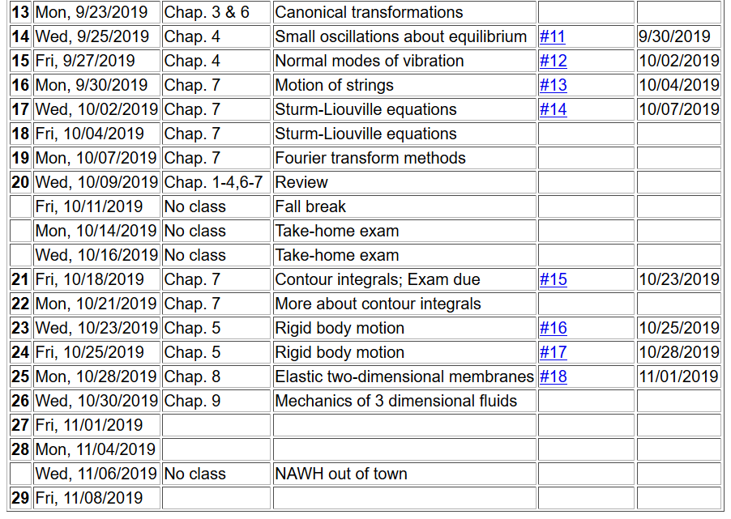

Slide 4
Review --
Consider a square boundary:
a
a

Slide 5
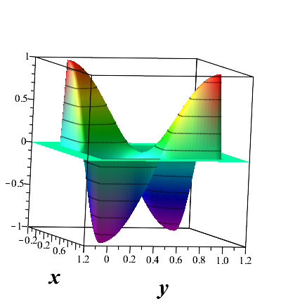
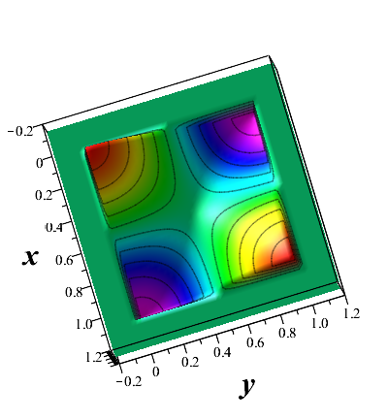

Slide 6
Hydrodynamic analysis
Motivation
Natural progression from strings, membranes, fluids; description of 1, 2, and 3 dimensional continua
Interesting and technologically important phenomena associated with fluids
Plan
Newton’s laws for fluids
Continuity equation
Stress tensor
Energy relations
Bernoulli’s theorem
Various examples
Sound waves

Slide 7
Newton’s equations for fluids
Use Euler formulation; following “particles” of fluid

Slide 8
p(x)
p(x+dx)

Slide 9
Newton’s equations for fluids -- continued

Slide 11
Newton’s equations for fluids -- continued

Slide 12
Solution of Euler’s equation for fluids

Slide 13
Bernoulli’s integral of Euler’s equation for irrotational and incompressible fluid

Slide 14
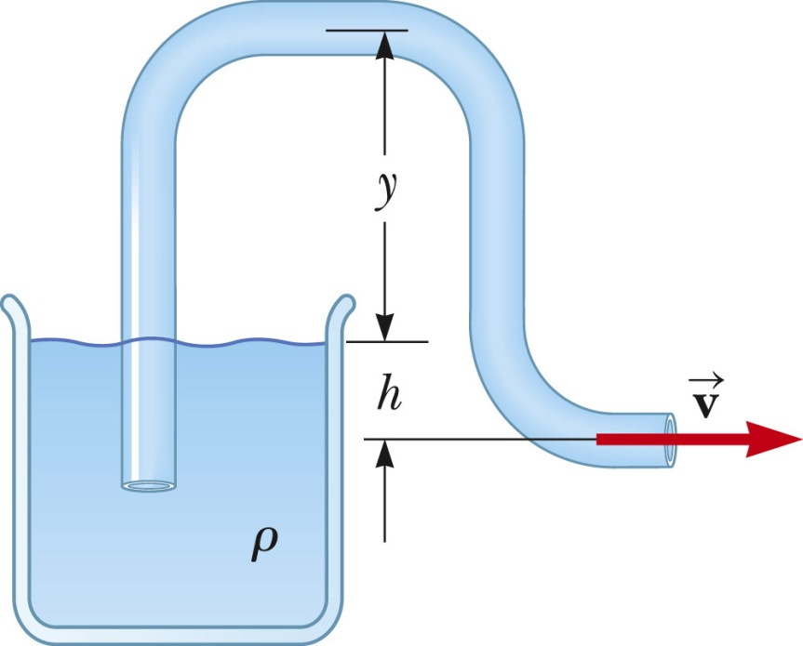
Examples of Bernoulli’s theorem
1
2

Slide 15
Examples of Bernoulli’s theorem -- continued
1
2

Slide 16
Examples of Bernoulli’s theorem -- continued
2
1

Slide 17
Examples of Bernoulli’s theorem -- continued
2
1

Slide 18
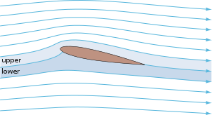
Examples of Bernoulli’s theorem – continued
Approximate explanation of airplane lift
Cross section view of airplane wing
http://en.wikipedia.org/wiki/Lift_%28force%29
1
2

Slide 19
Continuity equation connecting fluid density and velocity:

Slide 20
Some details on the velocity potential

Slide 21
Example – uniform flow
b
a
z

Slide 22
Example – flow around a long cylinder (oriented in the Y direction)
^
X
^
v₀ Z
r=a
^
θ
v₀ Z
^
Z

Slide 25
to be continued …

