Slide 1
PHY 711 Classical Mechanics and Mathematical Methods
10-10:50 AM MWF Olin 103
Plan for Lecture 28: Chap. 9 of F&W
    Wave equation for sound in linear approximation
      Wave equations for sound
      Speed of sound
      Standing wave solutions

Slide 2


Slide 3
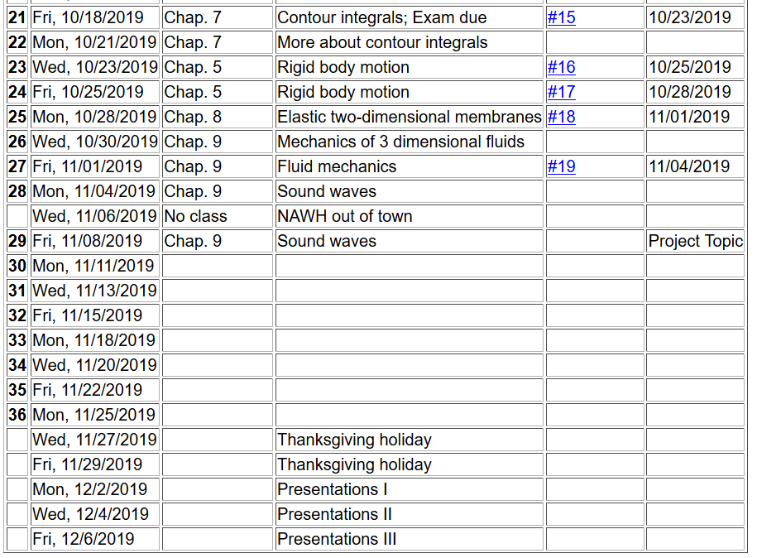

Slide 4
Application of fluid equations to the case of air in equilibrium plus small perturbation

Slide 8
Analysis of wave velocity in an ideal gas:
adiabatic conditions

Slide 10
Digression
 | f | γ
Spherical atom | 3 | 1.66667
Diatomic molecule | 5 | 1.40000

Slide 14
Solutions to wave equation:

Slide 16
Time harmonic standing waves in a pipe
a
L

Slide 20
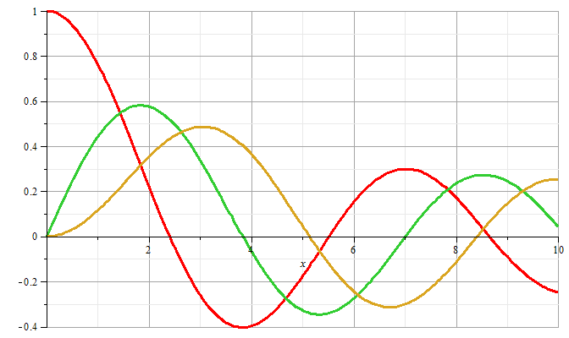
m=0
m=1
m=2

Slide 21
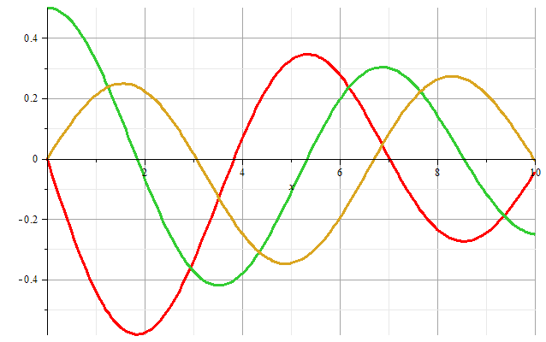
m=1
m=2
m=0
Zeros of derivatives: m=0: 0.00000, 3.83171, 7.01559
m=1: 1.84118, 5.33144, 8.53632
m=2: 3.05424, 6.70613, 9.96947

Slide 22
Boundary condition for z=0, z=L:

Slide 23
Example

Slide 24
Alternate boundary condition for z=0, z=L:

