Slide 1
PHY 711 Classical Mechanics and Mathematical Methods
10-10:50 AM MWF Olin 103
Plan for Lecture 29: Chap. 9 of F&W
Wave equation for sound in the linear approximation
Sound generation
Sound scattering

Slide 2
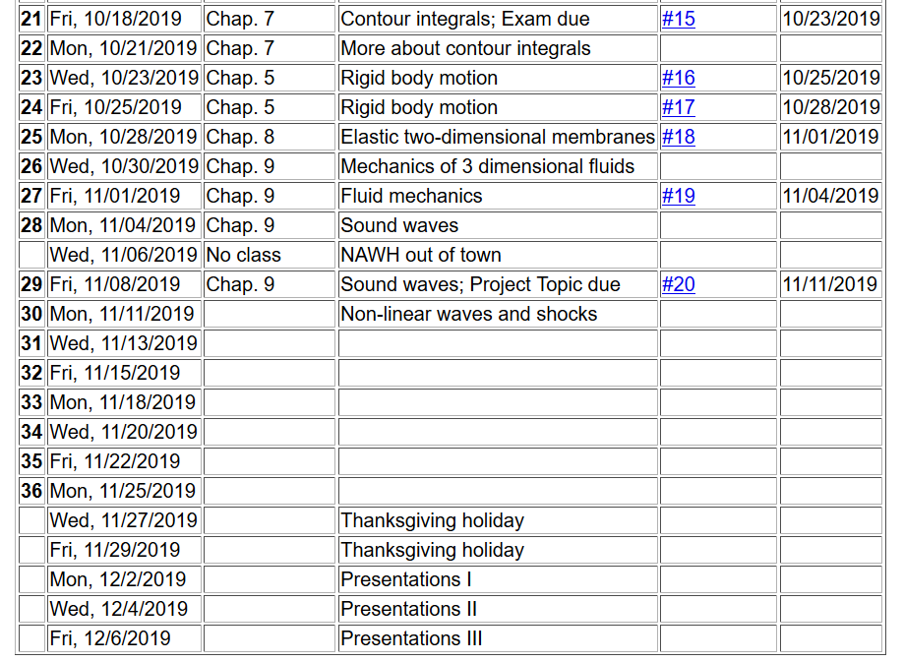

Slide 3
Solutions to wave equation:

Slide 4
Some comments about Monday’s lecture

Slide 5
Some comments about Monday’s lecture -- continued

Slide 6
Some comments about Monday’s lecture -- continued

Slide 7
Wave equation with source:

Slide 8
Wave equation with source -- continued:

Slide 9
Derivation of Green’s function for wave equation

Slide 10
Derivation of Green’s function for wave equation -- continued

Slide 11
Derivation of Green’s function for wave equation -- continued

Slide 12
Derivation of Green’s function for wave equation -- continued

Slide 13
Derivation of Green’s function for wave equation – continued
need to find A and B.

Slide 14
Derivation of Green’s function for wave equation – continued

Slide 15
Derivation of Green’s function for wave equation – continued

Slide 16
➔In order to solve an inhomogenous wave equation with a time harmonic forcing term, we can use the corresponding Green’s function:
In fact, this Green’s function is appropriate for solving equations with boundary conditions at infinity. For solving problems with surface boundary conditions where we know the boundary values or their gradients, the Green’s function must be modified.

Slide 18
➔extra contributions from boundary

Slide 19
Wave equation with source:
z
y
x

Slide 20
Treatment of boundary values for time-harmonic force:

Slide 25
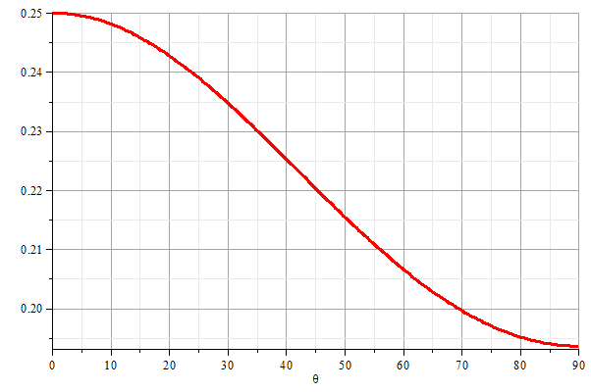
z
θ
y
x

Slide 26
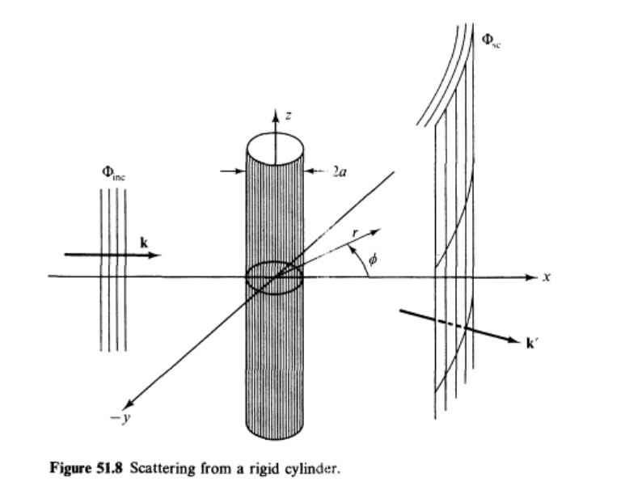
Scattering of sound waves –
for example, from a rigid cylinder
Figure from Fetter and Walecka pg. 337

Slide 27
Scattering of sound waves –
for example, from a rigid cylinder

Slide 30
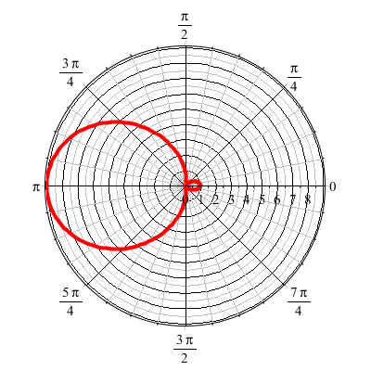
For ka << 1

