Slide 1
PHY 711 Classical Mechanics and Mathematical Methods
10-10:50 AM MWF Olin 103
Plan for Lecture 3:
Textbook reading: Chapter 1
Continuation of scattering theory discussion
Center of mass reference fame and its relationship to “laboratory” reference frame
Analytical evaluation of the differential scattering cross section

Slide 2
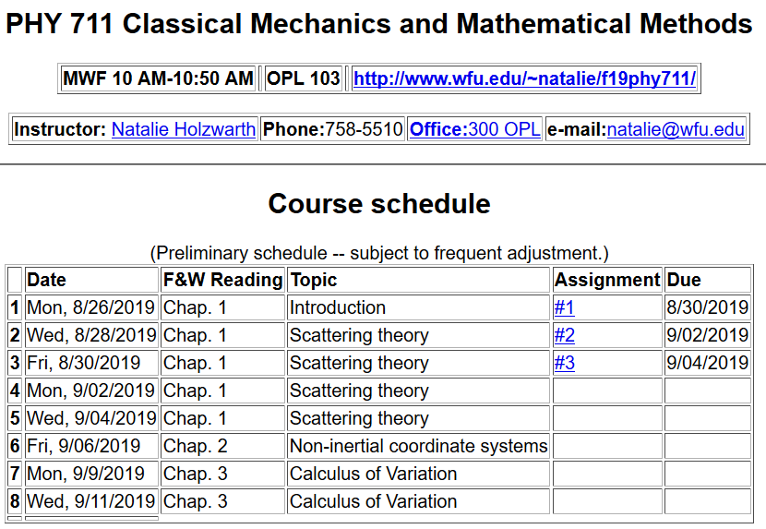

Slide 3
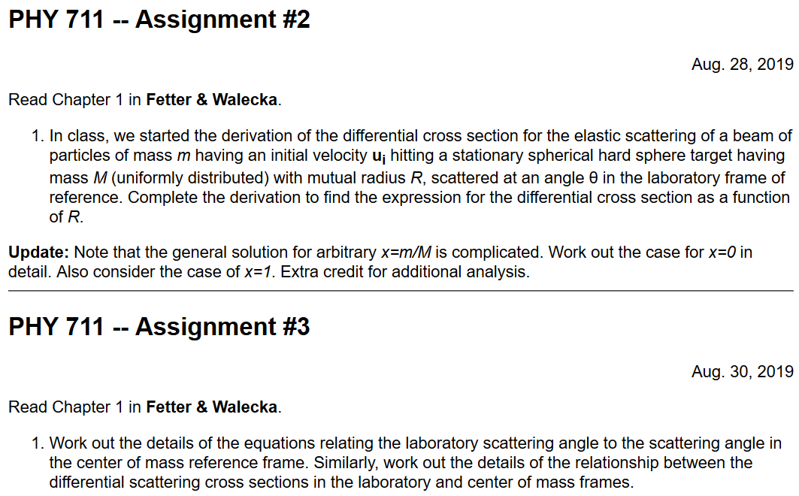

Slide 4
Scattering theory:
detector

Slide 5
b
Figure from Marion & Thorton, Classical Dynamics

Slide 6
Note: The notion of cross section is common to many areas of physics including classical mechanics, quantum mechanics, optics, etc. Only in the classical mechanics can we calculate it from a knowledge of the particle trajectory as it relates to the scattering geometry.
b
Figure from Marion & Thorton, Classical Dynamics
Note: We are assuming that the process is isotropic in φ

Slide 7
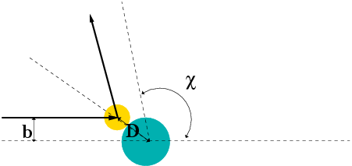
Simple example – collision of hard spheres
Microscopic view:

Slide 8
Simple example – collision of hard spheres -- continued
Hard sphere:

Slide 9
Relationship of scattering cross-section to particle interactions --
Classical mechanics of a conservative 2-particle system.
1
2

Slide 10
Typical two-particle interactions –
Scattering theory can help us analyze the interaction potential V(r). First we need to simply the number of variables.

Slide 11
Relationship between center of mass and laboratory frames of reference

Slide 12
Classical mechanics of a conservative 2-particle system -- continued

Slide 13
constants
vary in time
For scattering analysis only need to know trajectory before and after
the collision.

Slide 14
Note: The following analysis will be carried out in the center of mass frame of reference.
In laboratory frame: In center-of-mass frame:
V₁
v₁
μ
m₁
r
origin
v_{CM}
m_{target}
Also note: We are assuming that the interaction between particle and target V(r) conserves energy and angular momentum.

Slide 15
It is often convenient to analyze the scattering cross section in the center of mass reference frame.
Relationship between normal laboratory reference and center of mass:
Laboratory reference frame:
Before After
m₁
m₂
u₁
v₁
ψ
u₂=0
ζ
v₂
Center of mass reference frame:
Before After
m₁
m₂
V₁
U₁
U₂
θ
θ
V₂

Slide 16
Relationship between center of mass and laboratory frames of reference -- continued

Slide 17
Relationship between center of mass and laboratory frames of reference
V_{CM}
V₁
v₁
θ
ψ
For elastic
scattering

Slide 18
Digression – elastic scattering
Also note:

Slide 19
Relationship between center of mass and laboratory frames of reference – continued (elastic scattering)
V_{CM}
V₁
v₁
ψ
θ

Slide 20
Differential cross sections in different reference frames

Slide 21
Differential cross sections in different reference frames – continued:

Slide 22
Example: suppose m₁ = m₂

Slide 23
Summary --
Differential cross sections in different reference frames – continued:
For elastic scattering

Slide 24
Example: suppose m₁ = m₂

Slide 25
Example of hard spheres
θ

Slide 26
Hard sphere example – continued
m₁=m₂
Center of mass frame
Lab frame

Slide 27
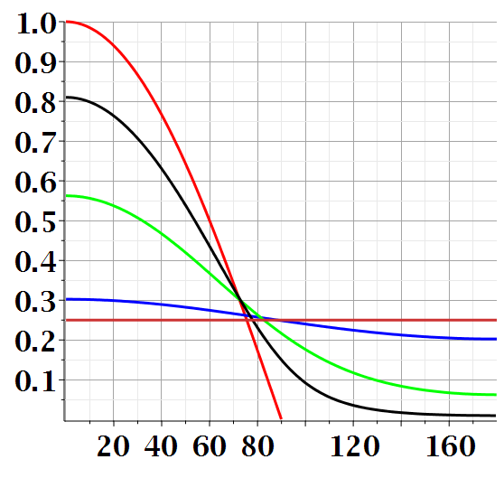
Scattering cross section for hard sphere in lab frame for various mass ratios:

Slide 28
Maple syntax:

Slide 29
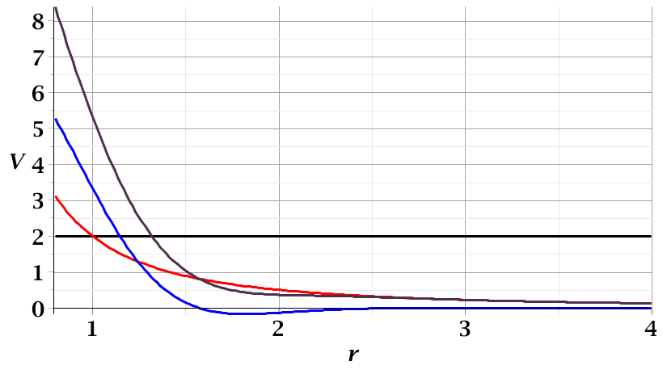
For a continuous potential interaction in center of mass reference frame:
Need to relate these parameters to differential cross section
E_{rel}
r_{min}

Slide 30
Focusing on the center of mass frame of reference:
Typical two-particle interactions –
X
⬅

