Slide 1
PHY 711 Classical Mechanics and Mathematical Methods
10-10:50 AM MWF Olin 103
Plan for Lecture 30: Chap. 9 of F&W
Wave equation for sound beyond the linear approximation
Non-linear effects in sound waves
Shock wave analysis

Slide 2
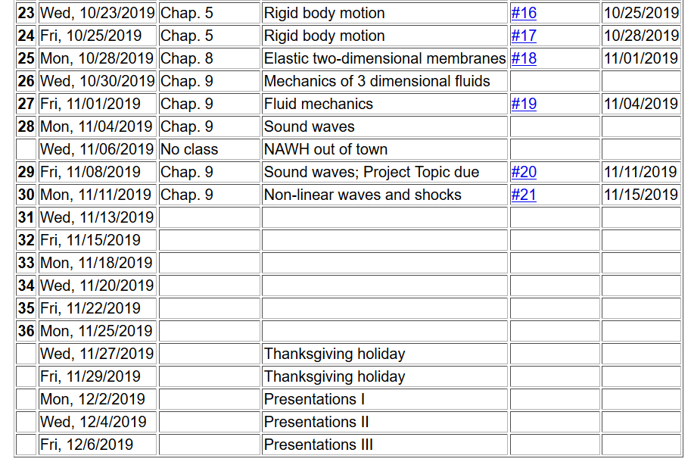

Slide 3
Effects of nonlinearities in fluid equations
-- one dimensional case

Slide 9
Traveling wave solution:

Slide 10
Traveling wave solution -- continued:

Slide 11
Traveling wave solution -- full non-linear case:
w

Slide 12
Visualization continued:

Slide 13
Summary

Slide 14
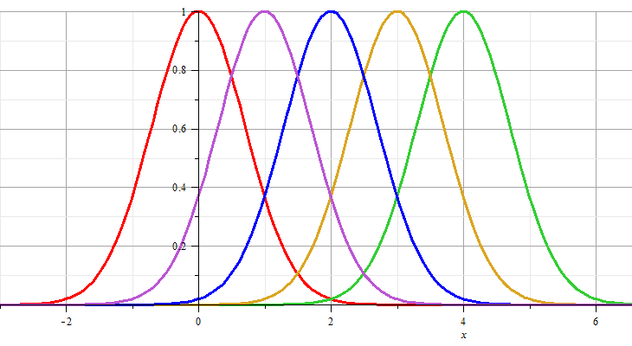
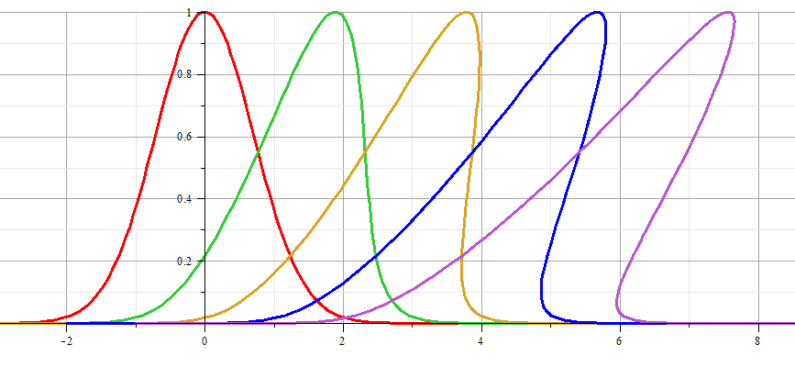
Linear wave:
Non-linear wave:

Slide 15
Linear wave
Non-linear wave

Slide 16
Analysis of shock wave
Plots of δρ
Solution becomes unphysical

Slide 17
Analysis of shock wave -- continued
After shock
t₂
δρ₂, δv₂, δp₂
Before shock
t₁
δρ₁, δv₁, δp₁
Shock front
x
u
Note that in this case u is assumed to be a given parameter of the system.

Slide 18
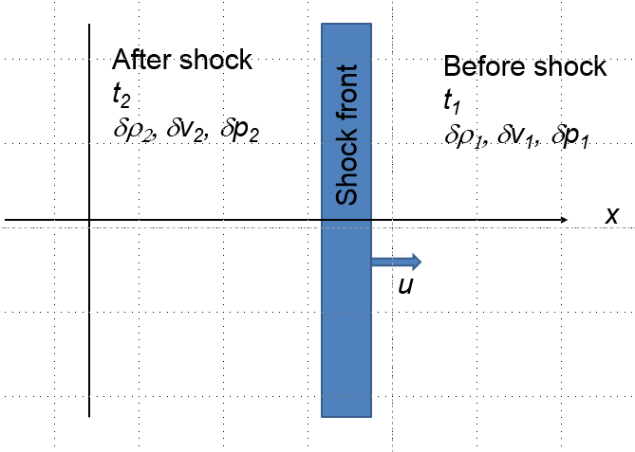
Analysis of shock wave – continued
While analysis in the shock region is complicated, we can use conservation laws to analyze regions 1 and 2

Slide 19
Analysis of shock wave – continued
While analysis in the shock region is complicated, we can use conservation laws to analyze regions 1 and 2

Slide 20
Analysis of shock wave – continued
For adiabatic ideal gas, also considering energy and momentum conservation:
ρ₂/ρ₁
p₂/p₁

Slide 21
Analysis of shock wave – continued
For adiabatic ideal gas, entropy considerations::

