Slide 1
PHY 711 Classical Mechanics and Mathematical Methods
10-10:50 AM MWF Olin 103
Plan for Lecture 31:
Chapter 10 in F & W: Surface waves
Water waves in a channel
Wave-like solutions; wave speed

Slide 2
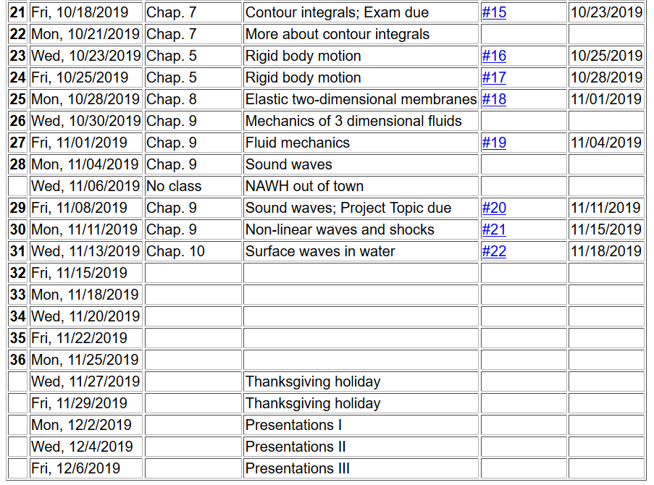

Slide 4
Physics of incompressible fluids and their surfaces
Reference: Chapter 10 of Fetter and Walecka

Slide 5
Consider a container of water with average height h and surface h+ζ(x,y,t); (h ⬅➔ z₀ on some of the slides)
p₀
ζ
z
h
y
x

Slide 6
within the water

Slide 7
Consider a surface ζ(x,t) wave moving in the x-direction in a channel of width b(x) and height h(x):
ζ(x,t)
v(x,t)
v(x+dx,t)
h(x)
b(x)
dx

Slide 8
ζ(x,t)
v(x,t)
v(x+dx,t)
h(x)
b(x)
dx

Slide 9
Example continued

Slide 10
Example continued

Slide 11
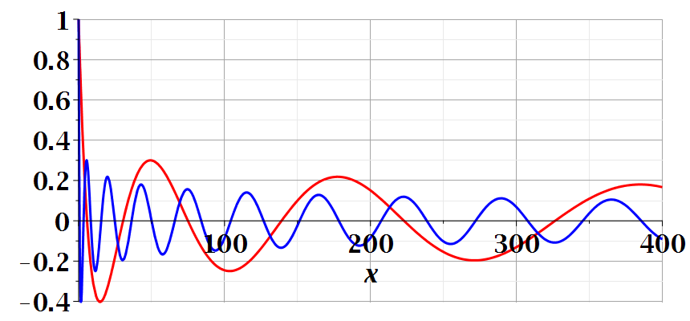

Slide 12
Another example:
ζ(x,t)
v(x,t)
v(x+dx,t)
h(x)
b(x)
dx
Special case, where b and h are constant --

Slide 13
Example with b and h constant -- continued
dζ(x,y,t)/dt
z₀
v(x,y,t)
v(x+dx,y+dy,t)

Slide 14
For uniform channel:

Slide 15
More details: -- recall setup --
Consider a container of water with average height h and surface h+ζ(x,y,t)
p₀
ζ
z
h
y
x

Slide 16
Equations describing fluid itself (without boundaries)

Slide 17
p₀
ζ
z
h
y
x
(We have absorbed p₀ in “constant”)

Slide 18
Full equations:
(We have absorbed p₀ in “constant”)
Linearized equations:

Slide 19
For simplicity, keep only linear terms and assume that horizontal variation is only along x:

Slide 20
For simplicity, keep only linear terms and assume that horizontal variation is only along x – continued:

Slide 21
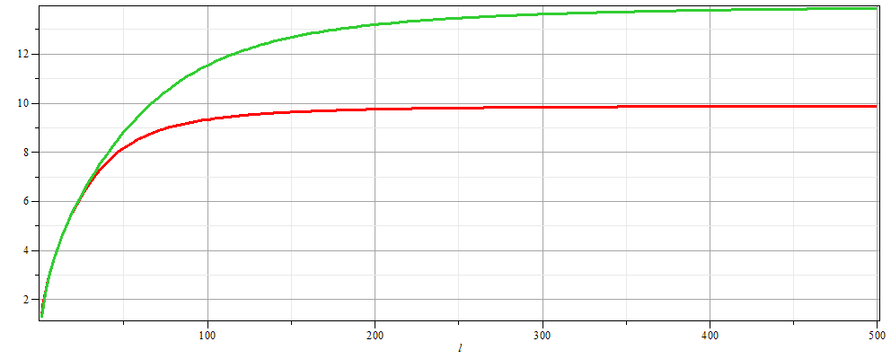
For simplicity, keep only linear terms and assume that horizontal variation is only along x – continued:
h=20 m
c
h=10 m
λ

Slide 22
For simplicity, keep only linear terms and assume that horizontal variation is only along x – continued:

Slide 23
General problem
including
non-linearities
p₀
ζ
z
h
y
x

