Slide 1
PHY 711 Classical Mechanics and Mathematical Methods
10-10:50 AM MWF Olin 103
Plan for Lecture 32:
    Chapter 10 in F & W: Surface waves
    Comment on Bessel functions (HW #21)
    Summary of linear surface wave solutions
    Non-linear contributions and soliton solutions

Slide 2
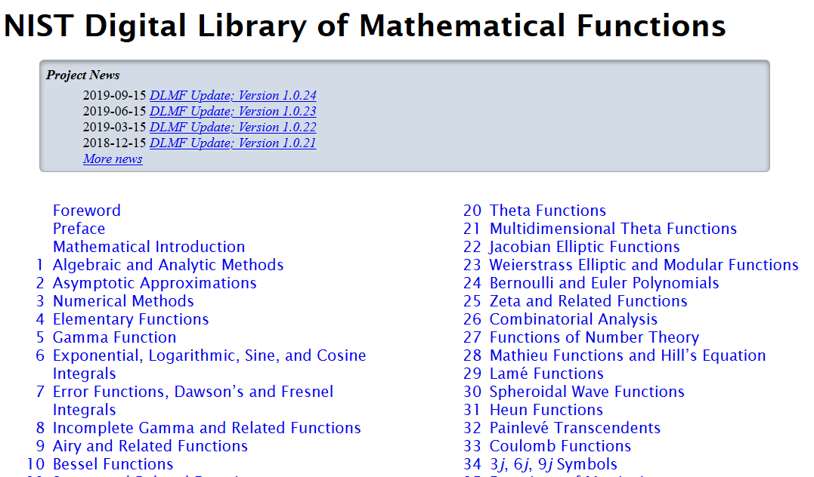
Comment on Bessel functions
https://dlmf.nist.gov/

Slide 3
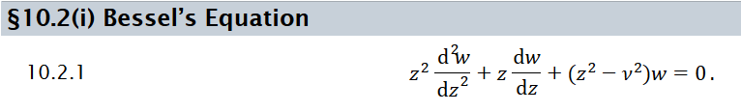
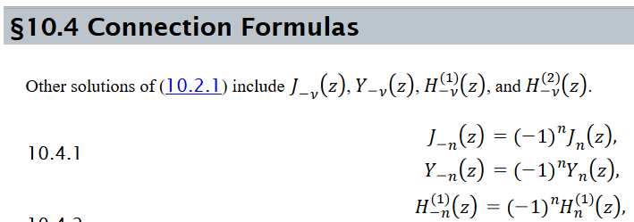
➔Note that, in principle, solutions for +ν and –ν are related; and for integer ν they are not independent. The “standard” conventions are given as follows.

Slide 4
This material is covered in Chapter 10 of your textbook using similar notation.

Slide 5
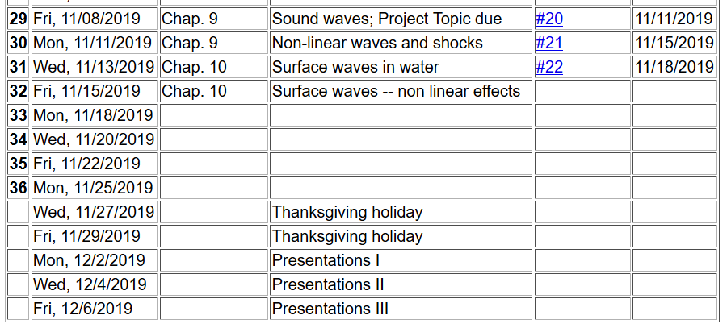

Slide 6
Consider a container of water with average height h and surface h+ζ(x,y,t)
p₀
ζ
z
h
y
x

Slide 7
p₀
ζ
z
h
y
x

Slide 8
Keep only linear terms and assume that horizontal variation is only along x:

Slide 9
Note that this solution represents a pure plane wave. More likely, there would be a linear combination of wavevectors k.
Additionally, your text considers the effects of surface tension. In this lecture, we will focus on the effects of the non-linear effects of Euler and continuity equations.

Slide 10
Surface waves in an incompressible fluid
General problem
  including
  non-linearities
p₀
ζ
z
h
y
x

Slide 11
p₀
ζ
z
h
y
x

Slide 12
Non-linear effects in surface waves:
p₀
ζ
z
h
y
z=0
x

Slide 13
Detailed analysis of non-linear surface waves
[Note that these derivations follow Alexander L. Fetter and John Dirk Walecka, Theoretical Mechanics of Particles and Continua (McGraw Hill, 1980), Chapt. 10.]
The surface of the fluid is described by z=h+ζ(x,t). It is assumed that the fluid is contained in a structure (lake, river, swimming pool, etc.) with a structureless bottom defined by the z = 0 plane and filled to an equilibrium height of z = h.

Slide 14
Defining equations for Φ(x,z,t) and ζ(x,t)
Bernoulli equation (assuming irrotational flow) and gravitation potential energy

Slide 15
Boundary conditions on functions –
Zero velocity at bottom of tank:
Consistent vertical velocity at water surface

Slide 16
Analysis assuming water height z is small relative to
variations in the direction of wave motion (x)
Taylor’s expansion about z = 0:
Note that the zero vertical velocity at the bottom ensures that all odd derivatives vanish from the
Taylor expansion. In addition, the Laplace equation allows us to convert all even derivatives with respect to z
to derivatives with respect to x.

Slide 17
Check linearized equations and their solutions:
Bernoulli equations --
Using Taylor's expansion results to lowest order
➔linear wave equation with c²=gh

Slide 18
Analysis of non-linear equations --

Slide 19
Analysis of non-linear equations -- keeping the lowest order nonlinear terms and include up to 4th order derivatives in the linear terms.

Slide 20
Note that the wave “speed” c will be consistently determined

Slide 21
Integrating and re-arranging coupled equations

Slide 22
Integrating and re-arranging coupled equations – continued --
Expressing modified surface velocity equation in terms of η(u):

Slide 23
Solution of the famous Korteweg-de Vries equation
Modified surface amplitude equation in terms of η
Soliton solution

Slide 25
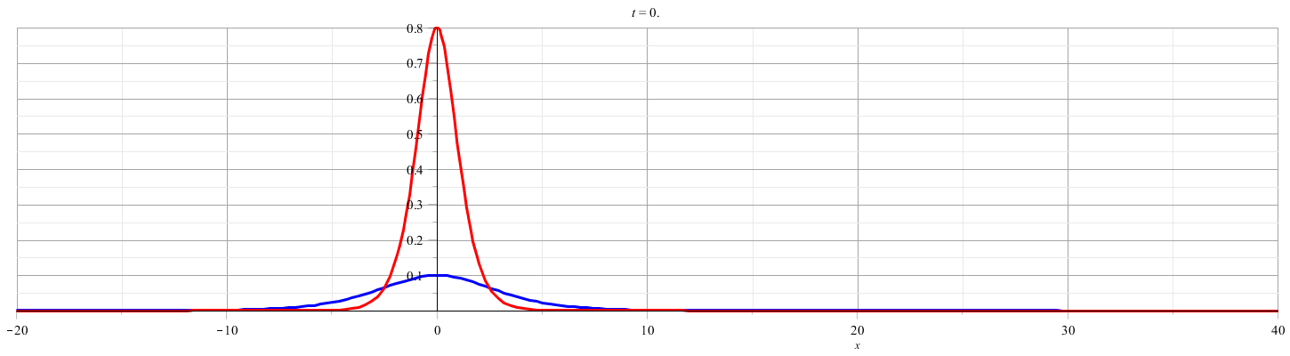

Slide 26
Relationship to “standard” form of Korteweg-de Vries equation

Slide 27
More details

Slide 28
Summary
Soliton solution

Slide 29
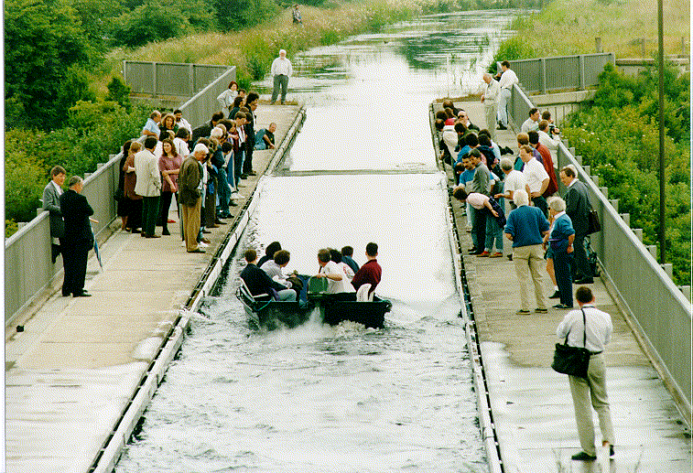
Photo of canal soliton http://www.ma.hw.ac.uk/solitons/
Some links:
Website – http://www.ma.hw.ac.uk/solitons/

Slide 30
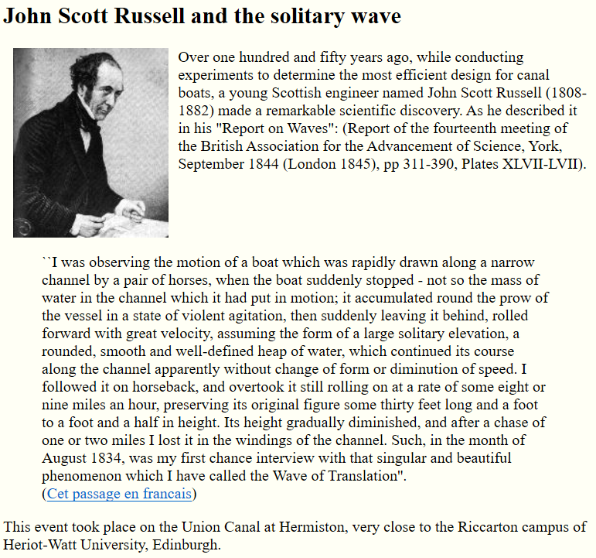
https://www.macs.hw.ac.uk/~chris/scott_russell.html

