Slide 1
PHY 711 Classical Mechanics and Mathematical Methods
10-10:50 AM MWF Olin 103
Plan for Lecture 33:
Chapter 11 in F & W:
Heat conduction
Basic equations
Boundary value problems

Slide 2
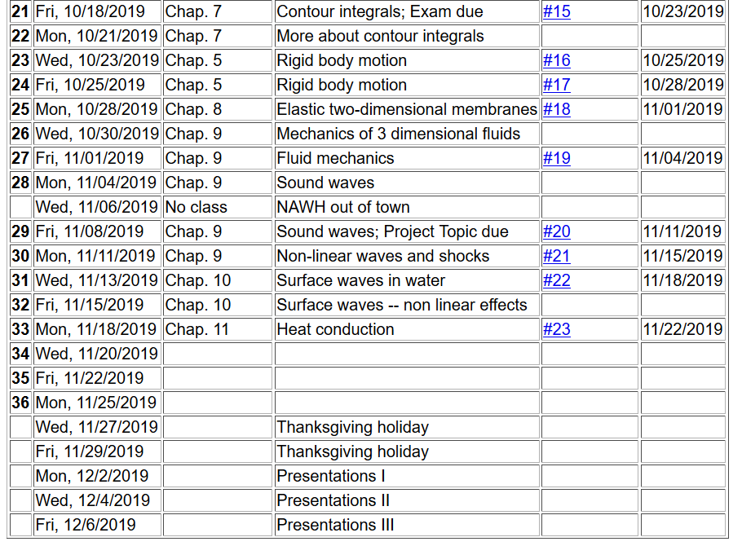

Slide 3
Conduction of heat
T(r,t)
j_{h}

Slide 4
Note that in this treatment we are considering a system at constant pressure p
More generally, note that c_{p} can depend on T; we are assuming that dependence to be trivial.

Slide 5
Conduction of heat -- continued
heat flux
heat source

Slide 6
Conduction of heat -- continued
thermal diffusivity
https://www.engineersedge.com/heat_transfer/thermal_diffusivity_table_13953.htm
Typical values (m²/s)
Air 2x10⁻⁵
Water 1x10⁻⁷
Copper 1x10⁻⁴

Slide 7
Boundary value problems for heat conduction
T₀
c
b
x
a

Slide 8
Boundary value problems for heat conduction
T₀
c
b
x
a
Assuming thermally insulated boundaries

Slide 9
Boundary value problems for heat conduction
T₀
c
b
a
x

Slide 10
Boundary value problems for heat conduction
T₀
c
b
x
a

Slide 11
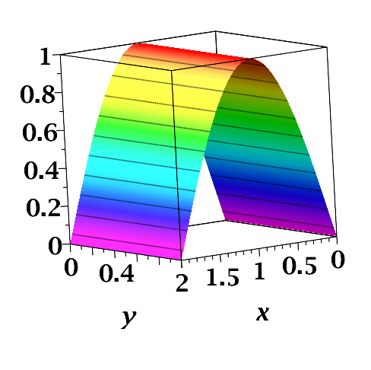
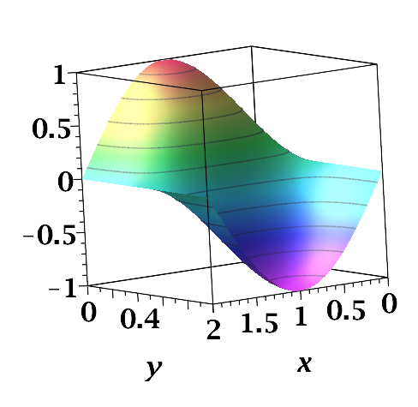
/b
/a
/a
/b

Slide 12
Oscillatory thermal behavior
z=0
z

Slide 13
Oscillatory thermal behavior -- continued
z=0
z

Slide 14
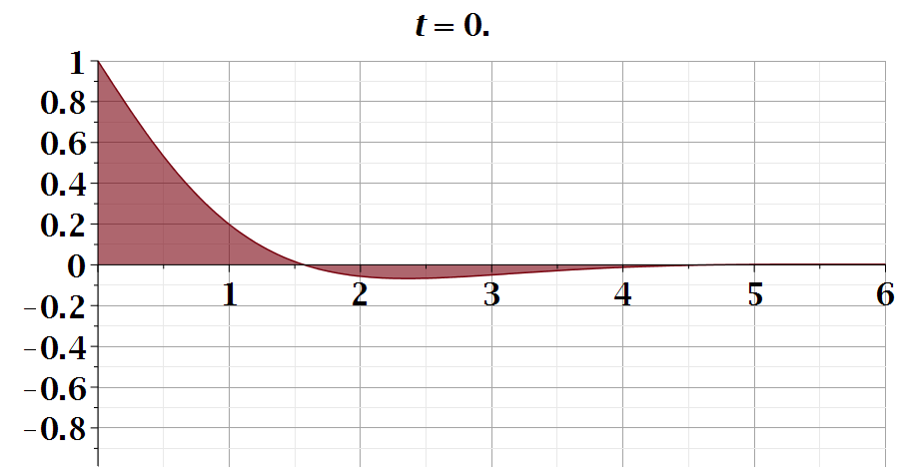
z

Slide 15
Initial value problem in an infinite domain; Fourier transform

Slide 16
Initial value problem in an infinite domain; Fourier transform

Slide 17
Initial value problem in an infinite domain; Fourier transform

Slide 18
Heat equation in half-space

Slide 19
Heat equation in half-space -- continued

Slide 20
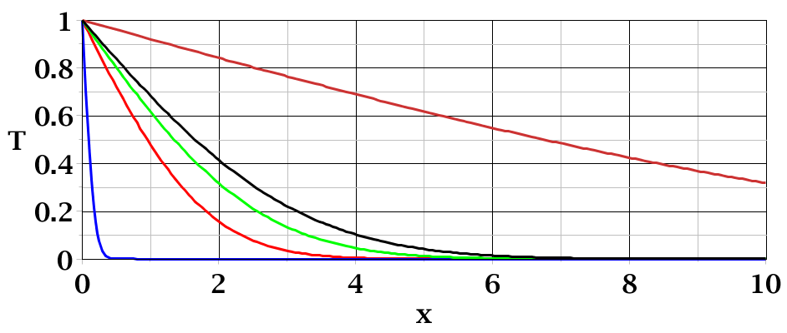
t=50
t=3
t=0.01

Slide 21
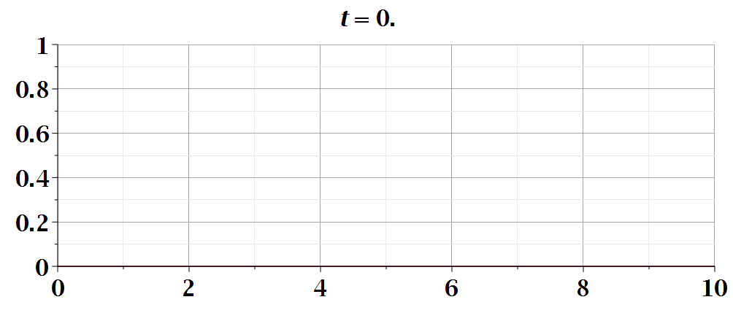
Temperature profile

