Slide 1
PHY 711 Classical Mechanics and Mathematical Methods
10-10:50 AM MWF Olin 103
Plan for Lecture 35
Review
Comments on presentation and exam
Mathematical methods
Classical mechanics concepts

Slide 2
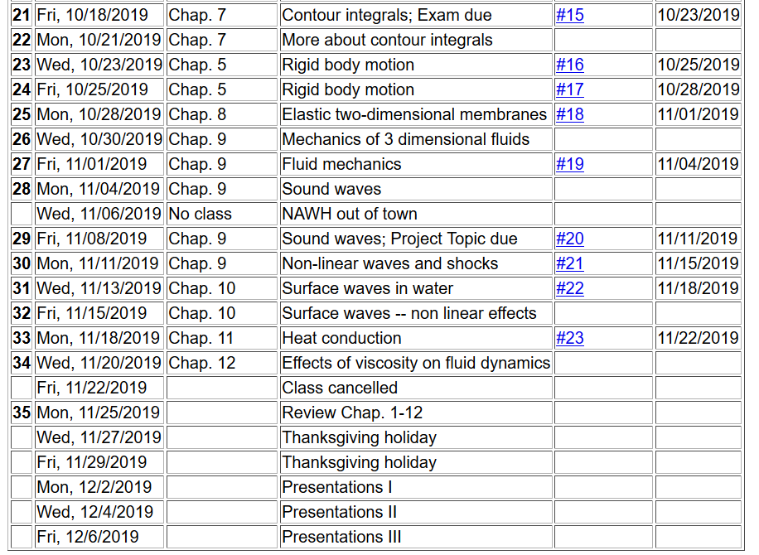
2

Slide 3
Comments on the “Computational Project”.
Presumably you have all completed or nearly completed your project. Nevertheless, just to remind –
The purpose of this assignment is to provide an opportunity for you to study a topic of your choice in greater depth. The general guideline for your choice of project is that it should have something to do with classical mechanics, and there should be some degree of analytical or numerical computation associated with the project. The completed project will include a presentation to the class (~20 min + 5 min for questions). After completing your presentation, please turn in a copy of your presentation slides plus any notes and references.
If you have not already signed up for your presentation time, please do so as soon as possible.

Slide 4
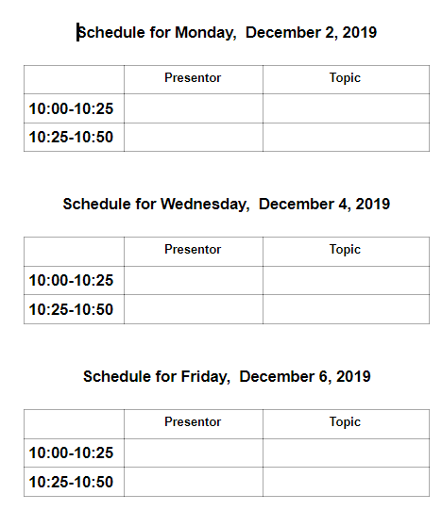
Comments on presentation schedule:

Slide 5
Comments on take-home final –
Similar to mid-term in form
Available: Fri. Dec. 6, 2019
Due before: Mon. Dec. 16, 2019 before 11 AM

Slide 6
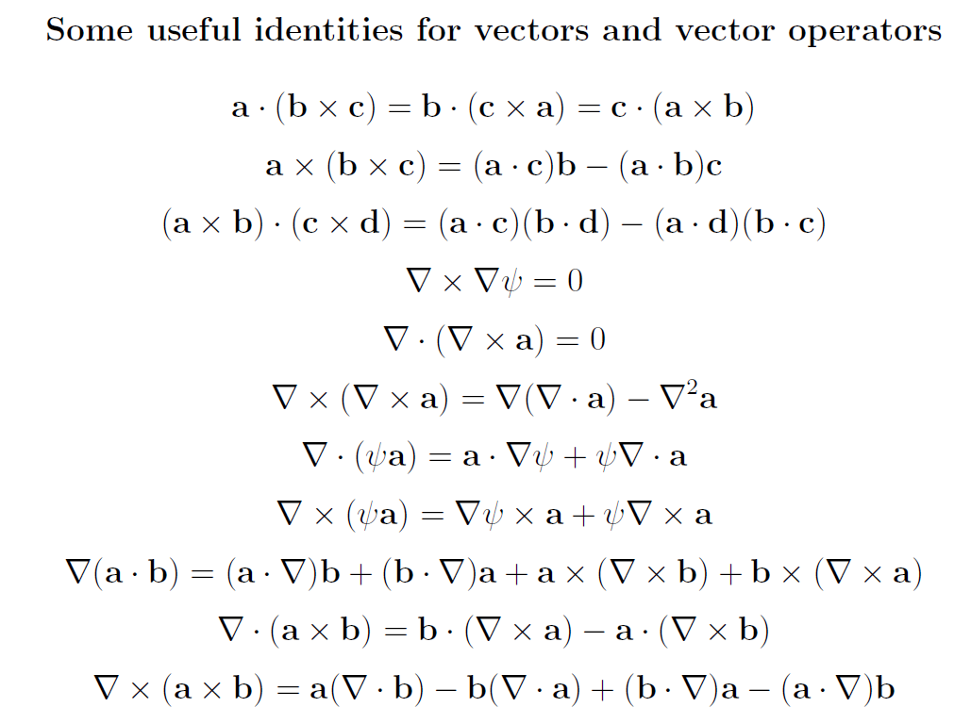
Review of mathematical methods

Slide 7
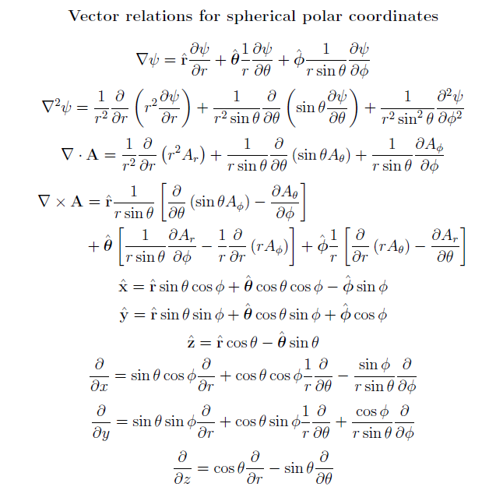

Slide 8
https://dlmf.nist.gov/

Slide 9
Example – special functions

Slide 10
Complex numbers
Functions of complex variables
Derivatives:
Cauchy-Riemann equations

Slide 11
Analytic function
➔A closed integral of an analytic function is zero.
However:

Slide 12
Contour integration methods --
No contribution
C

Slide 14
Fourier transforms --
Note: The location of the 2π factor varies among texts.

Slide 16
Doubly discrete Fourier Transforms
➔Fast Fourier Transforms (FFT)

Slide 17
Mechanics topics
Scattering theory
Lagrangian mechanics
Hamiltonian mechanics
Liouville theorem
Rigid body motion
Normal modes of oscillation about equilibrium
Wave motion
Fluid mechanics (ideal or including viscosity; linear and nonlinear)
Heat conduction
Note: The following review slides are necessarily brief. Please refer to the original lecture slides for details. Please email: natalie@wfu.edu with any corrections/suggestions

Slide 18
Scattering theory
Note: The notion of cross section is common to many areas of physics including classical mechanics, quantum mechanics, optics, etc. Only in the classical mechanics can we calculate it from a knowledge of the particle trajectory as it relates to the scattering geometry.
b
Figure from Marion & Thorton, Classical Dynamics
Note: We are assuming that the process is isotropic in φ

Slide 19
Lagrangian mechanics

Slide 20
Recipe for constructing the Hamiltonian and analyzing the equations of motion

Slide 21
Liouville’s Theorem (1838)
The density of representative points in phase space corresponding to the motion of a system of particles remains constant during the motion.

Slide 22
Rigid body motion
In a reference frame attached to the object, there are 3 moments of inertia and 3 distinct principal axes
Representation of rotational kinetic energy:

Slide 23
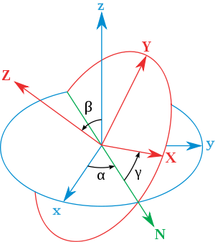
Euler’s transformation between body fixed and inertial reference frames
x
y
y
x

Slide 24
Normal modes of vibration -- potential in 2 and more dimensions
V(x,y)

Slide 25
Example – normal modes of a system with the symmetry of an equilateral triangle -- continued
3
u₃
u₂
1
2
u₁

Slide 26
Example – normal modes of a system with the symmetry of an equilateral triangle -- continued

Slide 27
Example – normal modes of a system with the symmetry of an equilateral triangle -- continued
= ω²

Slide 28
Discrete particle interactions → continuous media →
The wave equation

Slide 29
Mechanical motion of fluids
Newton’s equations for fluids
Use Euler formulation; following “particles” of fluid
Viscosity contributions

Slide 30
Fluid mechanics of incompressible fluid plus surface
Non-linear effects in surface waves:
p₀
ζ
z
h
y
z=0
x

