Slide 1
PHY 711 Classical Mechanics and Mathematical Methods
10-10:50 AM MWF Olin 103
Plan for Lecture 7:
    Calculus of variation; Continue reading Chapt. 3
    Brachistochrone problem
    Calculus of variation with constraints
    Application to classical mechanics

Slide 2
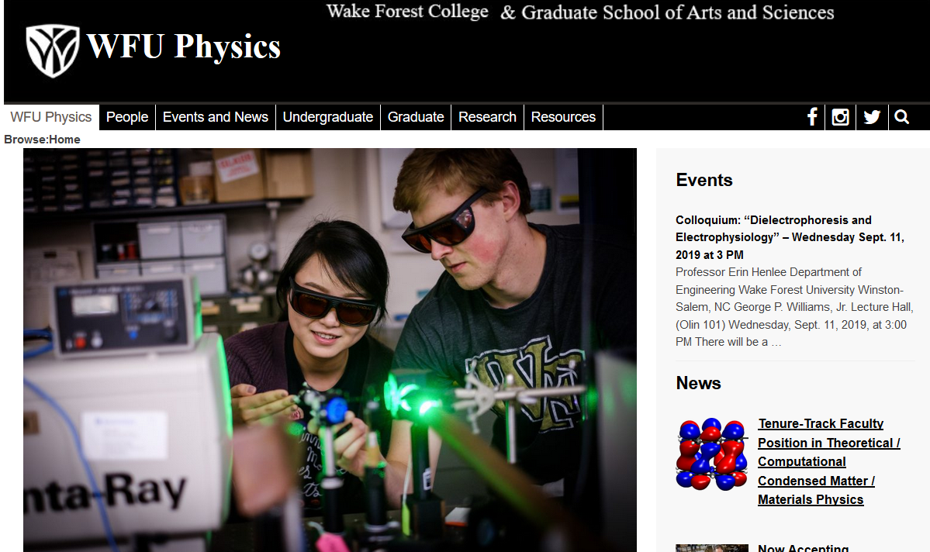
Physics colloquium on Wed. 9/11/2019

Slide 3
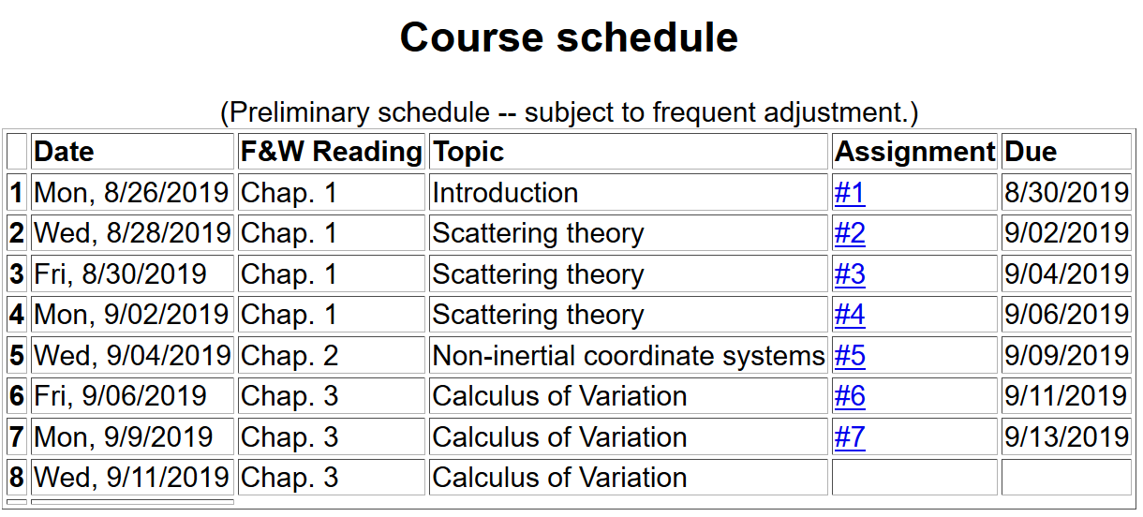

Slide 4
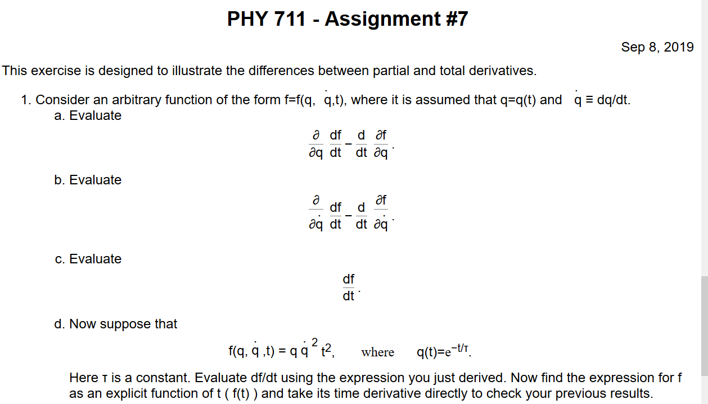

Slide 5
Euler-Lagrange equation
Alternate Euler-Lagrange equation

Slide 6
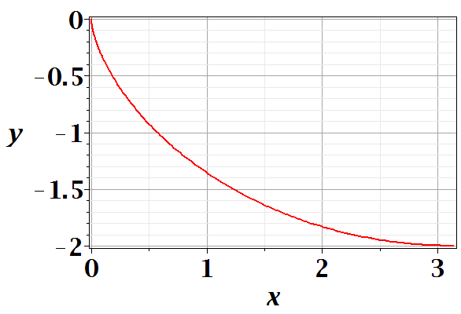
Brachistochrone problem: (solved by Newton in 1696)
http://mathworld.wolfram.com/BrachistochroneProblem.html
A particle of weight mg travels frictionlessly down a path of shape y(x). What is the shape of the path y(x) that minimizes the travel time from
y(0)=0 to y(π)=-2 ?

Slide 9
Parametric equations for Brachistochrone:

Slide 10
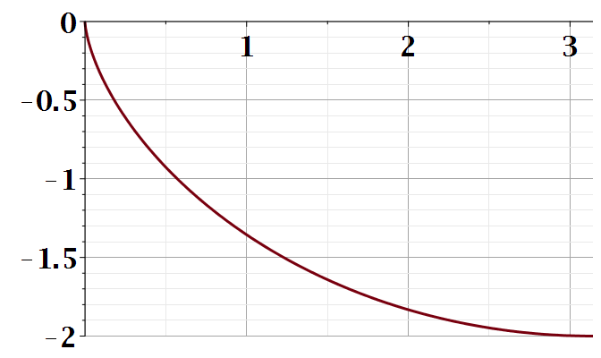
Parametric plot --
plot([theta-sin(theta), cos(theta)-1, theta = 0 .. Pi])
y
x

Slide 11
Summary of the method of calculus of variation --

Slide 13
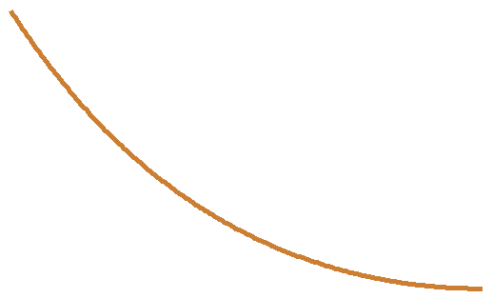
Another example optimization problem:
Determine the shape y(x) of a rope of length L and mass density ρ hanging between two points
x₁ y₁
x₂ y₂

Slide 14
Lagrange multiplier

Slide 18
Summary of results

Slide 19
Application to particle dynamics

Slide 20
Application to particle dynamics
  Hamilton’s principle states that the dynamical trajectory of a system is given by the path that extremizes the action integral
Simple example: vertical trajectory of particle of mass m subject to constant downward acceleration a=-g.

Slide 21
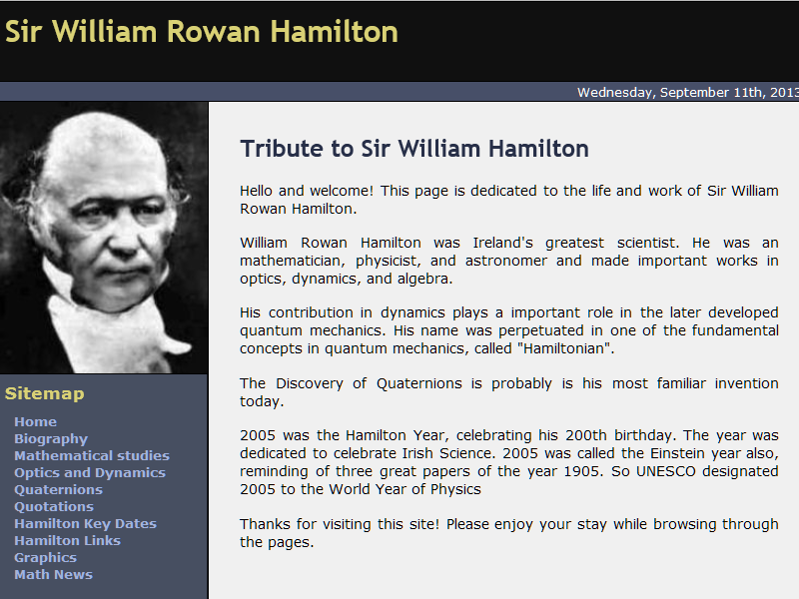
http://www-history.mcs.st-and.ac.uk/Biographies/Hamilton.html

Slide 22
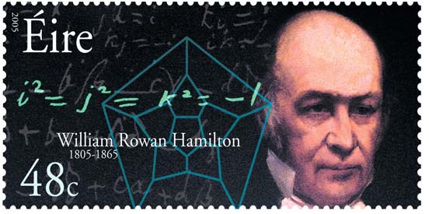
https://irishpostalheritagegpo.wordpress.com/2017/06/08/william-rowan-hamilton-irish-mathematician-and-scientist/

Slide 23
Potential energy
Kinetic energy

