Slide 1
PHY 711 Classical Mechanics and Mathematical Methods
10-10:50 AM MWF Olin 103
Plan for Lecture 8:
    Continue reading Chapter 3
      D’Alembert’s principle
      Hamilton’s principle
      Lagrange’s equation in generalized coordinates

Slide 2
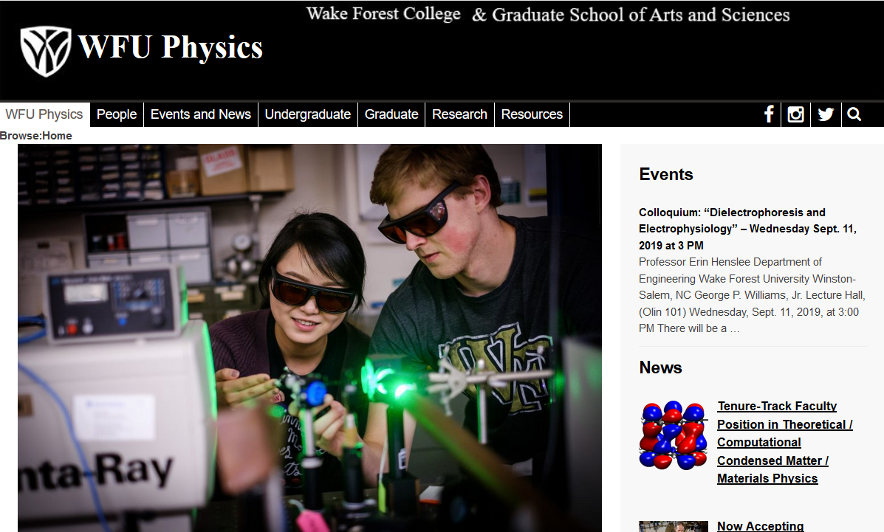
Physics Colloquium – Wednesday, Sept. 11, 2019

Slide 3
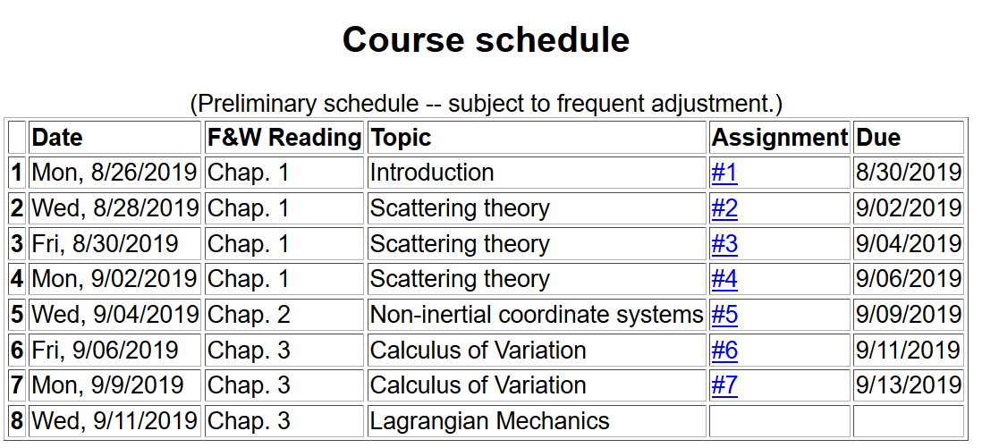

Slide 4
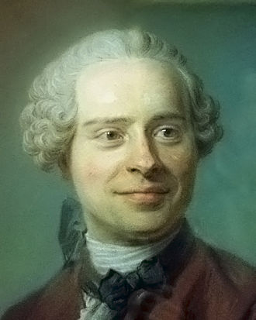
Jean d’Alembert 1717-1783
French mathematician and philosopher
“Deriving” Lagrangian mechanics from Newton’s laws.

Slide 5
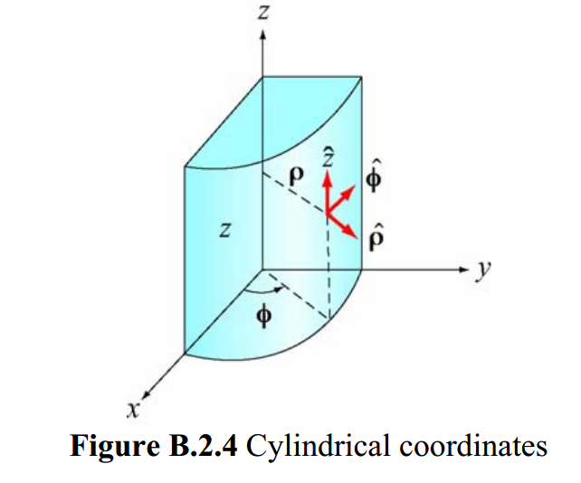
Cylindrical coordinates
(Figure taken from 8.02 handout from MIT.)

Slide 6
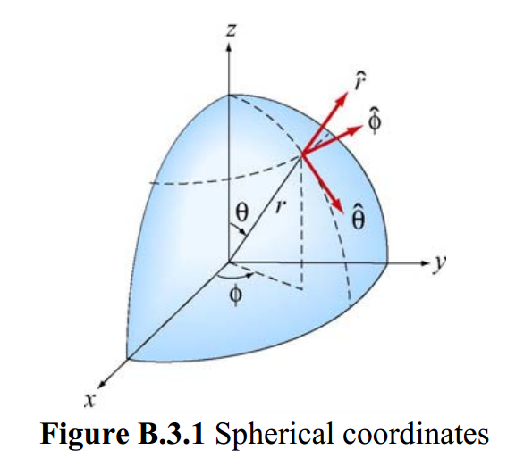
Spherical coordinates
(Figure taken from 8.02 handout from MIT.)

Slide 7
D’Alembert’s principle:

Slide 12
➔Hamilton’s principle

Slide 13
Example:
d
θ

Slide 15
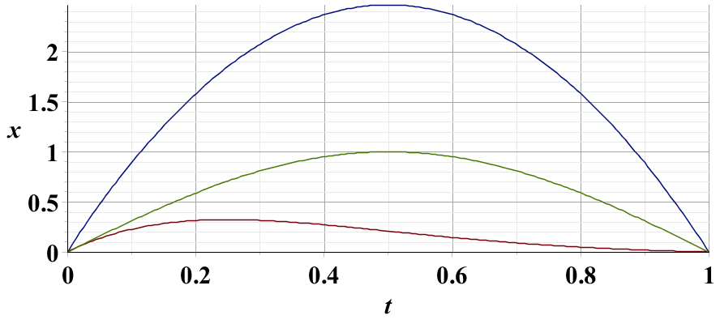
Example – simple harmonic oscillator
x₁
x₂
x₃

Slide 16
Summary –
Hamilton’s principle:

Slide 17
Note: in “proof” of Hamilton’s principle:

Slide 18
Lorentz forces:

Slide 19
Lorentz forces, continued:

Slide 20
Lorentz forces, continued:

Slide 21
Lorentz forces, continued:

Slide 22
Example Lorentz force

Slide 23
Example Lorentz force -- continued

Slide 24
Example Lorentz force -- continued

Slide 25
Example Lorentz force -- continued

Slide 26
Example Lorentz force -- continued

