Slide 1
PHY 711 Classical Mechanics and Mathematical Methods
10-10:50 AM MWF Olin 103
Plan for Lecture 9:
Continue reading Chapter 3 & 6
Summary & review
Lagrange’s equations with constraints

Slide 2
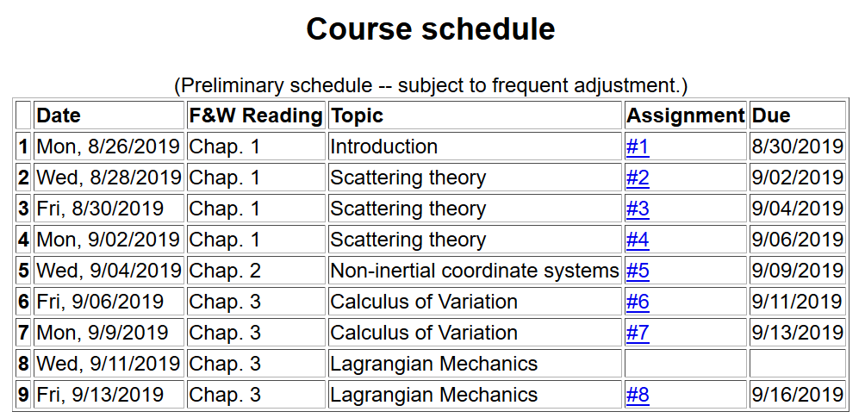

Slide 4
Lorentz forces, continued:

Slide 5
Example Lorentz force

Slide 6
Example Lorentz force -- continued

Slide 7
Example Lorentz force -- continued

Slide 8
Example Lorentz force -- continued

Slide 9
Example Lorentz force -- continued

Slide 10
Comments on generalized coordinates:
Here we have assumed that the generalized coordinates
q_{σ} are independent. Now consider the possibility that the coordinates are related through constraint equations of the form:
Lagrange
multipliers

Slide 11
Simple example:
u
θ
y
x
θ

Slide 12
Force of constraint;
normal to incline

Slide 13
Rational for Lagrange multipliers

Slide 14
Euler-Lagrange equations with constraints:
Example:
r
θ
mg

Slide 15
Example continued:

Slide 16
Another example:

Slide 17
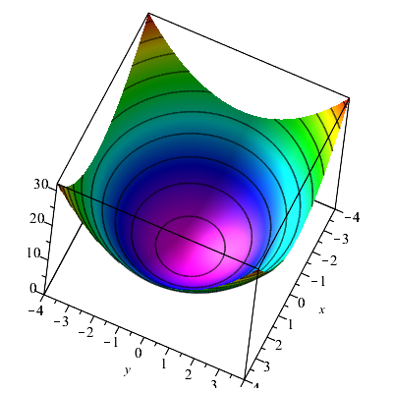
Consider a particle of mass m moving frictionlessly on a parabola z=c(x²+y²) under the influence of gravity. Find the equations of motion, particularly showing stable circular motion.

Slide 20
Some details --

