Slide 1
PHY 711 Classical Mechanics and Mathematical Methods
10-10:50 AM MWF Online or (occasionally) in Olin 103
Discussion of Lecture 10 – Chap. 3 & 6 in F & W
Lagrangian mechanics including constraints
Lagrangian representation of electromagnetic fields
Examples of Lagrangian analysis including constraints
Notes:
In this lecture we will review Lagrangian formulations of mechanics including the effects of electromagnetic fields and also formulations with constraints.

Slide 2
Physics colloquium Thursday, Sept. 17, 2020 at 4 PM
Notes:
Our colloquium speaker for Thursday’s session is speaking on a very timely topic. Please let me or Kittye know if you do not receive the zoom link.

Slide 3
Schedule for weekly one-on-one meetings
Nick – 11 AM Monday (ED/ST)
Tim – 9 AM Tuesday
Bamidele – 7 PM Tuesday
Zhi– 9 PM Tuesday
Jeanette – 11 AM Friday
Derek – 12 PM Friday

Slide 4
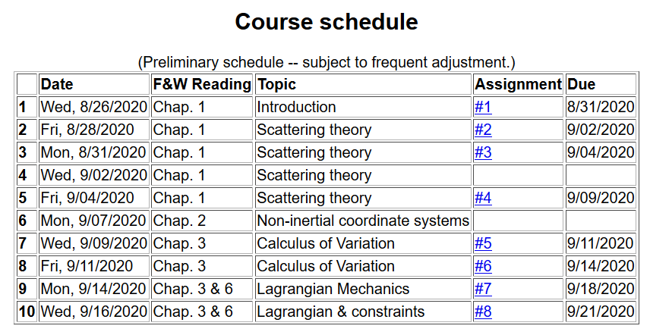
Notes:
Updated schedule.

Slide 5
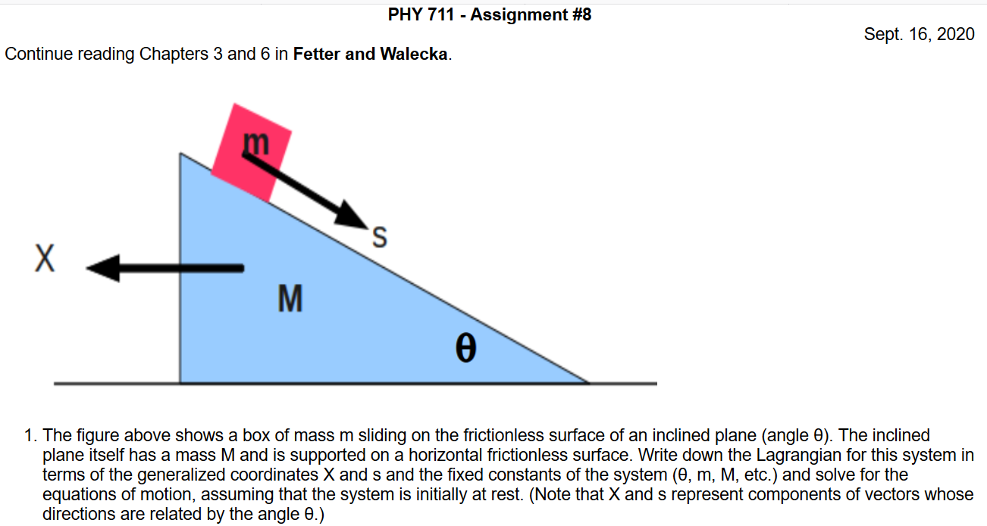
Notes:
Homework for Monday. Note that this problem does not include electromagnetic fields and does not need to impose constraints. It is necessary to consider the coupled motions of the two masses.

Slide 6
Your questions –
From Nick –
How do you solve the Lagrangian for Euler angles presented in Lecture 9?
Would like some details on the Lagrangian for electromagnetic interactions.
From Tim –
When adding a constraint to a lagrangian, is it usually associated with the geometry of the problem (ie. r-l for the pendulum)?
From Gao –
1.

Slide 7
Your questions –
From Jeanette –
1. I would like to go through the Lorentz force example from last lecture, it looked like it may already be included in the lecture today. I find the examples to be more helpful than the derivations.

Slide 8
Example from Lecture 9 representing the motion of a symmetric top with moments of inertia I₁ and I₃ and with generalized coordinates α, β, γ (Euler angles)
Worrisome equations, but we will develop some tricks to help us solve them.

Slide 9
Lagrangian mechanics with Lorentz forces
vector potential
scalar potential
Notes:
Here is a summary of the equations we “justified” at the end of the last lecture.

Slide 10
Note: In our discussion of D’Alembert’s virtual work analysis, we concluded that
Do you think that it is cheating to manipulate U in this way?
Yes
No
Depends on how we define U
Notes:
Here we consider how the equations of Lagrangian equations may be used to represent a velocity dependent force.

Slide 11
Lorentz forces:
Notes:
Here are given the results without proof. In the following slides we will show that this form of the Lagrangian is equivalent to Newton’s laws.

Slide 12
Lorentz forces, continued:
We want to demonstrate that the supposed form of U is consistent with the general Lorentz force given above. Evaluating the derivatives:
Notes:
Detailed steps in the analysis.

Slide 13
Lorentz forces, continued:
Notes:
Putting all of the terms together. In the last line we express the scalar and vector potentials in terms of the electric and magnetic field components.

Slide 14
Lorentz forces, continued:
Notes:
Summary of what the previous analysis showed.

Slide 15
Example Lorentz force
Notes:
Here we consider a particular example of a particle moving in the presence of a magnetic field along the z direction.

Slide 16
Example Lorentz force -- continued
Notes:
Coupled equations of motion.

Slide 17
Example Lorentz force -- continued
Notes:
Finally the equations show that the particle is moving in a circular trajectory in the x-y plane.

Slide 18
Example Lorentz force -- continued
Notes:
Now consider the same magnetic field but use a different vector potential. Do you think that the result should be the same as the previous case?

Slide 19
Example Lorentz force -- continued
Notes:
Here we see that the results are equivalent. Evaluating the equations for particular initial conditions, we find explicit functions for the trajectories.

Slide 20
Comments on generalized coordinates:
Here we have assumed that the generalized coordinates
q_{σ} are independent. Now consider the possibility that the coordinates are related through constraint equations of the form:
Lagrange
multipliers
Notes:
Shifting topics, we now consider examples where the generalized coordinates are related by some constraints.

Slide 21
Your question -- When adding a constraint to a Lagrangian, is it usually associated with the geometry?
Comment -- That is often the case. The constraint involves relationships between the generalized coordinates and that often has a geometric interpretation. Note that in order for these equations to work, the constraint must not involve time derivatives of the coordinates. If that happens, the problem is given a terrible name – “nonholonomic” and becomes very difficult to solve.

Slide 22
Simple example:
u
θ
y
x
θ
Notes:
Here is a simple example of an inclined plane. If we were so silly as to treat the x and y motions separately, we would have use a constraint equation as shown.

Slide 23
Which method would you use to solve the problem?
Case 1
Case 2
Force of constraint;
normal to incline
Notes:
In this case we see that the constraint is related to the normal force which can be considered as a force of constraint.

Slide 24
Rational for Lagrange multipliers
Notes:
Here we justify the use of Lagrange multipliers in a similar way that we used them when discussing the calculus of variation.

Slide 25
Euler-Lagrange equations with constraints:
Example:
r
θ
mg
Notes:
Another example of constrained motion.

Slide 26
Example continued:
Notes:
Continued analysis of pendulum motion

Slide 27
Another example:
Notes:
Example of Atwood’s machine with two masses and a pulley.

Slide 28
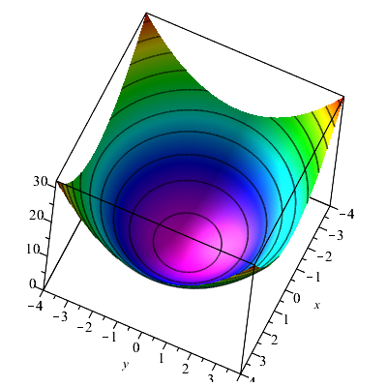
Consider a particle of mass m moving frictionlessly on a parabola z=c(x²+y²) under the influence of gravity. Find the equations of motion, particularly showing stable circular motion.
Notes:
Another example.

Slide 29
Notes:
Example continued.

Slide 30
Notes:
Continued

Slide 31
Some details --
Notes:
Continued

Slide 32
Notes:
Approximate solution.

