Slide 1
PHY 711 Classical Mechanics and Mathematical Methods
10-10:50 AM MWF Online or (occasionally) in Olin 103
Plan for Lecture 10 – Chap. 3 & 6 in F & W
Lagrangian mechanics including constraints
Lagrangian representation of electromagnetic fields
Examples of Lagrangian analysis including constraints
Notes:
In this lecture we will review Lagrangian formulations of mechanics including the effects of electromagnetic fields and also formulations with constraints.

Slide 2
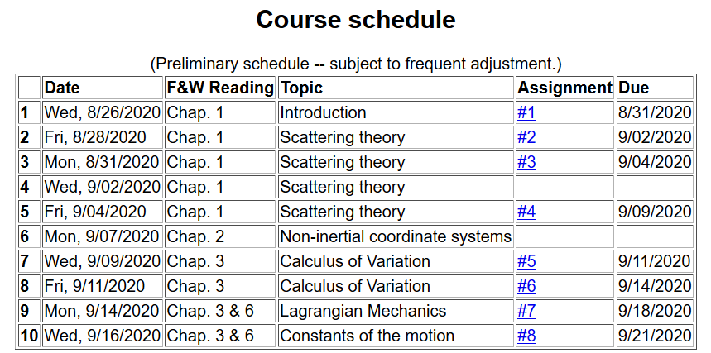
Notes:
Updated schedule.

Slide 3
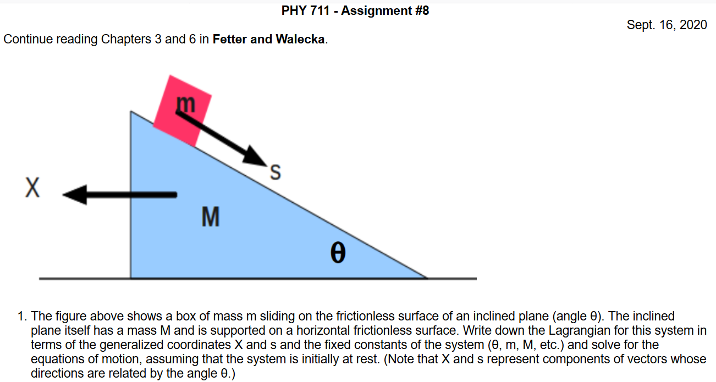
Notes:
Homework for Monday. Note that this problem does not include electromagnetic fields and does not need to impose constraints. It is necessary to consider the coupled motions of the two masses.

Slide 4
Physics colloquium Thursday, Sept. 17, 2020 at 4 PM
Notes:
Our colloquium speaker for Thursday’s session is speaking on a very timely topic. Please let me or Kittye know if you do not receive the zoom link.

Slide 5
Lagrangian mechanics with Lorentz forces
Notes:
Here is a summary of the equations we “justified” at the end of the last lecture.

Slide 6
Note: In our discussion of D’Alembert’s virtual work analysis, we concluded that
Notes:
Here we consider how the equations of Lagrangian equations may be used to represent a velocity dependent force.

Slide 7
Lorentz forces:
Notes:
Here are given the results without proof. In the following slides we will show that this form of the Lagrangian is equivalent to Newton’s laws.

Slide 8
Lorentz forces, continued:
Notes:
Detailed steps in the analysis.

Slide 9
Lorentz forces, continued:
Notes:
Putting all of the terms together. In the last line we express the scalar and vector potentials in terms of the electric and magnetic field components.

Slide 10
Lorentz forces, continued:
Notes:
Summary of what the previous analysis showed.

Slide 11
Example Lorentz force
Notes:
Here we consider a particular example of a particle moving in the presence of a magnetic field along the z direction.

Slide 12
Example Lorentz force -- continued
Notes:
Coupled equations of motion.

Slide 13
Example Lorentz force -- continued
Notes:
Finally the equations show that the particle is moving in a circular trajectory in the x-y plane.

Slide 14
Example Lorentz force -- continued
Notes:
Now consider the same magnetic field but use a different vector potential. Do you think that the result should be the same as the previous case?

Slide 15
Example Lorentz force -- continued
Notes:
Here we see that the results are equivalent. Evaluating the equations for particular initial conditions, we find explicit functions for the trajectories.

Slide 16
Comments on generalized coordinates:
Here we have assumed that the generalized coordinates
q_{σ} are independent. Now consider the possibility that the coordinates are related through constraint equations of the form:
Lagrange
multipliers
Notes:
Shifting topics, we now consider examples where the generalized coordinates are related by some constraints.

Slide 17
Simple example:
u
θ
y
x
θ
Notes:
Here is a simple example of an inclined plane. If we were so silly as to treat the x and y motions separately, we would have use a constraint equation as shown.

Slide 18
Force of constraint;
normal to incline
Notes:
In this case we see that the constraint is related to the normal force which can be considered as a force of constraint.

Slide 19
Rational for Lagrange multipliers
Notes:
Here we justify the use of Lagrange multipliers in a similar way that we used them when discussing the calculus of variation.

Slide 20
Euler-Lagrange equations with constraints:
Example:
r
θ
mg
Notes:
Another example of constrained motion.

Slide 21
Example continued:
Notes:
Continued analysis of pendulum motion

Slide 22
Another example:
Notes:
Example of Atwood’s machine with two masses and a pulley.

Slide 23
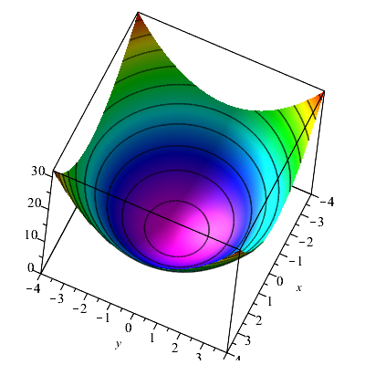
Consider a particle of mass m moving frictionlessly on a parabola z=c(x²+y²) under the influence of gravity. Find the equations of motion, particularly showing stable circular motion.
Notes:
Another example.

Slide 24
Notes:
Example continued.

Slide 25
Notes:
Continued

Slide 26
Some details --
Notes:
Continued

Slide 27
Notes:
Approximate solution.

