Slide 1
PHY 711 Classical Mechanics and Mathematical Methods
10-10:50 AM MWF online or (occasionally) in Olin 103
Discussion on Lecture 11-- Chap. 3 & 6 (F &W)
Details and extensions of Lagrangian mechanics
      Constants of the motion
      Conserved quantities
      Legendre transformations
Notes:
In this lecture we will continue to explore the mathematical and physical properties of the Lagrangian formalism.

Slide 2
Schedule for weekly one-on-one meetings
Nick – 11 AM Monday (ED/ST)
Tim – 9 AM Tuesday
Bamidele – 7 PM Tuesday
Zhi– 9 PM Tuesday
Jeanette – 11 AM Fri (moved to Wed next week)
Derek – 12 PM Friday

Slide 3
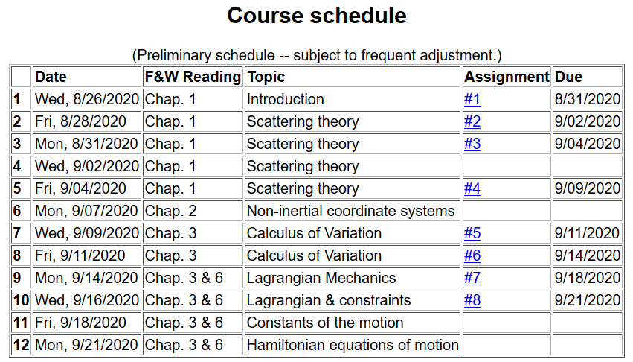
Notes:
Updated schedule. Home work from Lecture 10 due Monday.

Slide 4
Your questions –
From Nick –
What do the subscripts on the partial derivatives mean when you're doing the transformations of variables?
From Tim –
What is the reasoning behind doing a change of variables for the Lagrangian?
From Gao –
1. About today's lecture, why do we want to switch variables?

Slide 5
Summary of Lagrangian formalism (without constraints)
Notes:
Review of the Euler-Lagrange equations with a focus on finding constants of the motion.

Slide 6
Examples of constants of the motion:
Notes:
Simple example.

Slide 7
Examples of constants of the motion:
Notes:
Another example using different coordinates.

Slide 8
Recall alternative form of Euler-Lagrange equations:
Notes:
Reviewing “alternative” form of Euler0-Lagrange equations.

Slide 9
Additional constant of the motion:
Notes:
New constant of the motion found from the Lagrangian analysis.

Slide 10
Why might this be useful?
  It is not particularly useful
  It may be useful, but I learned this a long time ago.
  It may be more useful for more complicated Lagrangians where the constants of the motion are not intuitively obvious.

Slide 11
Additional constant of the motion -- continued:
Notes:
Another example.

Slide 12
Other examples
Notes:
Non-trivial example with constant magnetic field.

Slide 13
Other examples
Notes:
Another example with a constant magnetic field.

Slide 14
Lagrangian picture
Switching variables – Legendre transformation
Your question –
  What is the reasoning behind doing a change of variables for the Lagrangian?
Comment –
  We are leading up to deriving the Hamiltonian formulation of mechanics which is a useful alternative analysis tool.
Notes:
Noting that the Lagrangian analysis generally results in second order differential equations. We now explore the possibility of alternative formultions.

Slide 15
Mathematical transformations for continuous functions of several variables & Legendre transforms:
Simple change of variables:
Assuming dz=0.
Notes:
Digression on relationships between alternative coordinate formulations.

Slide 16
Note on notation for partial derivatives
hold y fixed.
hold x fixed.

Slide 17
Simple change of variables -- continued:
Notes:
Relationships for changing variables of general functionsl

Slide 18

Simple change of variables -- continued:
?
?
Notes:
Some examples.

Slide 19
Now that we see that these transformations are possible, we should ask the question why we might want to do this?
An example comes from thermodynamics where we have various interdependent variables such as temperature T, pressure P, volume V, etc. etc. Often a measurable property can be specified as a function of two of those, while the other variables are also dependent on those two. For example we might specify T and P while the volume will be V(T,P). Or we might specify T and V while the pressure will be P(T,V).

Slide 20
Other examples from thermo --
For thermodynamic functions:
Notes:
Examples from thermodynamic functions

Slide 21
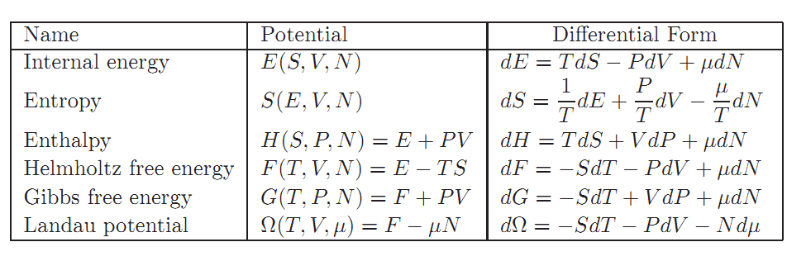
Notes:
Common thermodynamic energy functiosn.

Slide 22
Mathematical transformations for continuous functions of several variables & Legendre transforms continued:
Notes:
Relationships between the old and new variables.

Slide 23
Lagrangian picture
Switching variables – Legendre transformation
Notes:
Applying the ideas of variable change to the Lagrangian formulation.

Slide 24
Hamiltonian picture – continued
Notes:
Transforming from the Lagrangian to Hamiltonian formulation of mechanics. We will continue this discussion on Monday.

