Slide 1
PHY 711 Classical Mechanics and Mathematical Methods
10-10:50 AM MWF online or (occasionally) in Olin 103
Plan for Lecture 11-- Chap. 3 & 6 (F & W)
Details and extensions of Lagrangian mechanics
Constants of the motion
Conserved quantities
Legendre transformations
Notes:
In this lecture we will continue to explore the mathematical and physical properties of the Lagrangian formalism.

Slide 2
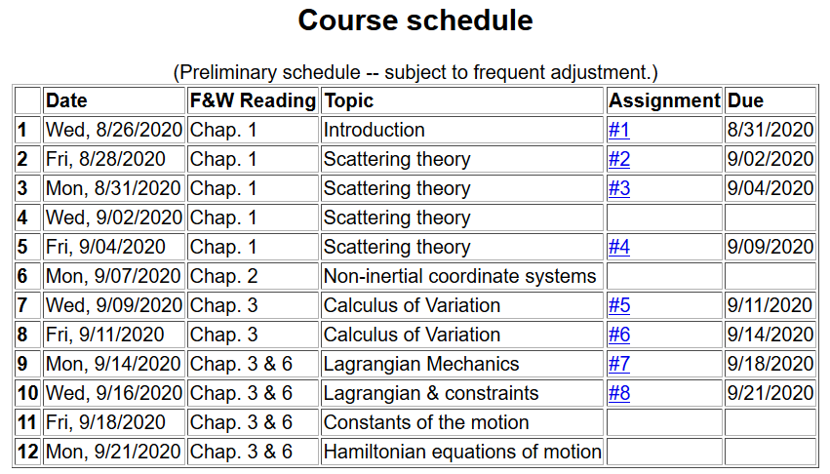
Notes:
Updated schedule. Home work from Lecture 10 due Monday.

Slide 3
Summary of Lagrangian formalism (without constraints)
Notes:
Review of the Euler-Lagrange equations with a focus on finding constants of the motion.

Slide 4
Examples of constants of the motion:
Notes:
Simple example.

Slide 5
Examples of constants of the motion:
Notes:
Another example using different coordinates.

Slide 6
Recall alternative form of Euler-Lagrange equations:
Notes:
Reviewing “alternative” form of Euler0-Lagrange equations.

Slide 7
Additional constant of the motion:
Notes:
New constant of the motion found from the Lagrangian analysis.

Slide 8
Additional constant of the motion -- continued:
Notes:
Another example.

Slide 9
Other examples
Notes:
Non-trivial example with constant magnetic field.

Slide 10
Other examples
Notes:
Another example with a constant magnetic field.

Slide 11
Lagrangian picture
Switching variables – Legendre transformation
Notes:
Noting that the Lagrangian analysis generally results in second order differential equations. We now explore the possibility of alternative formultions.

Slide 12
Mathematical transformations for continuous functions of several variables & Legendre transforms:
Simple change of variables:
Notes:
Digression on relationships between alternative coordinate formulations.

Slide 13
Simple change of variables -- continued:
Notes:
Relationships for changing variables of general functionsl

Slide 14
Simple change of variables -- continued:
?
?
Notes:
Some examples.

Slide 15
Mathematical transformations for continuous functions of several variables & Legendre transforms continued:
Notes:
Relationships between the old and new variables.

Slide 16
For thermodynamic functions:
Notes:
Examples from thermodynamic functions

Slide 17
Notes:
Common thermodynamic energy functiosn.

Slide 18
Lagrangian picture
Switching variables – Legendre transformation
Notes:
Applying the ideas of variable change to the Lagrangian formulation.

Slide 19
Hamiltonian picture – continued
Notes:
Transforming from the Lagrangian to Hamiltonian formulation of mechanics. We will continue this discussion on Monday.

