Slide 1
PHY 711 Classical Mechanics and Mathematical Methods
10-10:50 AM MWF Online or (occasional) in Olin 103
Discusion for Lecture 12 – Chap. 3&6 (F&W)
Constructing the Hamiltonian
Hamilton’s canonical equation
Examples
Notes:
This lecture shows how to “derive” the Hamiltonian formalism from the Lagrangian.

Slide 2
Schedule for weekly one-on-one meetings
Nick – 11 AM Monday (ED/ST)
Tim – 9 AM Tuesday
Bamidele – 7 PM Tuesday
Zhi– 9 PM Tuesday
Jeanette – 11 AM Wednesday (this week only?)
Derek – 12 PM Friday

Slide 3
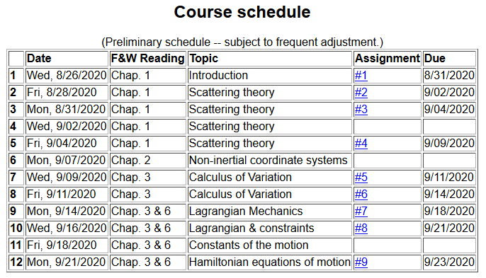
Notes:
There is a short homework problem due Wednesday.

Slide 4
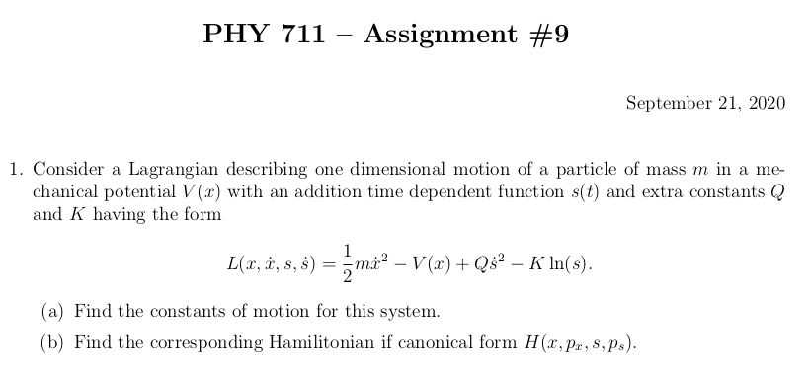
Notes:
Homework due Wednesday.

Slide 5
Your questions –
From Jeanette –
Is there a physical meaning to a constant H?
From Nick –
1. Can you also explain tomorrow why the term vanishes in the equation below?
From Tim –
How can we make the statement H = sum d/dt(q)*p - L? Where is this equation coming from?
From Gao –
1. Where can we use the Liouville theorem, the density of representative points in phase space corresponding to the motion of a system of particles remains constant during the motion?

Slide 6
Lagrangian picture
Switching variables – Legendre transformation
Notes:
Starting with the Lagrangian and then performing a Legendre transformation.

Slide 7
Your question -- How can we make the statement
H = sum d/dt(q)*p - L? Where is this equation coming from?
Comment – The reasoning for this came in the last lecture when we illustrated the notion of the Legendre transformation. Some details from Lecture 11

Slide 8
The analysis on the following slides is a generalization to multiple dimensions q_{σ} and p_{σ} ….

Slide 9
Hamiltonian picture – continued
Notes:
Finding the Hamiltonian equations of motion.

Slide 10
Direct application of Hamiltonian’s principle using the Hamiltonian function --
Notes:
Showing that Hamilton’s principle can be formulated with the Hamiltonian formulation.

Slide 11
Hamilton’s principle continued:
Canonical equations
0
Notes:
So called “Canonical” equations.

Slide 12
More comments about “details”
Vanishes because
δq(t_{f})=δq(t_{i}) due to
the premise of
Hamilton’s principle.

Slide 13
In the Hamiltonian formulation --
Why are these equations known as the “canonical equations”?
Because they are beautiful.
The term is meant to elevate their importance to the level of the music of J. S. Bach
To help you remember them
No good reason; it is just a name

Slide 14
Recipe for constructing the Hamiltonian and analyzing the equations of motion
Notes:
Important recipe. Tape this to your wall!!!

Slide 15
What happens when you miss a step in the recipe?
No big deal
Big deal – can lead to shame and humiliation (or at least wrong analysis)

Slide 16
Constants of the motion in Hamiltonian formalism
Notes:
Finding constants of the motion within the Hamiltonian formalism.

Slide 17
Your question -- Is there a physical meaning to a constant H?
Comment -- Whenever you find a constant of the motion, it is helpful for analyzing the trajectory. In this case, H often represents the mechanical energy of the system so that constant H implies that energy is conserved.

Slide 18
Here we should have done a better job of using notation to distinguish between constants and variables.
Notes:
Example.

Slide 19
Notes:
Another example

Slide 20
Other examples
Notes:
Another example

Slide 21
Other examples
Notes:
Example with magnetic field.

Slide 22
Canonical equations of motion for constant magnetic field:
Notes:
Working out the equations of motion.

Slide 23
Canonical equations of motion for constant magnetic field -- continued:
Notes:
More evaluation of the equations of motion.

Slide 24
Are these results equivalent to the results of the Lagrangian analysis?
a. Yes
b. No

Slide 25
Notes:
Recap of treatment of electromagnetic interactions in the Lagrangian and Hamiltonian formulations.

Slide 26
Canonical form
Notes:
Continued.

Slide 27
Other properties of Hamiltonian formalism –
Poisson brackets:
Notes:
Now a interesting addition property of the Hamiltonian formulation.

Slide 28
Poisson brackets -- continued:
Notes:
Poisson bracket continued.

Slide 29
Poisson brackets -- continued:
Liouville theorem
Notes:
Example.

Slide 30
Your question -- Where can we use the Liouville theorem, the density of representative points in phase space corresponding to the motion of a system of particles remains constant during the motion?
Comment – This idea is particularly important in statistical mechanics where the challenge is to describe macroscopic phenomena based on 10²³ particles in terms of our knowledge of individual particles and their interactions.

Slide 31
Phase space
Notes:
Notion of phase space

Slide 32
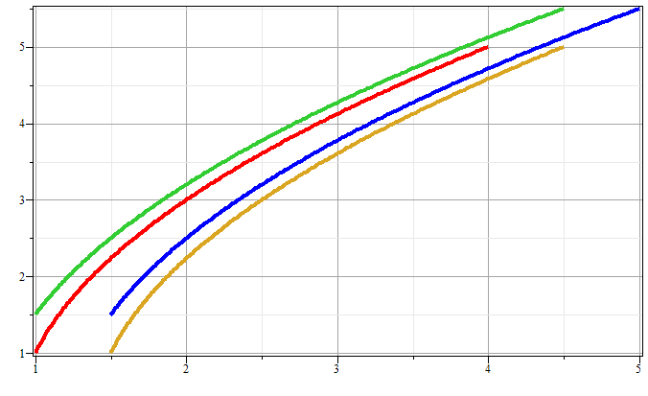
Phase space diagram for one-dimensional motion due to constant force
p
x
Notes:
Example of time evolution of phase space.

Slide 33
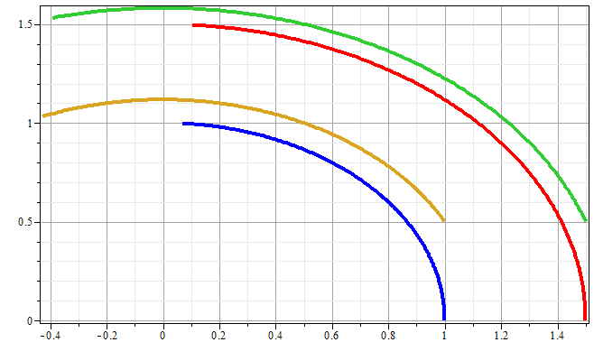
Phase space diagram for one-dimensional motion due to spring force
p
x
Notes:
Another example of time evolution of phase space.

Slide 34
Liouville’s Theorem (1838)
The density of representative points in phase space corresponding to the motion of a system of particles remains constant during the motion.
Notes:
Application to the density of phase space – Liouville theorm.

Slide 35
Liouville’s theorem
(x,p+Δp)
(x+Δx,p+Δp)
p
(x,p)
(x+Δx,p)
x
Notes:
Diagram of flow in phase space.

Slide 36
Liouville’s theorem -- continued
(x,p+Δp)
(x+Δx,p+Δp)
p
(x,p)
(x+Δx,p)
x
Notes:
Some details.

Slide 37
Liouville’s theorem -- continued
(x,p+Δp)
(x+Δx,p+Δp)
p
(x,p)
(x+Δx,p)
x
Notes:
More details.

Slide 38
Review:
Liouville’s theorem:
Imagine a collection of particles obeying the Canonical equations of motion in phase space.
Notes:
Summary of Liouville theorem.

Slide 39
Proof of Liouville’s theorem:
Notes:
Another more formal derivation of Liouville

Slide 40
Notes:
More details.

Slide 41
0
Notes:
Derivation of Liouville theorem

Slide 42
Importance of Liouville’s theorem to statistical mechanical analysis:
In statistical mechanics, we need to evaluate the probability of various configurations of particles. The fact that the density of particles in phase space is constant in time, implies that each point in phase space is equally probable and that the time average of the evolution of a system can be determined by an average of the system over phase space volume.
Notes:
Comment.

