Slide 1
PHY 711 Classical Mechanics and Mathematical Methods
10-10:50 AM MWF Online or (occasional) in Olin 103
Plan for Lecture 12 – Chap. 3&6 (F&W)
Constructing the Hamiltonian
Hamilton’s canonical equation
Examples
Notes:
This lecture shows how to “derive” the Hamiltonian formalism from the Lagrangian.

Slide 2
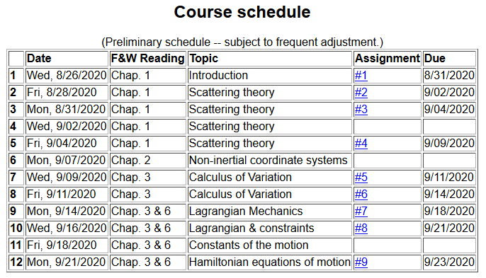
Notes:
There is a short homework problem due Wednesday.

Slide 3
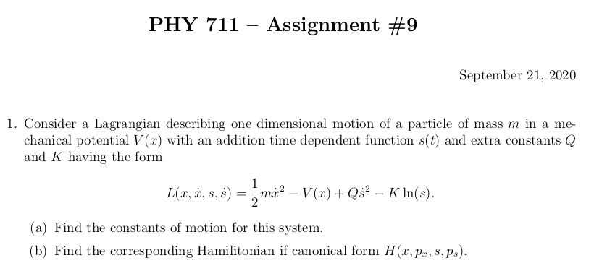
Notes:
Homework due Wednesday.

Slide 4
Lagrangian picture
Switching variables – Legendre transformation
Notes:
Starting with the Lagrangian and then performing a Legendre transformation.

Slide 5
Hamiltonian picture – continued
Notes:
Finding the Hamiltonian equations of motion.

Slide 6
Direct application of Hamiltonian’s principle using the Hamiltonian function --
Notes:
Showing that Hamilton’s principle can be formulated with the Hamiltonian formulation.

Slide 7
Hamilton’s principle continued:
Canonical equations
0
Notes:
So called “Canonical” equations.

Slide 8
Constants of the motion in Hamiltonian formalism
Notes:
Finding constants of the motion within the Hamiltonian formalism.

Slide 9
Recipe for constructing the Hamiltonian and analyzing the equations of motion
Notes:
Important recipe. Tape this to your wall!!!

Slide 10
Notes:
Example.

Slide 11
Notes:
Another example

Slide 12
Other examples
Notes:
Another example

Slide 13
Other examples
Notes:
Example with magnetic field.

Slide 14
Canonical equations of motion for constant magnetic field:
Notes:
Working out the equations of motion.

Slide 15
Canonical equations of motion for constant magnetic field -- continued:
Notes:
More evaluation of the equations of motion.

Slide 16
Notes:
Recap of treatment of electromagnetic interactions in the Lagrangian and Hamiltonian formulations.

Slide 17
Canonical form
Notes:
Continued.

Slide 18
Other properties of Hamiltonian formalism –
Poisson brackets:
Notes:
Now a interesting addition property of the Hamiltonian formulation.

Slide 19
Poisson brackets -- continued:
Notes:
Poisson bracket continued.

Slide 20
Poisson brackets -- continued:
Liouville theorem
Notes:
Example.

Slide 21
Phase space
Notes:
Notion of phase space

Slide 22
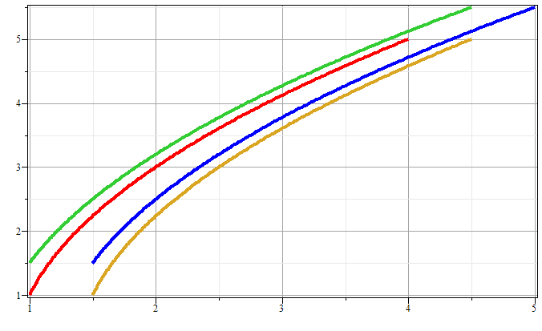
Phase space diagram for one-dimensional motion due to constant force
p
x
Notes:
Example of time evolution of phase space.

Slide 23
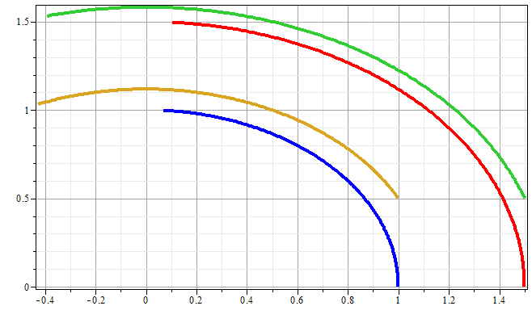
Phase space diagram for one-dimensional motion due to spring force
p
x
Notes:
Another example of time evolution of phase space.

Slide 24
Liouville’s Theorem (1838)
The density of representative points in phase space corresponding to the motion of a system of particles remains constant during the motion.
Notes:
Application to the density of phase space – Liouville theorm.

Slide 25
Liouville’s theorem
(x,p+Δp)
(x+Δx,p+Δp)
p
(x,p)
(x+Δx,p)
x
Notes:
Diagram of flow in phase space.

Slide 26
Liouville’s theorem -- continued
(x,p+Δp)
(x+Δx,p+Δp)
p
(x,p)
(x+Δx,p)
x
Notes:
Some details.

Slide 27
Liouville’s theorem -- continued
(x,p+Δp)
(x+Δx,p+Δp)
p
(x,p)
(x+Δx,p)
x
Notes:
More details.

Slide 28
Review:
Liouville’s theorem:
Imagine a collection of particles obeying the Canonical equations of motion in phase space.
Notes:
Summary of Liouville theorem.

Slide 29
Proof of Liouville’s theorem:
Notes:
Another more formal derivation of Liouville

Slide 30
Notes:
More details.

Slide 31
0
Notes:
Derivation of Liouville theorem

Slide 32
Importance of Liouville’s theorem to statistical mechanical analysis:
In statistical mechanics, we need to evaluate the probability of various configurations of particles. The fact that the density of particles in phase space is constant in time, implies that each point in phase space is equally probable and that the time average of the evolution of a system can be determined by an average of the system over phase space volume.
Notes:
Comment.

