Slide 1
PHY 711 Classical Mechanics and Mathematical Methods
10-10:50 AM MWF Online or (occasional) in Olin 103
Discussion of Lecture 13 – Chap. 3&6 (F&W)
Phase space
Liouville theorem
Examples
Notes:
In this lecture we will introduce the notion of phase space, prove an important theorem concerning the density of particles in phase space, and show some interesting examples. The slides at the end are included only for those of you who may be interested in statistical mechanics.

Slide 2
Physics Colloquium – Thursday, September 24, 2020
-- Bring your ideas and suggestions --
Notes:
Reminder about colloquium on Thursday.

Slide 3
Schedule for weekly one-on-one meetings
Nick – 11 AM Monday (ED/ST)
Tim – 9 AM Tuesday
Bamidele – 7 PM Tuesday
Zhi– 9 PM Tuesday
Jeanette – 11 AM Wednesday (this week only?)
Derek – 12 PM Friday

Slide 4
Your questions –
From Gao –
I have no questions about this lecture. Could you give a brief introduction to your research areas and their relationship with today's lecture if they have.
From Nick –
As of right now, Liouville's Theorem seems to make sense to me. But I wanted to ask, because I was intrigued by the numerical algorithms you slipped in there, are we going to be doing any more with numerical algorithms in this class? I was just wondering because I've seen Euler's method used in practice before but I have never used the Velocity Verlet algorithm.
From Tim –
1. For the homework due on Friday I am a little confused as to which Langrangian we are supposed to find the Hamiltonian for because all the Lagrangians I have found in the articles have already been solved.

Slide 5
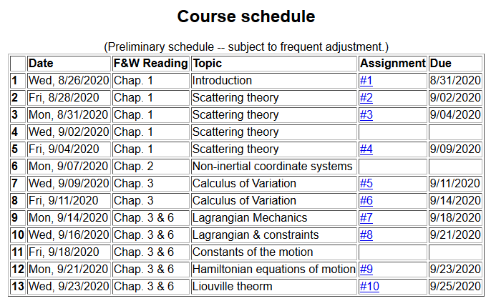
Notes:
There is a short homework problem due Friday.

Slide 6
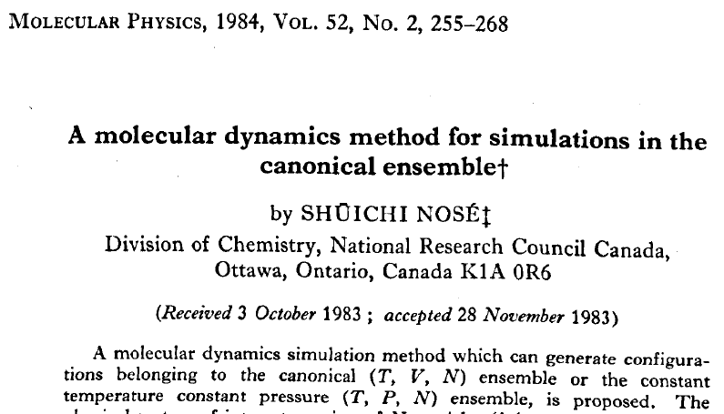
Notes:
Note you need only read a small part of one of the papers. Of course perhaps you will be interested to read more…. The papers are available from our webpage.

Slide 7
Your question -- For the homework due on Friday I am a little confused as to which Langrangian we are supposed to find the Hamiltonian for because all the Lagrangians I have found in the articles have already been solved.
Comment -- It is true that in both papers a lot of the analysis is given in the texts. The point of the problem is for you to critically read one of the papers and make sure the derivations makes sense to you given what we have learned in this class.

Slide 8
With the Hamiltonian formalism comes the notion of phase space --
Notes:
Now an interesting addition property of the Hamiltonian formulation.

Slide 9
Notes:
Introducing the Poisson Bracket.

Slide 10
Poisson brackets -- continued:
Liouville theorem
In the following slides we will justify this statement using several approaches.
Notes:
Examples followed by introducing the Liouville theorem.

Slide 11
Phase space
The notion of density of particles in phase space is simply the ratio of the number of particles per unit phase space volume. It seems reasonable that under conditions where there are no sources or sinks for the particles, that the density should remain constant in time.
Notes:
Notion of phase space

Slide 12
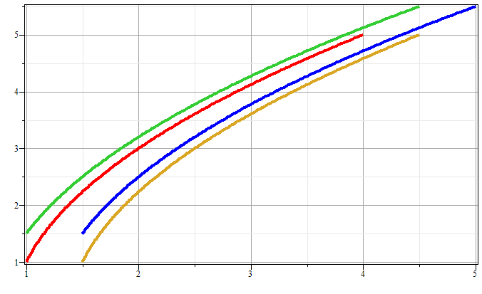
Phase space diagram for one-dimensional motion due to constant force
p
x
Notes:
Example of time evolution of phase space.

Slide 13
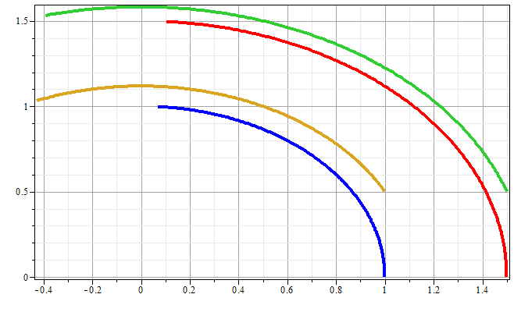
Phase space diagram for one-dimensional motion due to spring force
p
x
Notes:
Another example of time evolution of phase space.

Slide 14
Liouville’s Theorem (1838)
The density of representative points in phase space corresponding to the motion of a system of particles remains constant during the motion.
Notes:
Application to the density of phase space – Liouville theorm.

Slide 15
Liouville’s theorem
(x,p+Δp)
(x+Δx,p+Δp)
p
(x,p)
(x+Δx,p)
x
Notes:
Diagram of flow in phase space.

Slide 16
Liouville’s theorem -- continued
(x,p+Δp)
(x+Δx,p+Δp)
p
(x,p)
(x+Δx,p)
x
Notes:
Some details.

Slide 17
Liouville’s theorem -- continued
(x,p+Δp)
(x+Δx,p+Δp)
p
(x,p)
(x+Δx,p)
x
Notes:
More details.

Slide 18
Review:
Liouville’s theorem:
Imagine a collection of particles obeying the Canonical equations of motion in phase space.
Note that we are assuming that no particles are created or destroyed in these processes.
Notes:
Summary of Liouville theorem.

Slide 19
Another proof of Liouville’s theorem:
Notes:
Another more formal derivation of Liouville

Slide 20
Notes:
More details.

Slide 21
0
Notes:
Derivation of Liouville theorem

Slide 22
Importance of Liouville’s theorem to statistical mechanical analysis:
In statistical mechanics, we need to evaluate the probability of various configurations of particles. The fact that the density of particles in phase space is constant in time, implies that each point in phase space is equally probable and that the time average of the evolution of a system can be determined by an average of the system over phase space volume.
Notes:
Comment.

Slide 23
Modern usage of Lagrangian and Hamiltonian formalisms
J. Chem. Physics 72 2384-2393 (1980)
Notes:
This paper shows an example of Lagrangian and Hamiltonian mechanics use to make realistic simulations of real materials.

Slide 24
“Molecular dynamics” is a subfield of computational physics focused on analyzing the motions of atoms in fluids and solids with the goal of relating the atomistic and macroscopic properties of materials. Ideally molecular dynamics calculations can numerically realize the statistical mechanics viewpoint.
Notes:
Brief introduction to the approach of H. C. Andersen

Slide 25
r_{ij}
➔From this Lagrangian, can find the 3N coupled 2nd order differential equations of motion and/or find the corresponding Hamiltonian, representing the system at constant energy, volume, and particle number N (N,V,E ensemble).
Notes:
Schematic drawing of system modeled.

Slide 26
Lagrangian and Hamiltonian forms
Notes:
Lagrangian and Hamiltonian of particle system.

Slide 27
Digression on numerical evaluation of differential equations
x
t
Notes:
The equations cannot generally be solved analystically so that numerical methods must be used. This slide shows some of the ideas for numerical devaluations.

Slide 28
Your question –… I was intrigued by the numerical algorithms you slipped in there, are we going to be doing any more with numerical algorithms in this class? I was just wondering because I've seen Euler's method used in practice before but I have never used the Velocity Verlet algorithm.
Comment – Numerical algorithms is a big subject and we might have some time in this class and in PHY 712 to cover some of the ideas. I would be glad to help you research some aspects for your “project” in this class. For a more comprehensive presentation I would recommend some classes in Math and Computer science and Professor Greg Cook in our department teaches a class every other year or so.

Slide 29
Your question – a related question about research expertise.
Comment – I do not view myself as an expert in molecular dynamics which we are discussing, despite having used some of these techniques. Professors Sam Cho and Fred Salsbury have much more experience in these areas than I do. My main goal in presenting these ideas here is to help you understand that the seemingly dusty topic of classical mechanics and old ideas developed over a century ago can be useful in modern times.
In defense of numerical evaluation, here is a quote from Richard Feynman: First you guess. Don’t laugh, this is the most important step. Then you compute the consequences. Compare the consequences to experience. If it disagrees with experience, the guess is wrong. In that simple statement is the key to science. It doesn’t matter how beautiful your guess is or how smart you are or what your name is. If it disagrees with experience, it’s wrong. That’s all there is to it.

Slide 30
H. C. Andersen wanted to adapt the formalism for modeling an (N,V,E) ensemble to one which could model a system at constant pressure (P).
P
V constant
P constant, V variable
Notes:
Back to the ideas of H. C. Andersen.

Slide 31
PV contribution to potential energy
kinetic energy of “balloon”
Notes:
Andersen’s approach of “extending the Lagrangian to include pressure effects.

Slide 32
Notes:
Some details.

Slide 33
Relationship between system representations
Scaled Original
Equations of motion in “original” coordinates:
Notes:
More details.

Slide 34
Physical interpretation:
Notes:
Here alpha represents the controlling pressure.

Slide 35
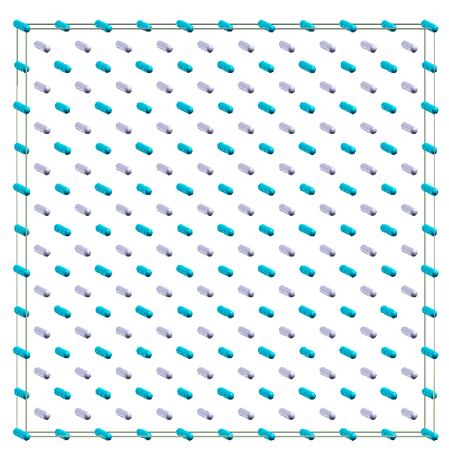
Example simulation for NPT molecular dynamics simulation of Li₂O using 1500 atoms with θ=0
Use LAMMPS code
http://LAMMPS.sandia.gov
Notes:
An illustration of simulation for a particular system.

Slide 36
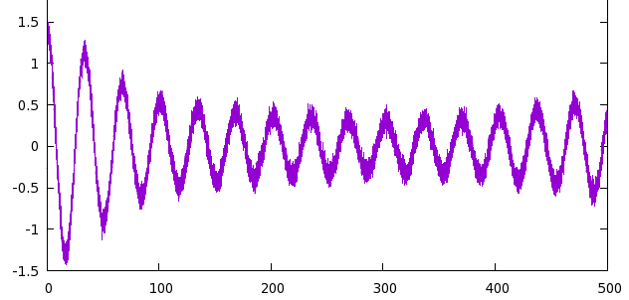
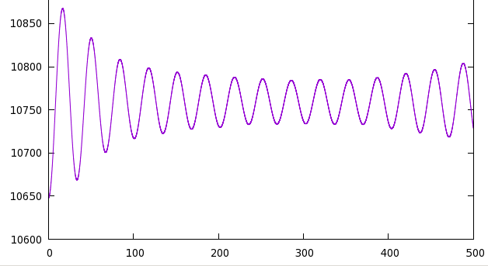
P (GPa)
α=0
t (ps)
V (Å³)
t (ps)
Notes:
Plot of volume and pressure variation for a particular simulation.

Slide 37
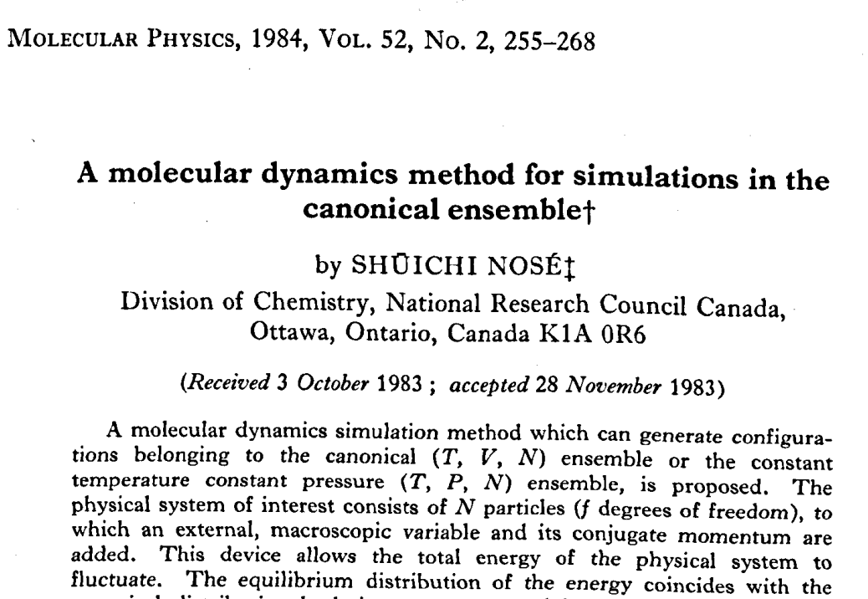
Notes:
Another famous paper controlling the temperature rather than the pressure.

Slide 38
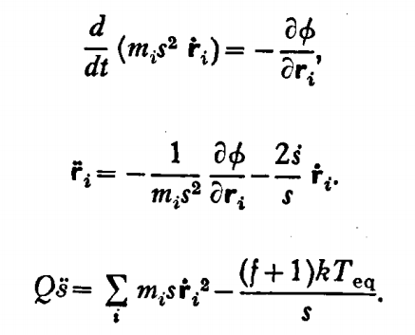
fictitious mass
velocity scaling
Equations of motion:
Notes:
Nose’’s idea to control the temperature using an “extended” Lagrangian.

Slide 39
Time averaged relationships
Notes:
Showing how the scale factor s behaves on averate.

Slide 40
Time averaged relationships
Hamiltonian
Notes:
More details.

Slide 41
Nose’ was able to show that his effective Hamiltonian well approximates such a canonical distribution.
Notes:
Some references to the related statistical mechanics developments.

Slide 42
Relationship between Nose’’s partition function and the canonical partition function:
constant factor
Some details:
Starting with partition for microcanonical ensemble:
Notes:
More statistical mechanics.

Slide 43
Notes:
Details.

Slide 44
When the dust clears --
constant factor
➔The Nose’ ensemble should sample phase space in the same way as does the canonical ensemble at T_{eq}.
Notes:
More details.

Slide 45
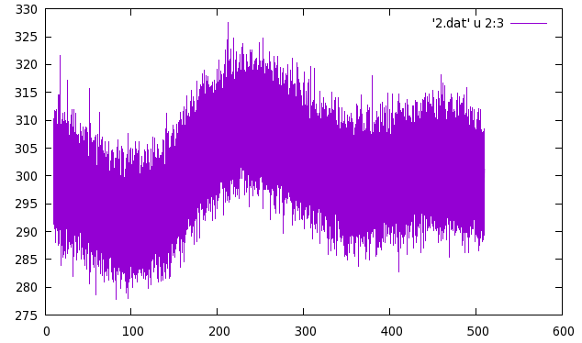
From LAMMPS simulation (using modified Nose’ algorithm)
T (K)
t (ps)
Notes:
How does this really work? We see that the approach allows fluctuations in the temperature, but the average is apparently controlled.

