Slide 1
PHY 711 Classical Mechanics and Mathematical Methods
10-10:50 AM MWF Online or (occasional) in Olin 103
Plan for Lecture 13 – Chap. 3&6 (F&W)
      Phase space
      Liouville theorem
      Examples
Notes:
In this lecture we will introduce the notion of phase space, prove an important theorem concerning the density of particles in phase space, and show some interesting examples. The slides at the end are included only for those of you who may be interested in statistical mechanics.

Slide 2

Physics Colloquium – Thursday, September 24, 2020
-- Bring your ideas and suggestions --
Notes:
Reminder about colloquium on Thursday.

Slide 3
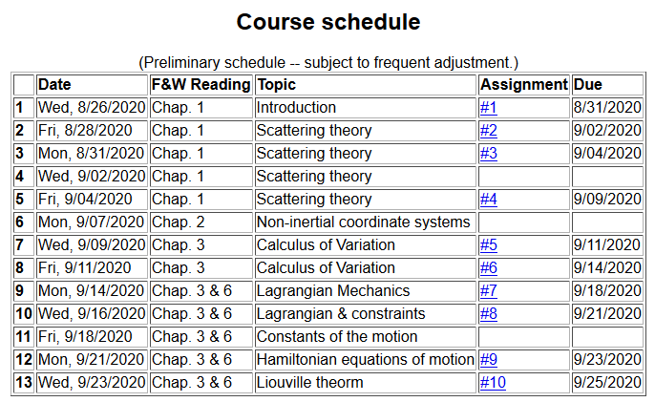
Notes:
There is a short homework problem due Friday.

Slide 4
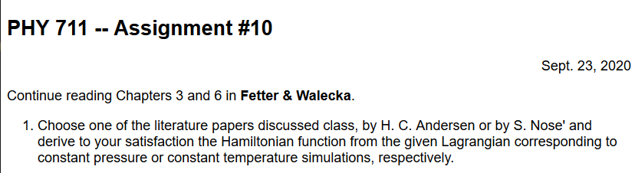
Notes:
Note you need only read a small part of one of the papers. Of course perhaps you will be interested to read more…. The papers are available from our webpage.

Slide 5
With the Hamiltonian formalism comes the notion of phase space --
Notes:
Now an interesting addition property of the Hamiltonian formulation.

Slide 6
Notes:
Introducing the Poisson Bracket.

Slide 7
Poisson brackets -- continued:
Liouville theorem
In the following slides we will justify this statement using several approaches.
Notes:
Examples followed by introducing the Liouville theorem.

Slide 8
Phase space
The notion of density of particles in phase space is simply the ratio of the number of particles per unit phase space volume. It seems reasonable that under conditions where there are sources or sinks for the particles, that the density should remain constant in time.
Notes:
Notion of phase space

Slide 9
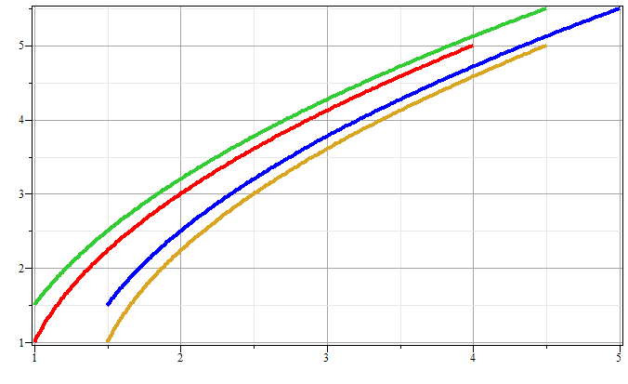
Phase space diagram for one-dimensional motion due to constant force
p
x
Notes:
Example of time evolution of phase space.

Slide 10
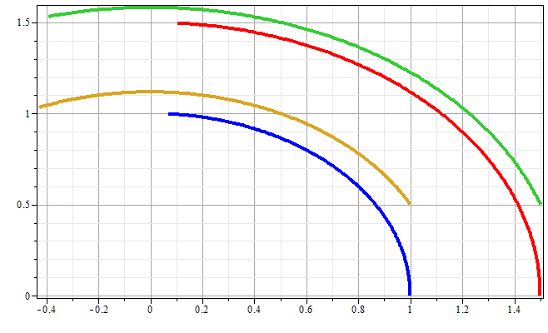
Phase space diagram for one-dimensional motion due to spring force
p
x
Notes:
Another example of time evolution of phase space.

Slide 11
Liouville’s Theorem (1838)
The density of representative points in phase space corresponding to the motion of a system of particles remains constant during the motion.
Notes:
Application to the density of phase space – Liouville theorm.

Slide 12
Liouville’s theorem
(x,p+Δp)
(x+Δx,p+Δp)
p
(x,p)
(x+Δx,p)
x
Notes:
Diagram of flow in phase space.

Slide 13
Liouville’s theorem -- continued
(x,p+Δp)
(x+Δx,p+Δp)
p
(x,p)
(x+Δx,p)
x
Notes:
Some details.

Slide 14
Liouville’s theorem -- continued
(x,p+Δp)
(x+Δx,p+Δp)
p
(x,p)
(x+Δx,p)
x
Notes:
More details.

Slide 15
Review:
Liouville’s theorem:
Imagine a collection of particles obeying the Canonical equations of motion in phase space.
Note that we are assuming that no particles are created or destroyed in these processes.
Notes:
Summary of Liouville theorem.

Slide 16
Another proof of Liouville’s theorem:
Notes:
Another more formal derivation of Liouville

Slide 17
Notes:
More details.

Slide 18
0
Notes:
Derivation of Liouville theorem

Slide 19
Importance of Liouville’s theorem to statistical mechanical analysis:
  In statistical mechanics, we need to evaluate the probability of various configurations of particles. The fact that the density of particles in phase space is constant in time, implies that each point in phase space is equally probable and that the time average of the evolution of a system can be determined by an average of the system over phase space volume.
Notes:
Comment.

Slide 20
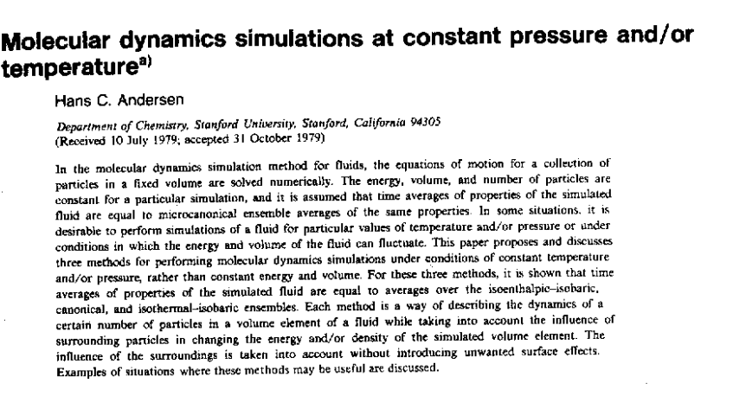
Modern usage of Lagrangian and Hamiltonian formalisms
J. Chem. Physics 72 2384-2393 (1980)
Notes:
This paper shows an example of Lagrangian and Hamiltonian mechanics use to make realistic simulations of real materials.

Slide 21
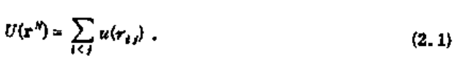
“Molecular dynamics” is a subfield of computational physics focused on analyzing the motions of atoms in fluids and solids with the goal of relating the atomistic and macroscopic properties of materials. Ideally molecular dynamics calculations can numerically realize the statistical mechanics viewpoint.
Notes:
Brief introduction to the approach of H. C. Andersen

Slide 22
r_{ij}
➔From this Lagrangian, can find the 3N coupled 2nd order differential equations of motion and/or find the corresponding Hamiltonian, representing the system at constant energy, volume, and particle number N (N,V,E ensemble).
Notes:
Schematic drawing of system modeled.

Slide 23
Lagrangian and Hamiltonian forms
Notes:
Lagrangian and Hamiltonian of particle system.

Slide 24
Digression on numerical evaluation of differential equations
x
t
Notes:
The equations cannot generally be solved analystically so that numerical methods must be used. This slide shows some of the ideas for numerical devaluations.

Slide 25
H. C. Andersen wanted to adapt the formalism for modeling an (N,V,E) ensemble to one which could model a system at constant pressure (P).
P
V constant
P constant, V variable
Notes:
Back to the ideas of H. C. Andersen.

Slide 26
PV contribution to potential energy
kinetic energy of “balloon”
Notes:
Andersen’s approach of “extending the Lagrangian to include pressure effects.

Slide 27
Notes:
Some details.

Slide 28
Relationship between system representations
Scaled Original
Equations of motion in “original” coordinates:
Notes:
More details.

Slide 29
Physical interpretation:
Notes:
Here alpha represents the controlling pressure.

Slide 30
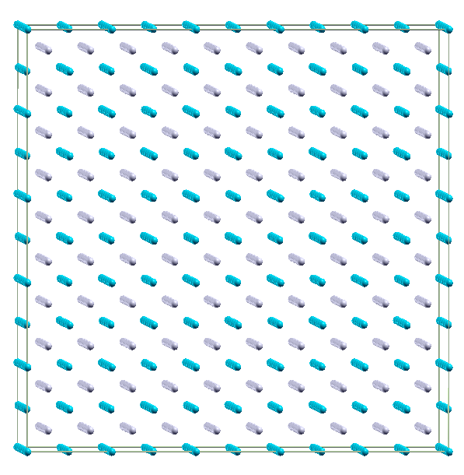
Example simulation for NPT molecular dynamics simulation of Li₂O using 1500 atoms with θ=0
Use LAMMPS code
http://LAMMPS.sandia.gov
Notes:
An illustration of simulation for a particular system.

Slide 31
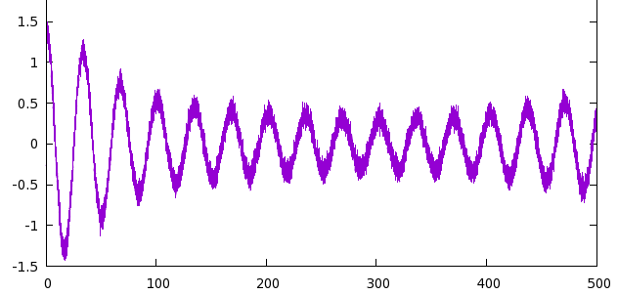
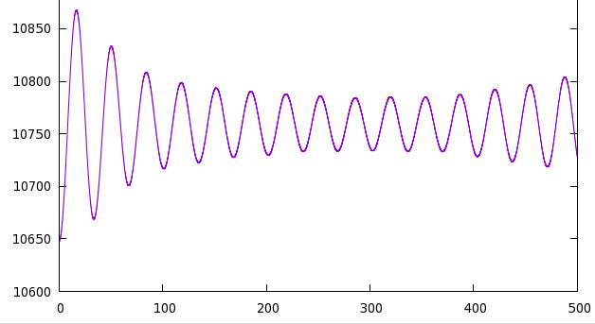
P (GPa)
t (ps)
V (Å³)
t (ps)
Notes:
Plot of volume and pressure variation for a particular simulation.

Slide 32
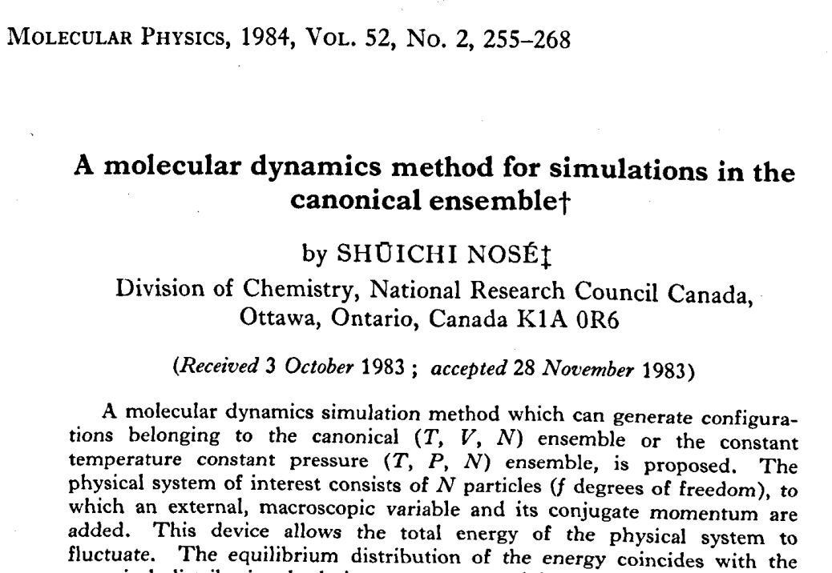
Notes:
Another famous paper controlling the temperature rather than the pressure.

Slide 33
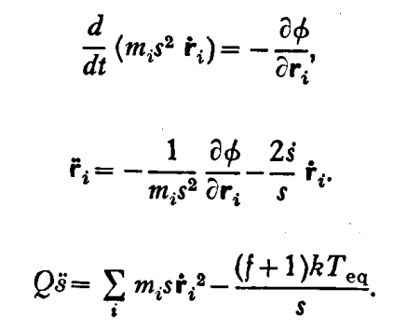
fictitious mass
velocity scaling
Equations of motion:
Notes:
Nose’’s idea to control the temperature using an “extended” Lagrangian.

Slide 34
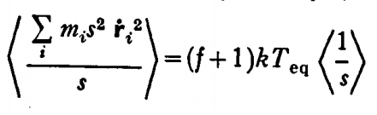
Time averaged relationships
Notes:
Showing how the scale factor s behaves on averate.

Slide 35
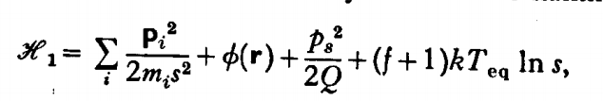
Time averaged relationships
Hamiltonian
Notes:
More details.

Slide 36
Nose’ was able to show that his effective Hamiltonian well approximates such a canonical distribution.
Notes:
Some references to the related statistical mechanics developments.

Slide 37
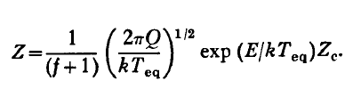
Relationship between Nose’’s partition function and the canonical partition function:
constant factor
Some details:
Starting with partition for microcanonical ensemble:
Notes:
More statistical mechanics.

Slide 38
Notes:
Details.

Slide 39
When the dust clears --
constant factor
➔The Nose’ ensemble should sample phase space in the same way as does the canonical ensemble at T_{eq}.
Notes:
More details.

Slide 40
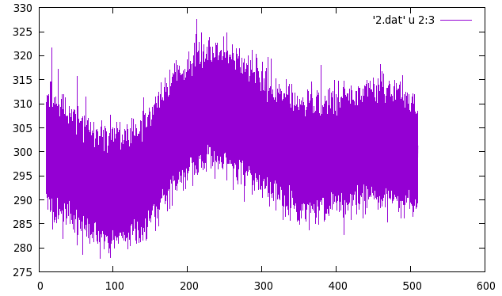
From LAMMPS simulation (using modified Nose’ algorithm)
T (K)
t (ps)
Notes:
How does this really work? We see that the approach allows fluctuations in the temperature, but the average is apparently controlled.

