Slide 1
PHY 711 Classical Mechanics and Mathematical Methods
10-10:50 AM MWF online or (occasionally) in Olin 103
Plan for Lecture 14 -- Finish reading Chap. 6
Extensions of Hamiltonian formalism
Virial theorem
Canonical transformations
Hamilton-Jacobi formalism
Notes:
In this lecture we will discuss a variety of identities and methods and historically important ideas related to Hamiltonian and Lagrangian mechanics.

Slide 2
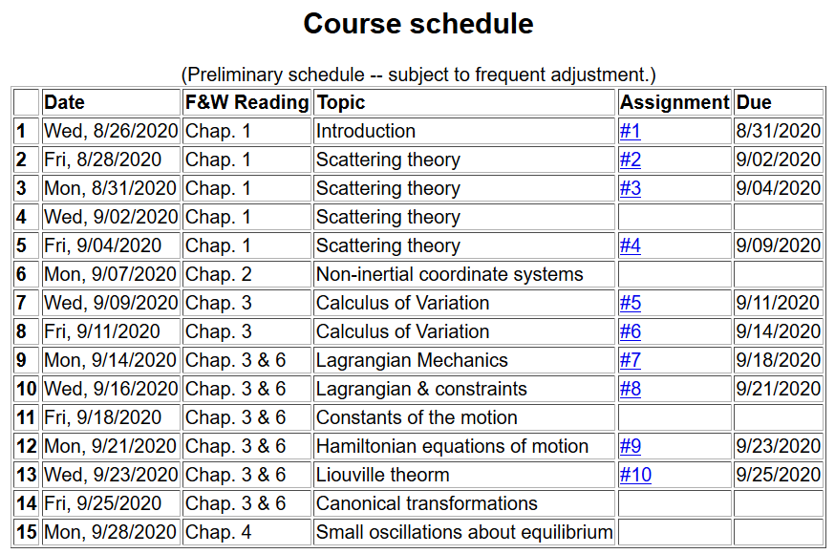
Notes:
Note that the schedule shows that this lecture will wrap up Chapters 3 and 6. There is no new homework assignment. On Monday we will start discussing Chap. 4 and apply Lagrangian and Hamiltonian mechanics to small oscillations.

Slide 3
Virial theorem (Rudolf Clausius ~ 1870)
Note that this implies that the motion is bounded
Notes:
The “virial theorem” is a useful identity for studying some mechanical systems.

Slide 4
Examples of the Virial Theorem
Notes:
Examples.

Slide 5
Examples of the Virial Theorem
centripetal acceleration
gravitational force
Notes:
Another example.

Slide 6
Hamiltonian formalism and the canonical equations of motion:
Notes:
Review for a general Hamiltonian system. The question is what would happen if we change coordinates?

Slide 7
Notion of “Canonical” generalized coordinate transformations
Notes:
Thinking about changing the coordinates – indicated with lower case and larger case symbols.

Slide 8
Some details --
Notes:
Some details.

Slide 9
Some relations between old and new variables:
Notes:
More details.

Slide 10
Notes:
Relationship between new Hamiltonian and original Hamiltonian.

Slide 11
Note that it is conceivable that if we were extraordinarily clever, we could find all of the constants of the motion!
Possible solution – Hamilton-Jacobi theory:
Notes:
Focusing on finding the constants of motion.

Slide 12
Notes:
Deriving equations for identifying constants of motion.

Slide 13
0
0
0
Notes:
Details of derivation.

Slide 14
0
0
0
Notes:
More details.

Slide 15
Differential equation for S:
Notes:
Hamilton-Jacobi using harmonic oscillator example.

Slide 16
Continued:
Notes:
Hamilton-Jacobi equations for harmonic oscillator.

Slide 17
Continued:
Notes:
Continued.

Slide 18
Another example of Hamilton Jacobi equations
Notes:
Another example of using the Hamilton-Jacobi equations.

Slide 19
Notes:
Continued.

Slide 20
Check action:
Notes:
More details.

Slide 21
Recap --
Lagrangian picture
Hamiltonian picture
Notes:
Summary of what we have learned.

Slide 22
Notes:
More summary.

Slide 23
Recipe for constructing the Hamiltonian and analyzing the equations of motion
Notes:
Recipe to remember.

