Slide 1
PHY 711 Classical Mechanics and Mathematical Methods
10-10:50 AM MWF Online or (occasionally) in Olin 103
Discussiont of Lecture 15 – Chap. 4 (F & W)
Analysis of motion near equilibrium
Small oscillations about equilibrium
Normal modes of vibration
Notes:
In this lecture we will analyze systems near equilibrium. This system represents a lot of physical systems and has a rich toolbox of mathematical formalisms.

Slide 2
Schedule for weekly one-on-one meetings
Nick – 11 AM Monday (ED/ST)
Tim – 9 AM Tuesday
Bamidele – 7 PM Tuesday
Zhi– 8 PM Tuesday -- possibly shift time?
Jeanette – 11 AM Friday
Derek – 12 PM Friday

Slide 3
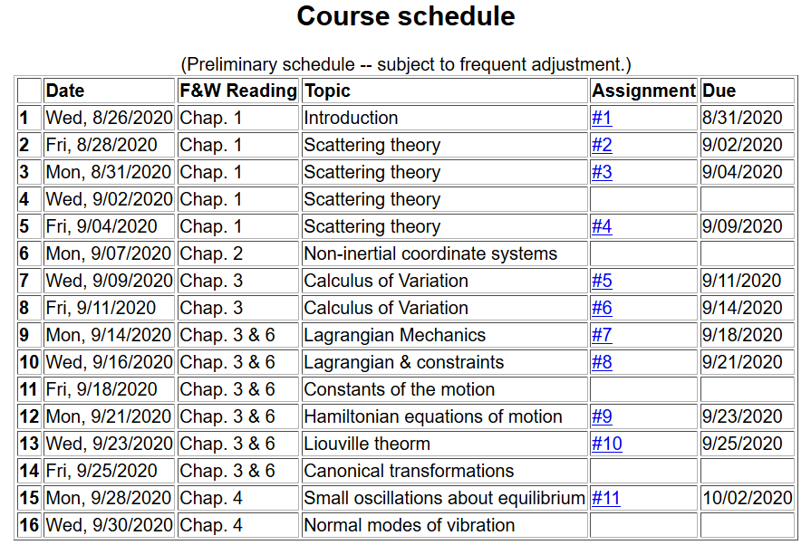
Notes:
We are starting the material covered in Chap. 4. The assigned homework is due on Friday.

Slide 4
Notes:
This is the homework problem.

Slide 5
Your questions –
From Gao –
How to find U and V to diagonal the matrix that makes a coupled question to be a decoupled question?
My question –
For the mathematical methods portion of this class, what is the state of your knowledge of linear algebra methods as they relate to physics?
Good enough
Could use more information specially for …..?
Need N dedicated lectures to this material

Slide 6
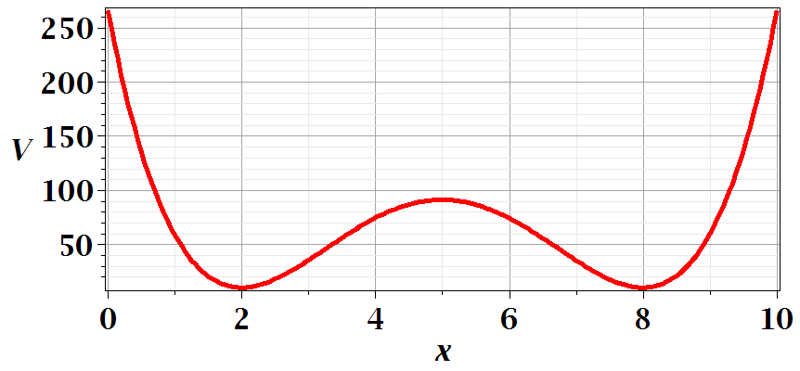
Motivation for studying small oscillations – many interacting systems have stable and meta-stable configurations. For a one-dimensional system, this is well approximated by:
Notes:
This is a plot for an arbitrary one dimensional potential function showing two stable equilibria near x=2 and x=8.

Slide 7
Notes:
Lagrangian analysis and general solution.

Slide 8
Extending the analysis to coupled oscillators near equilibrium --
Example – linear molecule
m₁
m₂
m₃
Notes:
A more complicated example with 3 masses connected with springs.

Slide 9
Notes:
Analyzing the equations of motion.

Slide 10
Mathematical methods for solving these coupled linear differential equations:
Notes:
Coupled differential equation and tricks for solution.

Slide 11
Notes:
Resulting linear equations also written in matrix form.

Slide 12
Notes:
The original equations are not symmetric. With this transformation, we can make the equations take a symmetric form.

Slide 13
If you had to solve* these equations, which form is more convenient?

Slide 14
Digression:
Notes:
Digression on linear algebra theory.

Slide 15
Digression on matrices -- continued
Eigenvalues of a matrix are “invariant” under a similarity transformation
Notes:
Similarity transformations used to analyze our system.

Slide 16
Example of transformation:
Notes:
Details for our case..

Slide 17
Note, here we have defined S as a transformation matrix (often called a similarity transformation matrix)
How can you find the transformation that diagonalizes a matrix?

Slide 19
Notes:
More details for our case.

Slide 21
m₁
m₂
m₃
m₁
m₂
m₃
m₁
m₂
m₃
Notes:
Visualization of the solution for our case.

Slide 22
Notes:
The general solution will depend on initial values or boundary values.

Slide 23
Additional digression on matrix properties
Singular value decomposition
Notes:
An unrelated digression that may be useful – singular value decomposistion.

Slide 24
Singular value decomposition -- continued
Notes:
Digression continued.

Slide 25
Consider an extended system of masses and springs:
m
m
m
Notes:
Another example; this one is in your textbook.

Slide 26
Notes:
Details for N masses.

Slide 27
Can solve as an eigenvalue problem –
(Why did we not have to transform the equations as we did in the previous example?)
Notes:
Form of matrix equations.

Slide 28
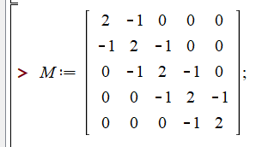
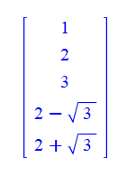
Notes:
Finding eigenvalues with Maple.

Slide 29
This example also has an algebraic solution --
Is this treatment cheating?
Yes.
No cheating, but we are not done.
Notes:
Analytic methods for this highly symmetric case.

Slide 30
Notes:
Setting the boundary values.

Slide 31
Notes:
Boundary conditions continued.

Slide 32
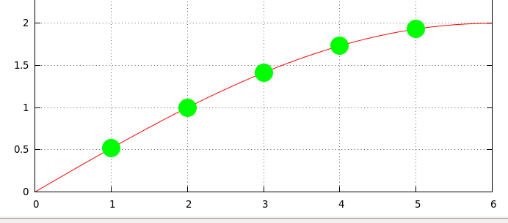
Notes:
Plot of the results.

