Slide 1
PHY 711 Classical Mechanics and Mathematical Methods
10-10:50 AM MWF Online or (occasionally) in Olin 103
Plan for Lecture 15 – Chap. 4 (F & W)
Analysis of motion near equilibrium
Small oscillations about equilibrium
Normal modes of vibration
Notes:
In this lecture we will analyze systems near equilibrium. This system represents a lot of physical systems and has a rich toolbox of mathematical formalisms.

Slide 2
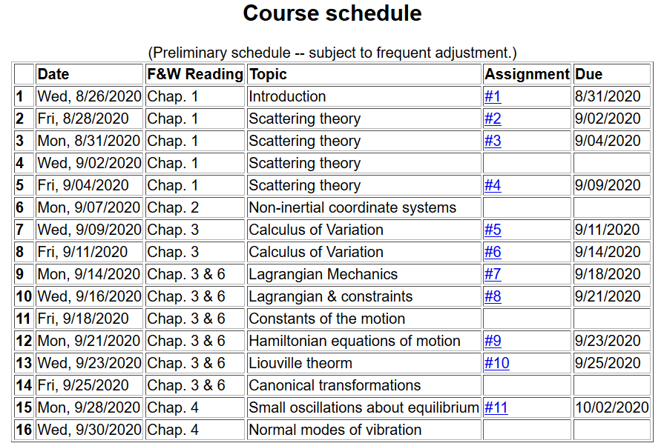
Notes:
We are starting the material covered in Chap. 4. The assigned homework is due on Friday.

Slide 3
Notes:
This is the homework problem.

Slide 4
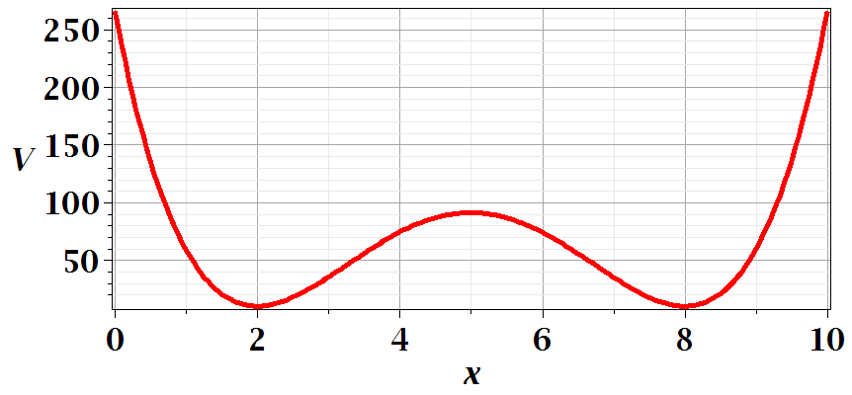
Motivation for studying small oscillations – many interacting systems have stable and meta-stable configurations which are well approximated by:
Notes:
This is a plot for an arbitrary one dimensional potential function showing two stable equilibria near x=2 and x=8.

Slide 5
Notes:
Lagrangian analysis and general solution.

Slide 6
Example – linear molecule
m₁
m₂
m₃
Notes:
A more complicated example with 3 masses connected with springs.

Slide 7
Notes:
Analyzing the equations of motion.

Slide 8
Notes:
Coupled differential equation and tricks for solution.

Slide 9
Notes:
Resulting linear equations also written in matrix form.

Slide 10
Notes:
The original equations are not symmetric. With this transformation, we can make the equations take a symmetric form.

Slide 11
Digression:
Notes:
Digression on linear algebra theory.

Slide 12
Digression on matrices -- continued
Eigenvalues of a matrix are “invariant” under a similarity transformation
Notes:
Similarity transformations used to analyze our system.

Slide 13
Example of transformation:
Notes:
Details for our case..

Slide 14
Notes:
More details for our case.

Slide 16
m₁
m₂
m₃
m₁
m₂
m₃
m₁
m₂
m₃
Notes:
Visualization of the solution for our case.

Slide 17
Notes:
The general solution will depend on initial values or boundary values.

Slide 18
Additional digression on matrix properties
Singular value decomposition
Notes:
An unrelated digression that may be useful – singular value decomposistion.

Slide 19
Singular value decomposition -- continued
Notes:
Digression continued.

Slide 20
Consider an extended system of masses and springs:
m
m
m
Notes:
Another example; this one is in your textbook.

Slide 21
Notes:
Details for N masses.

Slide 22
Can solve as an eigenvalue problem --
Notes:
Form of matrix equations.

Slide 23
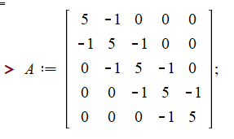
Notes:
Finding eigenvalues with Maple.

Slide 24
This example also has an algebraic solution --
Notes:
Analytic methods for this highly symmetric case.

Slide 25
Notes:
Setting the boundary values.

Slide 26
Notes:
Boundary conditions continued.

Slide 27
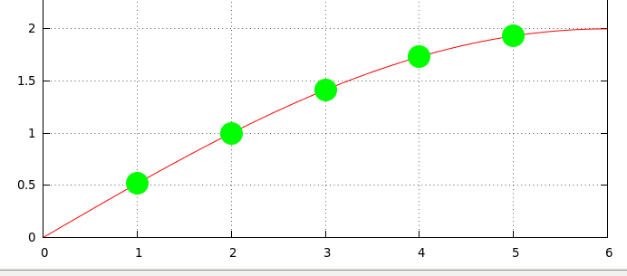
Notes:
Plot of the results.

