Slide 1
PHY 711 Classical Mechanics and Mathematical Methods
10-10:50 AM MWF Online or (occasionally) in Olin 103
Discussion of Lecture 16 – Chap. 4 (F & W)
    Analysis of motion near equilibrium
      Normal modes of vibration for simple systems
      Some concepts of linear algebra
      Normal modes of vibration for more complicated systems
Notes:
In this lecture we will analyze systems near equilibrium. This system represents a lot of physical systems and has a rich toolbox of mathematical formalisms.

Slide 2
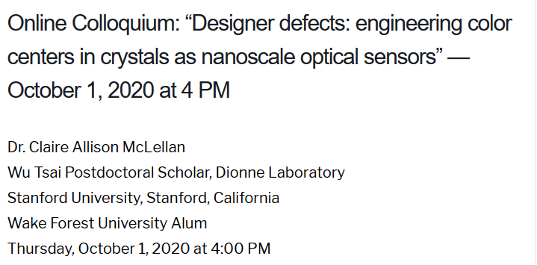
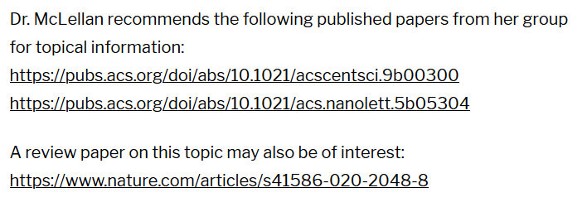
Physics Colloquium Thursday, October 1, 2020
Notes:
Thursday’s colloquium -- WFU alum

Slide 3
Schedule for weekly one-on-one meetings
Nick – 11 AM Monday (ED/ST)
Tim – 9 AM Tuesday
Bamidele – 7 PM Tuesday
Zhi– 9 PM Tuesday
Jeanette – 11 AM Friday
Derek – 12 PM Friday

Slide 4
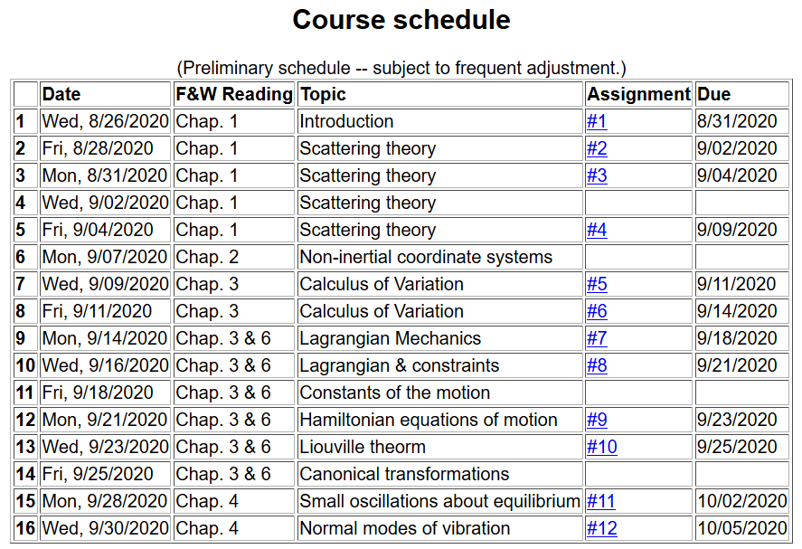
Notes:
We are starting the material covered in Chap. 4. The assigned homework will be covered in Friday’s lecture and due on Monday.

Slide 5
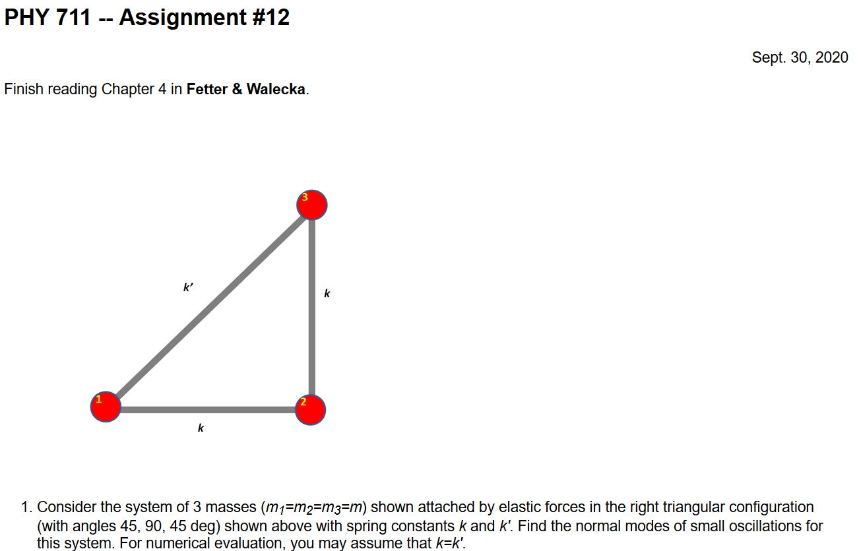
Notes:
Extension of ideas discussed today to 2 dimensions.

Slide 6
Your questions –
From Tim –
  What do the arrows represent on the three separate frequencies on slide 13?
From Nick –
  From the last lecture and beginning of this one, are the N_i and N'_i just normalization constants for the eigenvectors?
  In 741, we've used linear algebra to construct diagonal matrices by sandwiching our operator between the matrix of eigenvectors and its Hermitian conjugate. Is that kind of like what we're doing here with U and V^H with SVD? I guess I'm also asking what's all the fuss about singular values? What's their importance relative to eigenvalues?
From Gao –
  About today’s lecture, to solve coupled problems we need only symmetric transformation? The first matrix in page 10 is symmetric or not why?
The following slides quickly review what we covered in Lecture 15 --

Slide 7
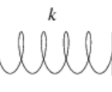
Non-trivial example of coupled oscillator in the form of a linear molecule
m₁
m₂
m₃
Notes:
Example with 3 masses connected with springs moving in one dimension

Slide 8
Notes:
Analyzing the equations of motion.

Slide 9
Mathematical methods for solving these coupled linear differential equations:
Notes:
Coupled differential equation and tricks for solution.

Slide 10
Notes:
Resulting linear equations also written in matrix form.

Slide 11
Notes:
The original equations are not symmetric. With this transformation, we can make the equations take a symmetric form.

Slide 12
Notes:
More details for our case.

Slide 13
(with help from Maple)
N,N’ are normalization constants.

Slide 14
m₁
m₂
m₃
m₁
m₂
m₃
m₁
m₂
m₃
Notes:
Visualization of the solution for our case.

Slide 15
Your question -- What is the meaning of the arrows in the previous slide.
Comment -- The arrows indicate the displacement of each atom at a snapshot in time.
Which of the following statements are false?
  Molecules always have one zero frequency mode.
  CO₂ really has more than 3 normal modes .
  Some molecules have more than one zero frequency modes.
  The normal modes of molecules are only of academic interest and cannot be measured.

Slide 16
Notes:
In general, we will want help from computational tools, but we can illustrate the concepts for 3 dimensions.

Slide 17
Note that the normalization of the eigenvector is arbitrary.
Notes:
Finding the polynomial of the eigenvalues and solving, followed by solving for the eigenvector components.

Slide 18
Summary of results for linear CO₂ molecule
m₁
m₂
m₃
m₁
m₂
m₃
m₁
m₂
m₃
Notes:
Summary of the results for this case.

Slide 19
Notes:
The general solution will depend on initial values or boundary values.

Slide 20
Digression:
Notes:
Digression on linear algebra theory.

Slide 21
Digression on matrices -- continued
Eigenvalues of a matrix are “invariant” under a similarity transformation
This means that if a matrix is “similar” to a Hermitian matrix,
it has the same eigenvalues. The corresponding eigenvectors of M and M’ are not the same but
Notes:
Similarity transformations used to analyze our system.

Slide 22
Example of a similarity transformation:
Note that this matrix is not symmetric
Note that this matrix is symmetric
Notes:
Details for our case..

Slide 23
Note – there was a question about why we want a symmetric matrix. The answer is that a symmetric (or more generally a Hermitian) NxN matrix is known to have N real eigenvalues. Moreover, we have shown that if our matrix is not Hermitian, but can be made into a Hermitian form with a similarity transformation, it too will have N real eigenvalues.

Slide 24
Note, here we have defined S as a transformation matrix (often called a similarity transformation matrix)
How can you find a unitary transformation that also diagonalizes a matrix?
Notes:
Another example of similarity transformation for the 2x2 case.

Slide 25
Note that this “trick” is special for 2x2 matrices, but numerical extensions based on the trick are possible.
Notes:
Only for 2x2 case.

Slide 26
Note that transformations using unitary matrices are often
convenient and they can be easily constructed from the
eigenvalues of a matrix.
Apparently, you also saw this in Quantum Mechanics?
Notes:
Comment on unitary matrices in general.

Slide 27
Additional digression on matrix properties
Singular value decomposition
Notes:
An unrelated digression that may be useful – singular value decomposition.

Slide 28
Singular value decomposition -- continued
Details are complicated ….
Your question -- what's all the fuss about singular values? What's their importance relative to eigenvalues?
Comment – I would like to see a bigger fuss. SVD is different from eigenvalue analysis and more broadly applicable. At a minimum SVD analysis identifies mathematically poorly posed problems and offers a “fix”.
Notes:
Digression continued.

Slide 29
Consider an extended system of masses and springs:
m
m
m
Notes:
Another example; this one is in your textbook.

Slide 30
Notes:
Details for N masses.

Slide 31
Can solve as an eigenvalue problem –
  (Why did we not have to transform the equations as we did in the previous example?)
Notes:
Form of matrix equations.

Slide 32
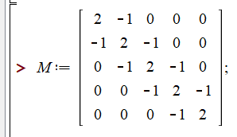

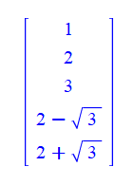
Notes:
Finding eigenvalues with Maple.

Slide 33
Because of its very regular form, this example also has an algebraic solution --
Is this treatment cheating?
  Yes.
  No cheating, but we are not done.
Notes:
Analytic methods for this highly symmetric case.

Slide 34
Notes:
Setting the boundary values.

Slide 35
Notes:
Boundary conditions continued.

Slide 36
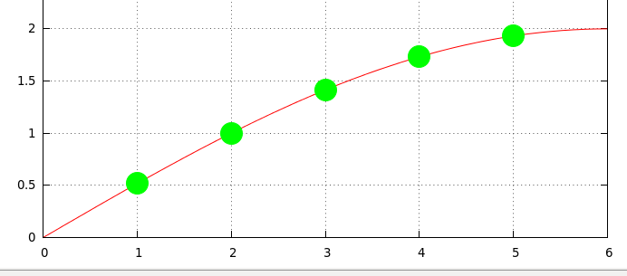
Notes:
Plot of the results.

