Slide 1
PHY 711 Classical Mechanics and Mathematical Methods
10-10:50 AM MWF Online or (occasionally) in Olin 103
Plan for Lecture 16 – Chap. 4 (F & W)
Analysis of motion near equilibrium
Normal modes of vibration for simple systems
Some concepts of linear algebra
Normal modes of vibration for more complicated systems
Notes:
In this lecture we will analyze systems near equilibrium. This system represents a lot of physical systems and has a rich toolbox of mathematical formalisms.

Slide 2
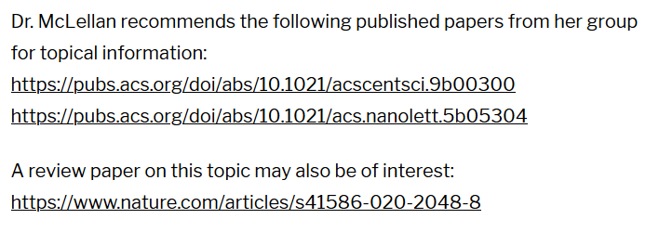
Physics Colloquium Thursday, October 1, 2020
Notes:
Thursday’s colloquium -- WFU alum

Slide 3
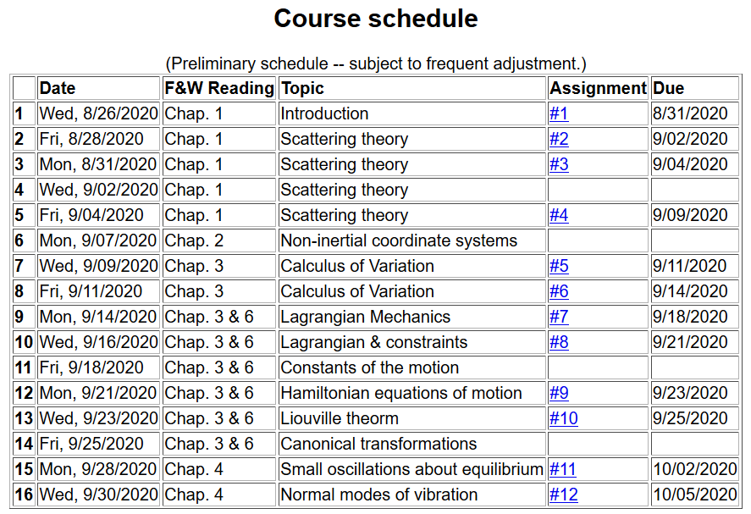
Notes:
We are starting the material covered in Chap. 4. The assigned homework will be covered in Friday’s lecture and due on Monday.

Slide 4
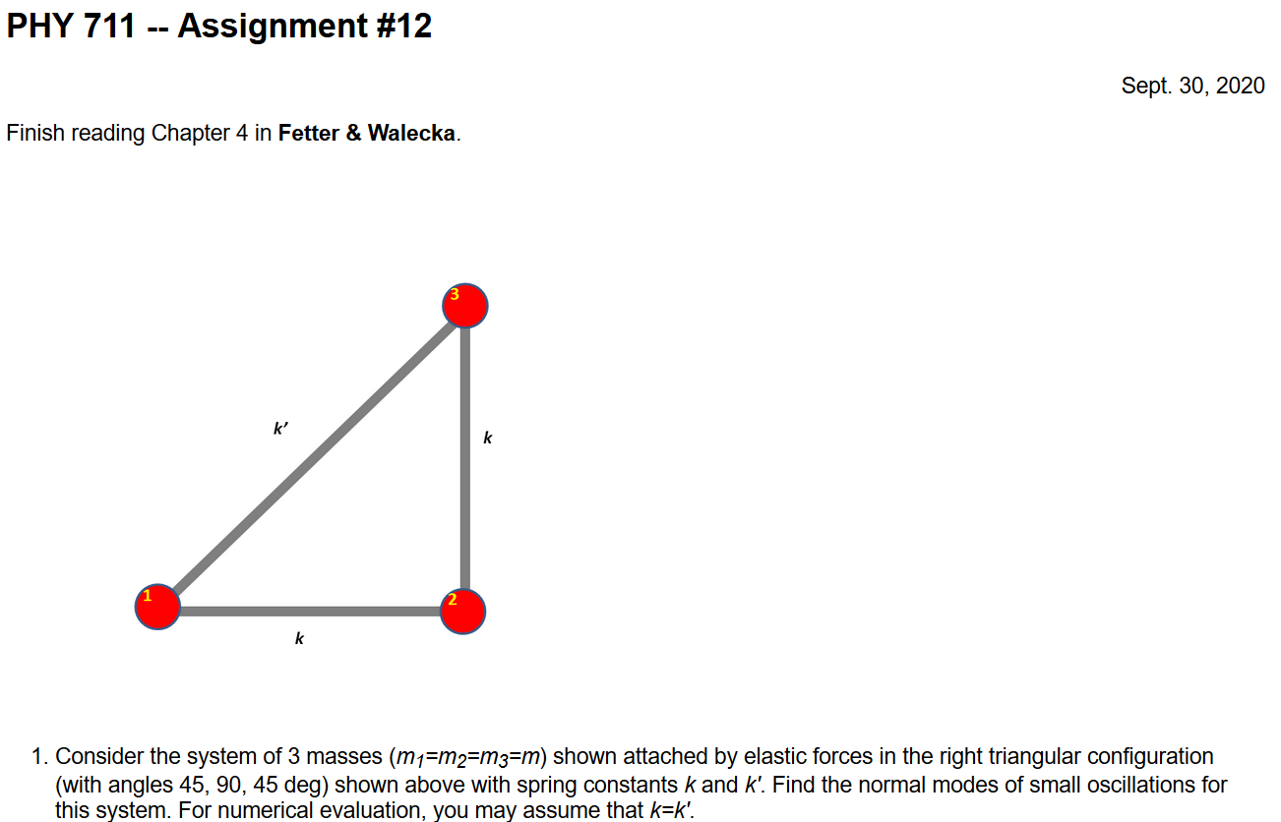
Notes:
Extension of ideas discussed today to 2 dimensions.

Slide 5
The following slides quickly review what we covered in Lecture 15 --

Slide 6
Non-trivial example of coupled oscillator in the form of a linear molecule
m₁
m₂
m₃
Notes:
Example with 3 masses connected with springs moving in one dimension

Slide 7
Notes:
Analyzing the equations of motion.

Slide 8
Mathematical methods for solving these coupled linear differential equations:
Notes:
Coupled differential equation and tricks for solution.

Slide 9
Notes:
Resulting linear equations also written in matrix form.

Slide 10
Notes:
The original equations are not symmetric. With this transformation, we can make the equations take a symmetric form.

Slide 11
Notes:
More details for our case.

Slide 12
(with help from Maple)

Slide 13
m₁
m₂
m₃
m₁
m₂
m₃
m₁
m₂
m₃
Notes:
Visualization of the solution for our case.

Slide 14
Which of the following statements are false?
Molecules always have one zero frequency mode.
CO₂ really has more than 3 normal modes .
Some molecules have more than one zero frequency modes.
The normal modes of molecules are only of academic interest and cannot be measured.

Slide 15
Notes:
In general, we will want help from computational tools, but we can illustrate the concepts for 3 dimensions.

Slide 16
Note that the normalization of the eigenvector is arbitrary.
Notes:
Finding the polynomial of the eigenvalues and solving, followed by solving for the eigenvector components.

Slide 17
Summary of results for linear CO₂ molecule
m₁
m₂
m₃
m₁
m₂
m₃
m₁
m₂
m₃
Notes:
Summary of the results for this case.

Slide 18
Notes:
The general solution will depend on initial values or boundary values.

Slide 19
Digression:
Notes:
Digression on linear algebra theory.

Slide 20
Digression on matrices -- continued
Eigenvalues of a matrix are “invariant” under a similarity transformation
This means that if a matrix is “similar” to a Hermitian matrix,
it has the same distribution of eigenvalues.
Notes:
Similarity transformations used to analyze our system.

Slide 21
Example of a similarity transformation:
Notes:
Details for our case..

Slide 22
Note, here we have defined S as a transformation matrix (often called a similarity transformation matrix)
How can you find the transformation that diagonalizes a matrix?
Notes:
Another example of similarity transformation for the 2x2 case.

Slide 23
Note that this “trick” is special for 2x2 matrices, but numerical extensions based on the trick are possible.
Notes:
Only for 2x2 case.

Slide 24
Note that transformations using unitary matrices are often
convenient and they can be easily constructed from the
eigenvalues of a matrix.
Notes:
Comment on unitary matrices in general.

Slide 25
Additional digression on matrix properties
Singular value decomposition
Notes:
An unrelated digression that may be useful – singular value decomposition.

Slide 26
Singular value decomposition -- continued
Details are complicated ….
Notes:
Digression continued.

Slide 27
Consider an extended system of masses and springs:
m
m
m
Notes:
Another example; this one is in your textbook.

Slide 28
Notes:
Details for N masses.

Slide 29
Can solve as an eigenvalue problem –
(Why did we not have to transform the equations as we did in the previous example?)
Notes:
Form of matrix equations.

Slide 30
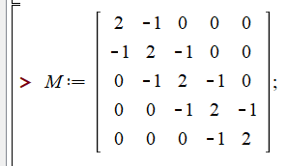
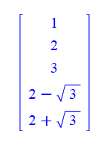
Notes:
Finding eigenvalues with Maple.

Slide 31
This example also has an algebraic solution --
Is this treatment cheating?
Yes.
No cheating, but we are not done.
Notes:
Analytic methods for this highly symmetric case.

Slide 32
Notes:
Setting the boundary values.

Slide 33
Notes:
Boundary conditions continued.

Slide 34
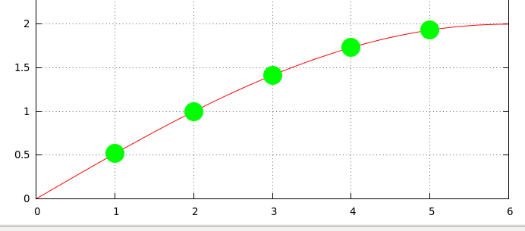
Notes:
Plot of the results.

