Slide 1
PHY 711 Classical Mechanics and Mathematical Methods
10-10:50 AM MWF online or (occasionally) in Olin 103
Discussion for Lecture 17: Chap. 4 (F&W)
Normal Mode Analysis
Short digression on singular value decomposition
Normal modes for extended one-dimensional systems (correcting some errors in previous slides)
Normal modes for 2 and 3 dimensional systems
Notes:
In this lecture, we will extend our normal mode analysis to more complicated systems, including infinite periodic systems and beyond one dimension.

Slide 3
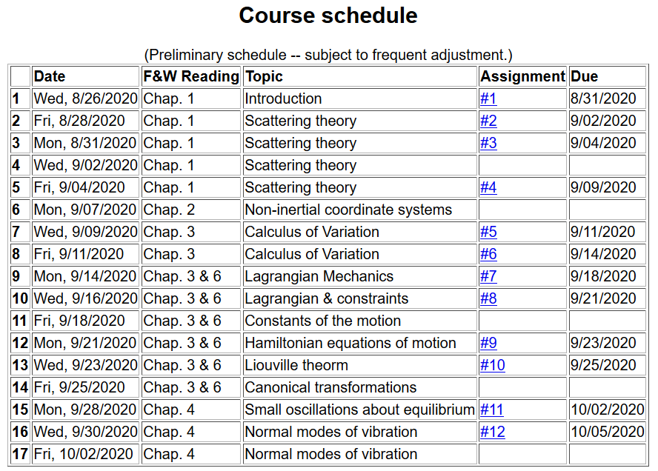
Notes:
Updated schedule. This is the last lecture for Chap. 4. On Monday we will continue to discuss vibrations in extended one dimensional motion as covered in Chap. 7.

Slide 4
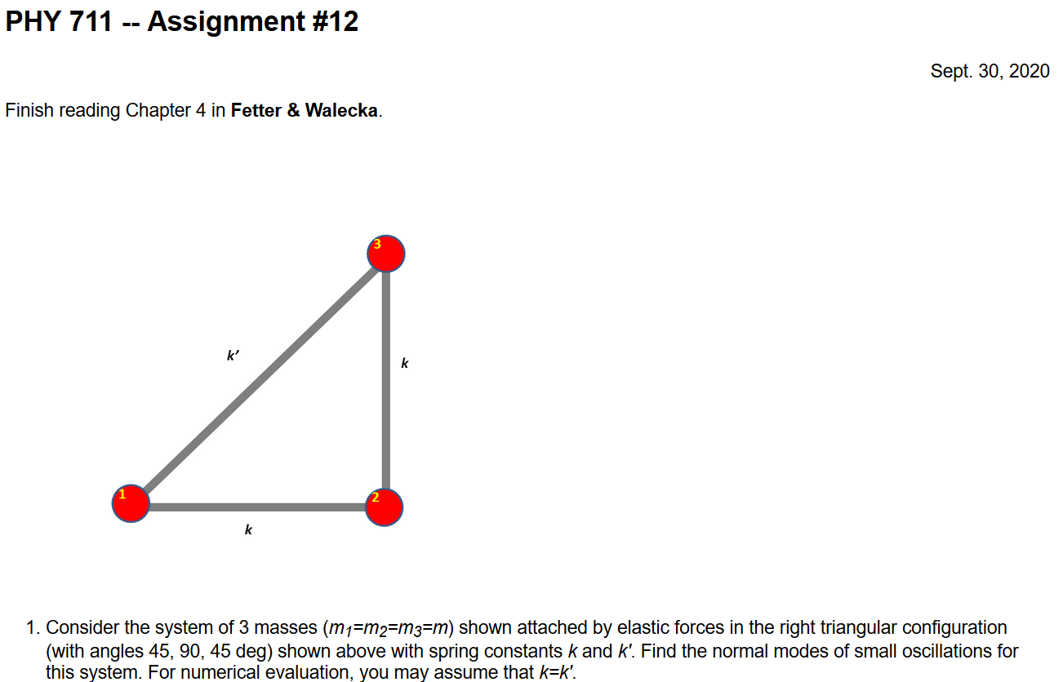
Notes:
Homework due Monday.

Slide 5
Schedule for weekly one-on-one meetings
Nick – 11 AM Monday (ED/ST)
Tim – 9 AM Tuesday
Bamidele – 7 PM Tuesday
Zhi– 9 PM Tuesday
Jeanette – 11 AM Wednesday
Derek – 12 PM Friday

Slide 6
Your questions –
From Tim
Do the number of spring constants k, determine the number of normal modes of a system?
What is the meaning of q-space?
From Nick
Why can we reduce the infinite problem to 2D? Are we suggesting, since we're alternating between m and M, that the motion for any two consecutive sets of m and M is the same?
I think the Taylor expansion in 2-D makes sense with that cross term but what does it look like in 3-D?

Slide 7
Additional digression on matrix properties
Singular value decomposition
Notes:
Digression from linear algebra omitted from Wednesday’s lecture.

Slide 8
Singular value decomposition -- continued
Details are complicated ….
Your question -- what's all the fuss about singular values? What's their importance relative to eigenvalues?
Comment – I would like to see a bigger fuss. SVD is different from eigenvalue analysis and more broadly applicable. At a minimum SVD analysis identifies mathematically poorly posed problems and offers a “fix”.
Notes:
Introducing the concept of SVD without going into detail.

Slide 9
Example – linear molecule
m₁
m₂
m₃
Notes:
Back to the discussion of one-dimensional motion of masses and springs.

Slide 10
Notes:
More review.

Slide 11
m₁
m₂
m₃
m₁
m₂
m₃
m₁
m₂
m₃
Notes:
Reviewing results for example isolated molecule.

Slide 12
Consider an extended system of masses and springs:
m
m
m
Notes:
Example of one dimensional system with fixed boundary values.

Slide 13
Notes:
Review of detailed equations.

Slide 14
Notes:
Review of solutions discussed on Wednesday.

Slide 15
Notes:
Review of boundary conditions.

Slide 17
Notes:
Review of full solution.

Slide 18
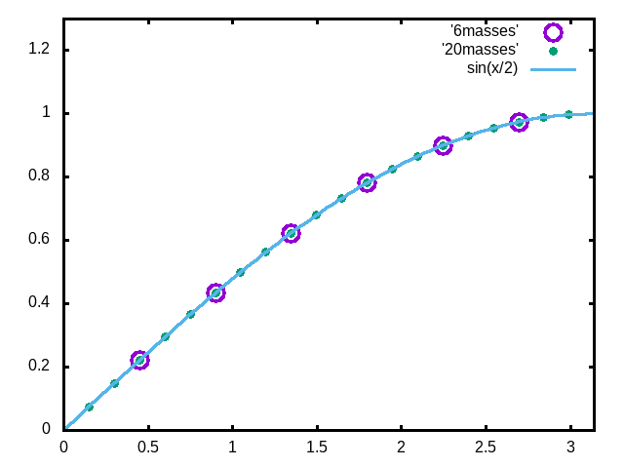
Examples
Note that solution form remains correct for N→∞
Notes:
Plot for example. Now consider the case where N is very large.

Slide 19
Your question -- What is the meaning of q-space?
Comment – We have seen that for N masses, there are N “normal” modes. So if we imagine that N grows to infinity we should have an infinite number of modes. The parameter q allows us to “count” the infinite number of modes in a convenient way.
From previous slide –
remains consistent as N→∞
Your question -- Do the number of spring constants k, determine the number of normal modes of a system?
Comment – While the spring constants certainly affect the normal modes, the number of modes is typically dN, where d is the dimension and N is the number of masses.

Slide 20
For extended chain without boundaries:
m
m
…
…
m
Note that we are assuming that all masses and springs are identical here.
Notes:
Now consider the case where N is infinite so that there are an infinite number of solutions parameterized by qa as a continuous varable.

Slide 21
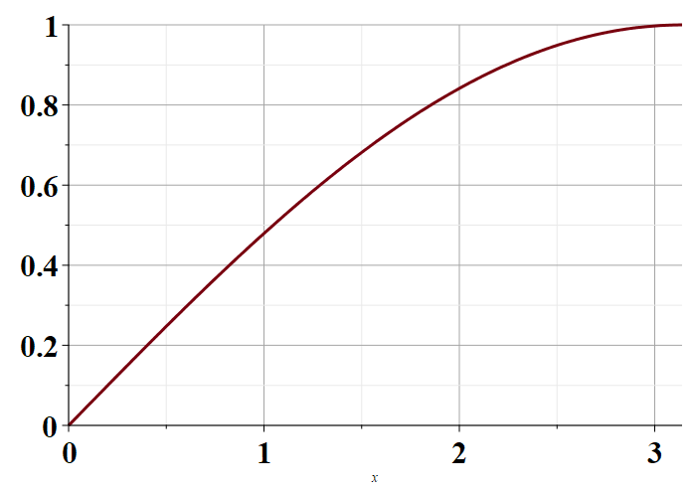
Notes:
Distinct solutions occur for qa in the range of 0-pi as shown in the plot.

Slide 22
Consider an infinite system of masses and springs now with two kinds of masses:
m
M
m
M
m
m
Because the masses are different, we cannot yet know how their displacements might be related.
Notes:
Now consider a slight modification of the previous example where masses are alternately m and M with labels x and y.

Slide 23
Note that 2qa is an unknown parameter.
Notes:
In this case, we can analyze the system by considering different amplitudes for the m and M masses. The resulting coupled equations can be written in matrix form.

Slide 24
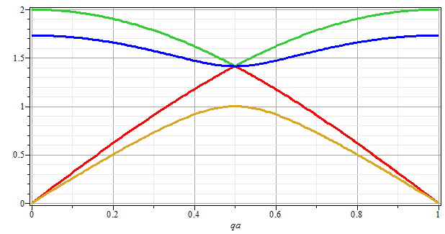
Note that for m=M, we obtain the same normal modes as before. Is this reassuring?
No
Yes
ω
qa/π
Notes:
Plotting the solutions for the frequencies as a function of qa.

Slide 25
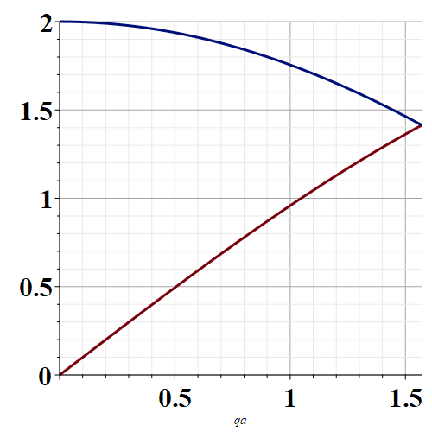
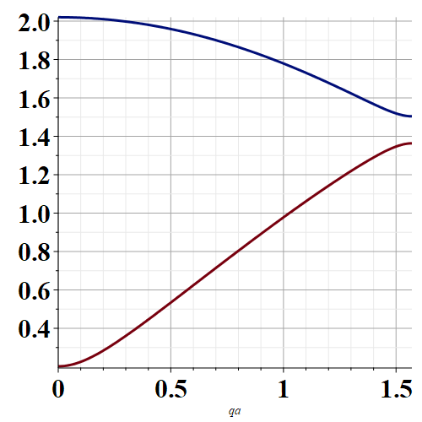
Note that for every qa, there are 2 modes.
m=M
m≠M
qa
qa

Slide 26
Eigenvectors:
Notes:
Some details about the solutions.

Slide 27
Potential in 2 and more dimensions
V(x,y)
Notes:
Returning to the finite systems, consider equilibria in two dimensions as shown.

Slide 28
Example – normal modes of a system with the symmetry of an equilateral triangle
3
u₃
m
k
k
u₂
1
2
u₁
k
m
m
Notes:
Specifically, we will consider 3 masses in an equilateral triangle configuration as shown.

Slide 29
Example – normal modes of a system with the symmetry of an equilateral triangle -- continued
3
u₃
u₂
1
2
u₁
Notes:
We need to consider displacements from equilibrium in the x-y plane. Keeping only linear terms in the displacements we wind up with a simple relationship to analyze.

Slide 30
Note that this analysis of the leading term is true in 1, 2, and 3 dimensions.

Slide 31
Example – normal modes of a system with the symmetry of an equilateral triangle -- continued
3
u₃
u₂
1
2
u₁
Notes:
We need to consider displacements from equilibrium in the x-y plane. Keeping only linear terms in the displacements we wind up with a simple relationship to analyze.

Slide 32
Example – normal modes of a system with the symmetry of an equilateral triangle -- continued
Notes:
Analyzing the 3 displacements for the equilateral triangle geometry, we find these equations.

Slide 33
Example – normal modes of a system with the symmetry of an equilateral triangle -- continued
= ω²
Notes:
The results is a 6x6 matrix problem to find eigenvalues and eigenvectors.

Slide 34
Example – normal modes of a system with the symmetry of an equilateral triangle -- continued
With help from Maple
3
u₃
m
k
k
u₂
1
2
u₁
k
m
m
Notes:
Results from Maple. We have 6 eigenvalues and 3 non-zero modes for this case.

Slide 35
3
u₃
What can you say about the 3 zero frequency modes?
m
k
k
u₂
1
2
u₁
k
m
m

Slide 36
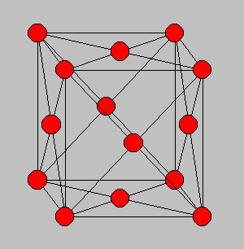
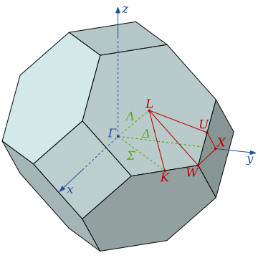
3-dimensional periodic lattices
Example – face-centered-cubic unit cell (Al or Ni)
Diagram of atom positions
Diagram of q-space ν(q)
Notes:
Interesting extensions to a 3-dimensional crystalline system.

Slide 37
From: PRB 59 3395 (1999); Mishin et. al. ν(q)
Notes:
Results of normal modes from experiment and simulations for face centered cubic Al (left) and Ni (right). Interestingly, the phonon frequency patterns are similar for these very different materials.

Slide 38
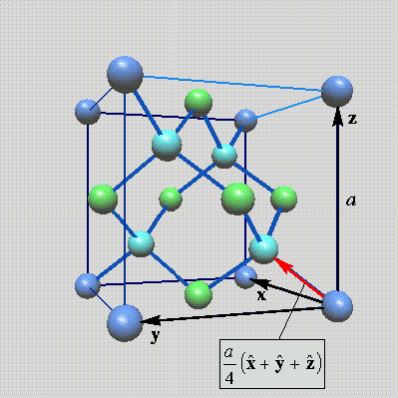
Lattice vibrations for 3-dimensional lattice
Example: diamond lattice
Ref: http://phycomp.technion.ac.il/~nika/diamond_structure.html
Notes:
Another example – diamond.

Slide 39
Notes:
Some equations for extended systems.

Slide 40
Notes:
More euqations.

Slide 41
Notes:
More equations.

Slide 42
B. P. Pandy and B. Dayal, J. Phys. C. Solid State Phys. 6 2943 (1973)
Notes:
Results for diamond from simulation and experiment.

