Slide 1
PHY 711 Classical Mechanics and Mathematical Methods
10-10:50 AM MWF online or (occasionally) in Olin 103
Plan for Lecture 17: Chap. 4 (F&W)
Normal Mode Analysis
Short digression on singular value decomposition
Normal modes for extended one-dimensional systems
Normal modes for 2 and 3 dimensional systems
Notes:
In this lecture, we will extend our normal mode analysis to more complicated systems, including infinite periodic systems and beyond one dimension.

Slide 2
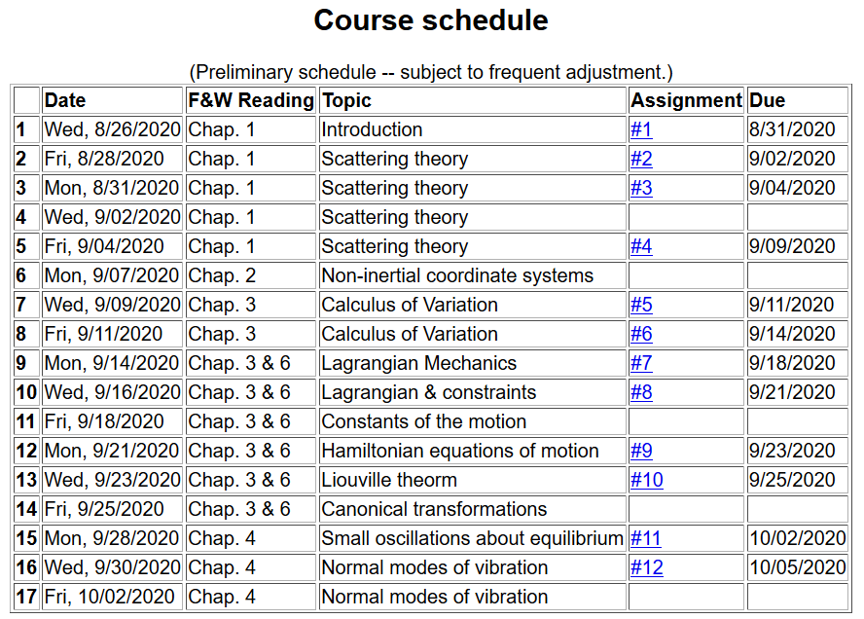
Notes:
Updated schedule. This is the last lecture for Chap. 4. On Monday we will continue to discuss vibrations in extended one dimensional motion as covered in Chap. 7.

Slide 3
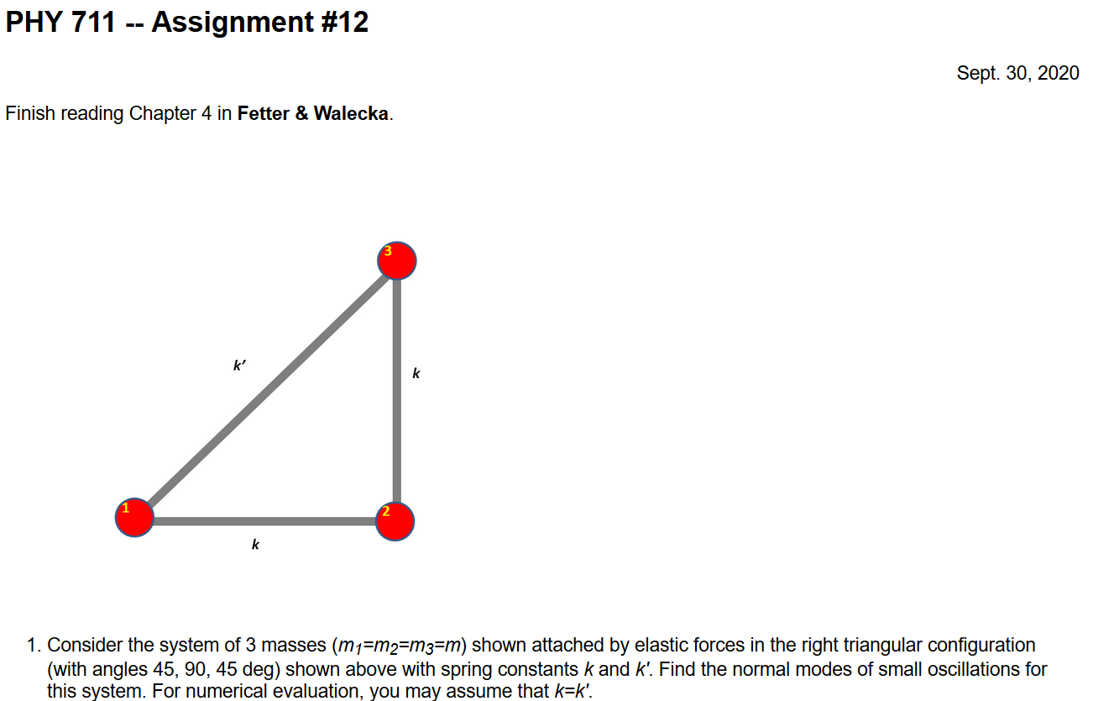
Notes:
Homework due Monday.

Slide 4
Additional digression on matrix properties
Singular value decomposition
Notes:
Digression from linear algebra omitted from Wednesday’s lecture.

Slide 5
Singular value decomposition -- continued
Details are complicated ….
Your question -- what's all the fuss about singular values? What's their importance relative to eigenvalues?
Comment – I would like to see a bigger fuss. SVD is different from eigenvalue analysis and more broadly applicable. At a minimum SVD analysis identifies mathematically poorly posed problems and offers a “fix”.
Notes:
Introducing the concept of SVD without going into detail.

Slide 6
Example – linear molecule
m₁
m₂
m₃
Notes:
Back to the discussion of one-dimensional motion of masses and springs.

Slide 7
Notes:
More review.

Slide 8
m₁
m₂
m₃
m₁
m₂
m₃
m₁
m₂
m₃
Notes:
Reviewing results for example isolated molecule.

Slide 9
Consider an extended system of masses and springs:
m
m
m
Notes:
Example of one dimensional system with fixed boundary values.

Slide 10
Notes:
Review of detailed equations.

Slide 11
Notes:
Review of solutions discussed on Wednesday.

Slide 12
Notes:
Review of boundary conditions.

Slide 14
Notes:
Review of full solution.

Slide 15
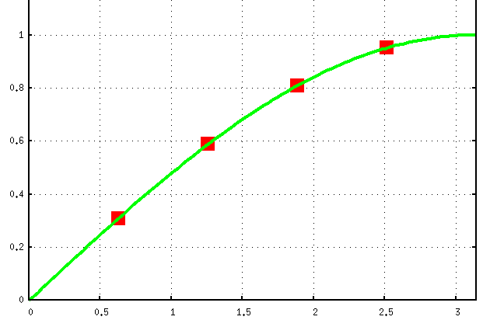
Example for N=4:
Note that solution form remains correct for N→∞
Notes:
Plot for example. Now consider the case where N is very large.

Slide 16
For extended chain without boundaries:
m
m
…
…
m
Notes:
Now consider the case where N is infinite so that there are an infinite number of solutions parameterized by qa as a continuous varable.

Slide 17
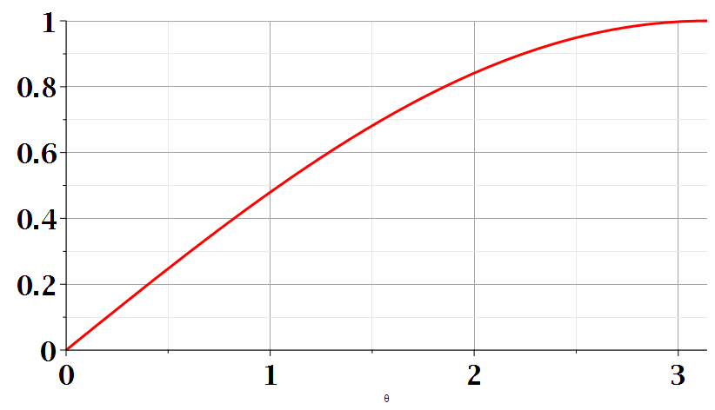
Notes:
Distinct solutions occur for qa in the range of 0-pi as shown in the plot.

Slide 18
Consider an infinite system of masses and springs now with two kinds of masses:
m
M
m
M
m
m
Notes:
Now consider a slight modification of the previous example where masses are alternately m and M with labels x and y.

Slide 19
Notes:
In this case, we can analyze the system by considering different amplitudes for the m and M masses. The resulting coupled equations can be written in matrix form.

Slide 20
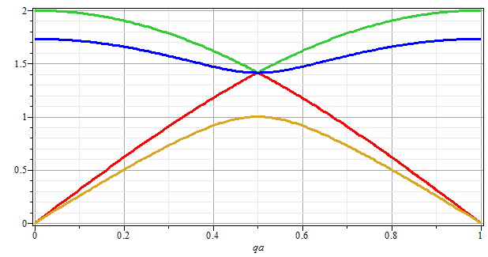
ω
qa/π
Notes:
Plotting the solutions for the frequencies as a function of qa.

Slide 21
Eigenvectors:
Notes:
Some details about the solutions.

Slide 22
Potential in 2 and more dimensions
V(x,y)
Notes:
Returning to the finite systems, consider equilibria in two dimensions as shown.

Slide 23
Example – normal modes of a system with the symmetry of an equilateral triangle
3
u₃
m
k
k
u₂
1
2
u₁
k
m
m
Notes:
Specifically, we will consider 3 masses in an equilateral triangle configuration as shown.

Slide 24
Example – normal modes of a system with the symmetry of an equilateral triangle -- continued
3
u₃
u₂
1
2
u₁
Notes:
We need to consider displacements from equilibrium in the x-y plane. Keeping only linear terms in the displacements we wind up with a simple relationship to analyze.

Slide 25
Example – normal modes of a system with the symmetry of an equilateral triangle -- continued
Notes:
Analyzing the 3 displacements for the equilateral triangle geometry, we find these equations.

Slide 26
Example – normal modes of a system with the symmetry of an equilateral triangle -- continued
= ω²
Notes:
The results is a 6x6 matrix problem to find eigenvalues and eigenvectors.

Slide 27
Example – normal modes of a system with the symmetry of an equilateral triangle -- continued
3
u₃
m
k
k
u₂
1
2
u₁
k
m
m
Notes:
Results from Maple. We have 6 eigenvalues and 3 non-zero modes for this case.

Slide 28
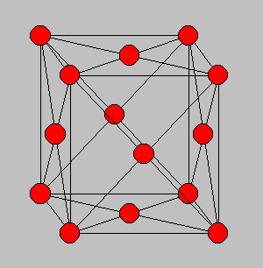
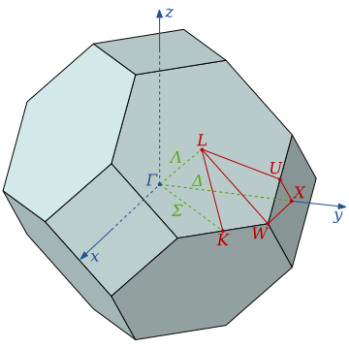
3-dimensional periodic lattices
Example – face-centered-cubic unit cell (Al or Ni)
Diagram of atom positions
Diagram of q-space ν(q)
Notes:
Interesting extensions to a 3-dimensional crystalline system.

Slide 29
From: PRB 59 3395 (1999); Mishin et. al. ν(q)
Notes:
Results of normal modes from experiment and simulations for face centered cubic Al (left) and Ni (right). Interestingly, the phonon frequency patterns are similar for these very different materials.

Slide 30
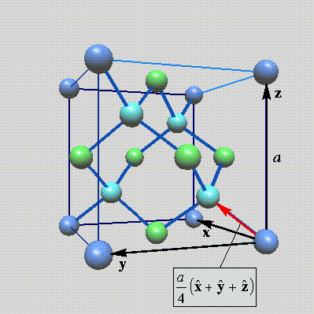
Lattice vibrations for 3-dimensional lattice
Example: diamond lattice
Ref: http://phycomp.technion.ac.il/~nika/diamond_structure.html
Notes:
Another example – diamond.

Slide 31
Notes:
Some equations for extended systems.

Slide 32
Notes:
More euqations.

Slide 33
Notes:
More equations.

Slide 34
B. P. Pandy and B. Dayal, J. Phys. C. Solid State Phys. 6 2943 (1973)
Notes:
Results for diamond from simulation and experiment.

