Slide 1
PHY 711 Classical Mechanics and Mathematical Methods
10-10:50 AM MWF online or (occasionally) in Olin 103
Discussion for Lecture 18: Chap. 7 (F&W)
Mechanical motion of a continuous string
Masses coupled by springs ⬅➔masses coupled by string
Mechanics one-dimensional continuous system
The wave equation
Comments on linear vs. non-linear equations
Notes:
The one dimensional motion of a large number masses interconnected with springs provides a model of longitudinal motions of a continuous elastic spring and related topics covered in Chapter 7 of your textbook

Slide 2
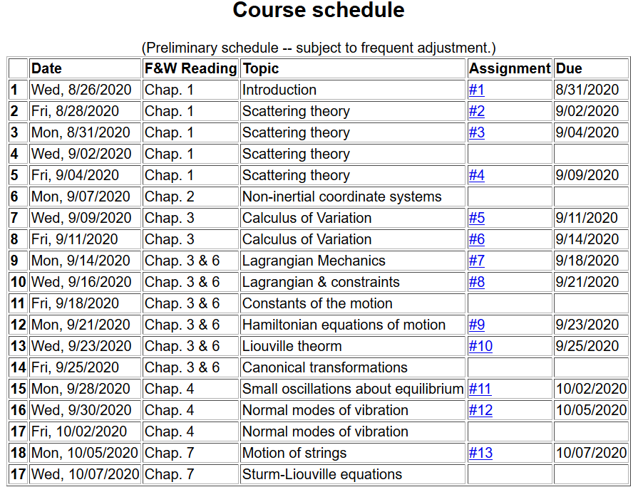
Notes:
Start reading Chapter 7. The homework problem concerns one dimensional wave motion using methods discussed in this lecture.

Slide 3
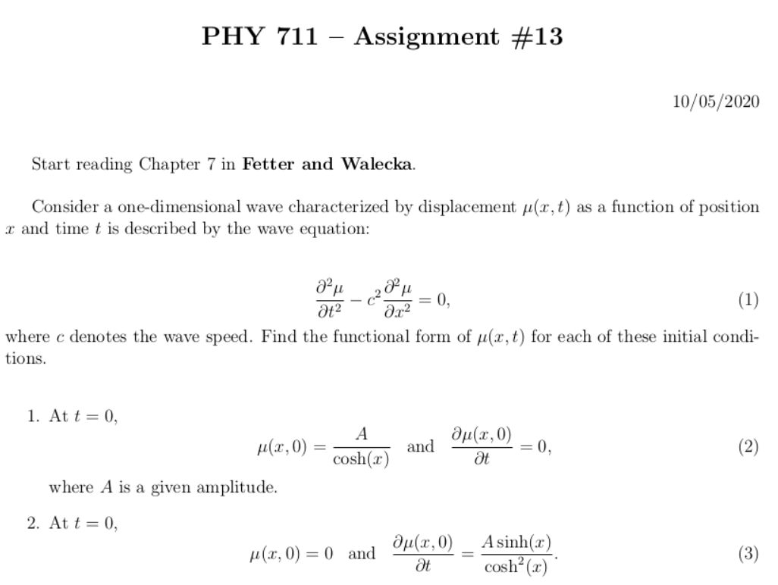
Notes:
Homework problem is due Wednesday.

Slide 4
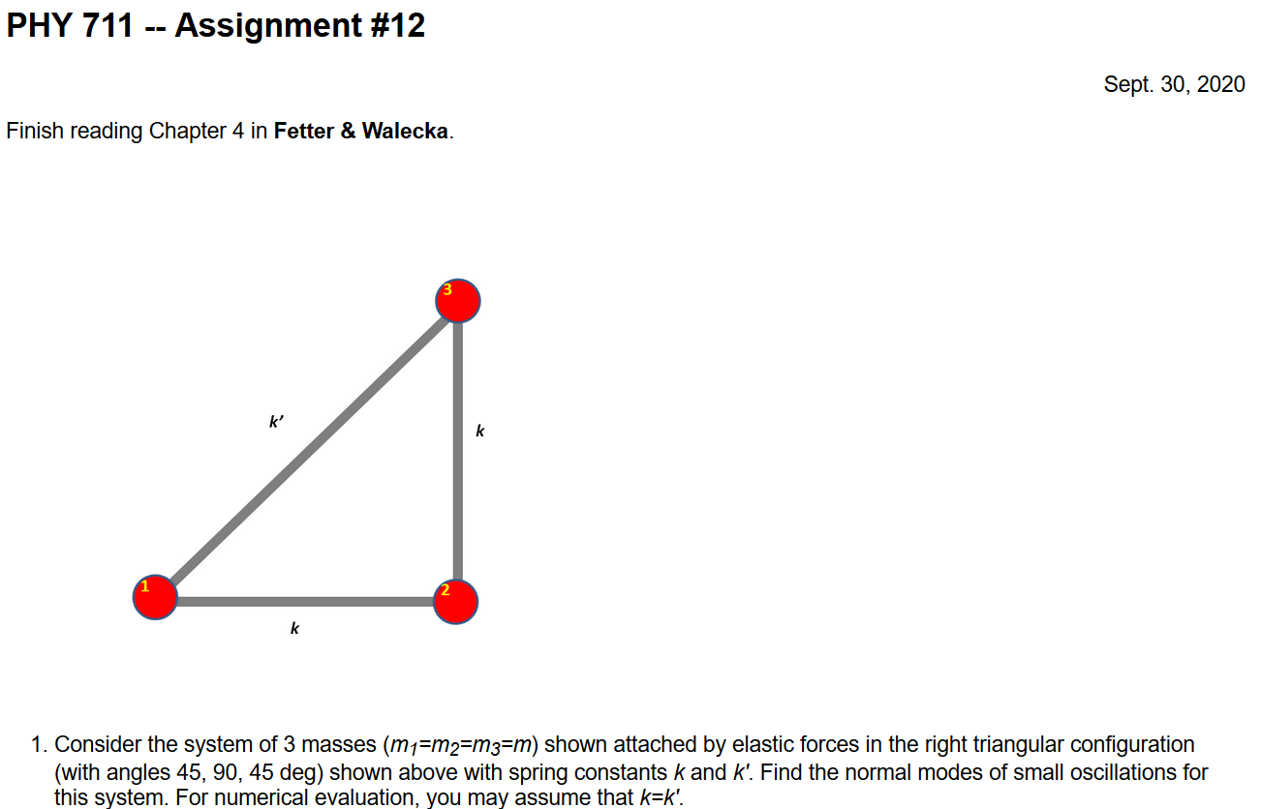
Comment about Assignment #12 due today.
Please set up the 6x6 matrix and solve for the eigenvalues using Maple, Mathematica, or Wolfram, or…??

Slide 5
Schedule for weekly one-on-one meetings
Nick – 11 AM Monday (ED/ST)
Tim – 9 AM Tuesday
Bamidele – 7 PM Tuesday
Zhi– 9 PM Tuesday
Jeanette – 11 AM Wednesday
Derek – 12 PM Friday

Slide 6
Your questions –
From Jeanette
On slide 6 - Is this saying that the system parameter doesn't simplify for the longitudinal case? By simplifying I mean it can be rewritten in other terms (like tension and mass/length for the transverse case). Does it only simplify in the transverse case?
From Gao
1. About lecture 18, we do not know Phi(x) and Psi(x), how can we solve U(x,0)? Or how can we get Phi(x) and Psi(x)?

Slide 7
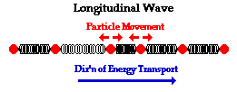
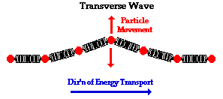
Continuum limit of masses and springs --
Longitudinal versus transverse vibrations
Images from web page:
http://www.physicsclassroom.com/class/waves/u10l1c.cfm
Notes:
Visualization (taken from the web) of wave motion, showing the difference between longitudinal and transverse waves.

Slide 8
Longitudinal case: a system of masses and springs:
m
m
m
Notes:
Showing how the case of the infinite mass and spring system approximates the continuous elastic string.

Slide 9
system parameter with units of (velocity)²
Notes:
Regrouping constants in terms of spring constant times increment of length and mass per unit length which combine to give a squared velocity for the longitudinal case. For the transverse case, string tension is involved.

Slide 10
More details

Slide 11
More details
Transverse case
τ₁
θ₁
y+Δy
θ₂
y
τ₂
x
x+Δx

Slide 12
Transverse displacement:
τ
μ(x,t)
Notes:
The diagram shows how the y component of the net tension contributes to the transverse motion.

Slide 13
Notes:
It is possible to adapt the Lagrangian formalism to this continuous system.

Slide 14
Notes:
The continuum version of the Euler-Lagrange equations result in the wave equation for this example.

Slide 15
Notes:
In the next several slides we will discuss solutions to the wave equation. Note that the one dimensional wave equation has some special properties.

Slide 16
These functions would be given
Notes:
This method by D’Alembert is based on the special property of the wave equation.

Slide 17
Notes:
D’Alembert’s method continued.

Slide 18
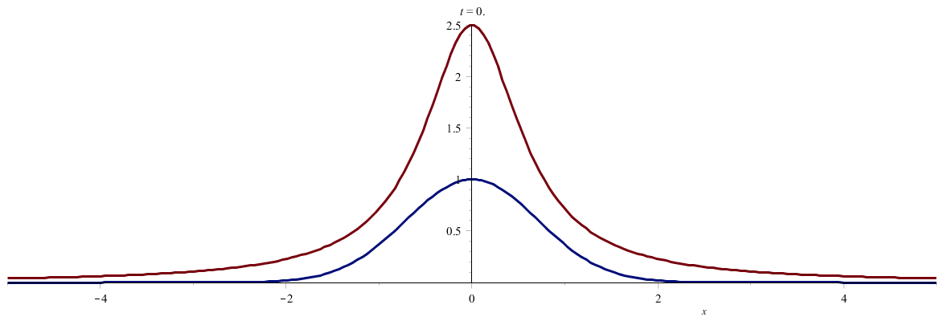
Notes:
An example. (Use slide show to see animation.)

Slide 19
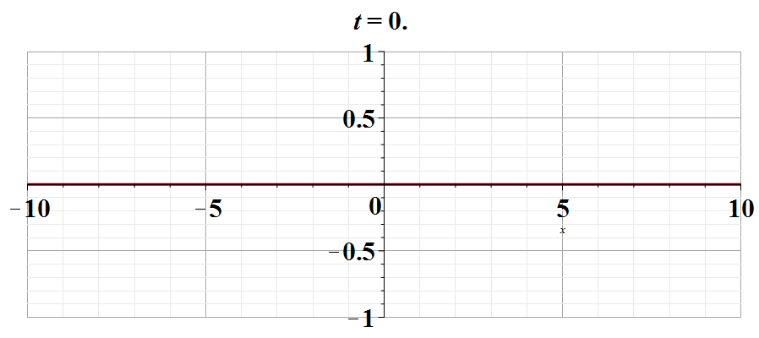
Notes:
Another example. Use slide show to see animation.

Slide 20
Notes:
Digression on the special properties of linear equations in contrast to complications for non-linear equations.

Slide 21
Notes:
An example of the effects of non-linearity.

Slide 22
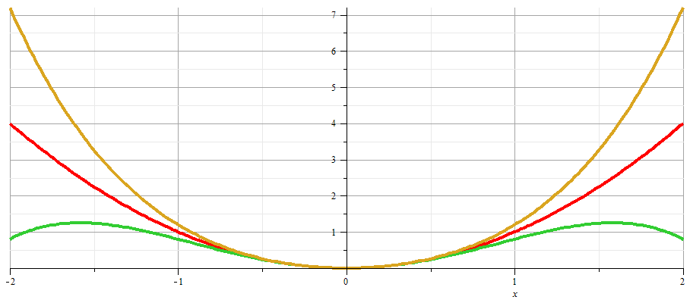
x
Notes:
Plot of nonlinear potentials.

Slide 23
Notes:
Approximate solution to example non-linear equation.

Slide 24
Notes:
Non-linear equation continued.

Slide 25
Notes:
More details.

Slide 26
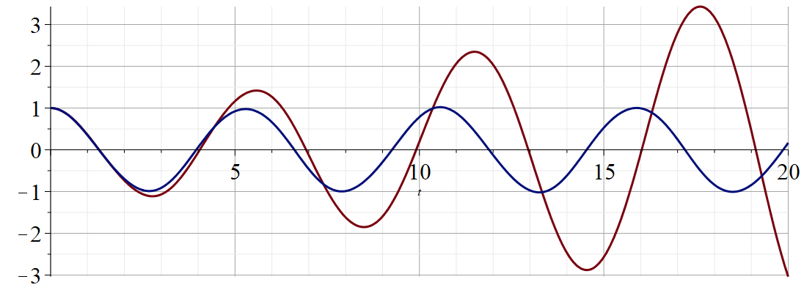
Regrouped expansion
x
t
Original perturbation expansion
Numerical solution according to Maple
Notes:
Plot of results.

