Slide 1
PHY 711 Classical Mechanics and Mathematical Methods
10-10:50 AM MWF online or (occasionally) in Olin 103
Plan for Lecture 18: Chap. 7 (F&W)
Mechanical motion of a continuous string
Masses coupled by springs ⬅➔masses coupled by string
Mechanics one-dimensional continuous system
The wave equation
Comments on linear vs. non-linear equations
Notes:
The one dimensional motion of a large number masses interconnected with springs provides a model of longitudinal motions of a continuous elastic spring and related topics covered in Chapter 7 of your textbook

Slide 2
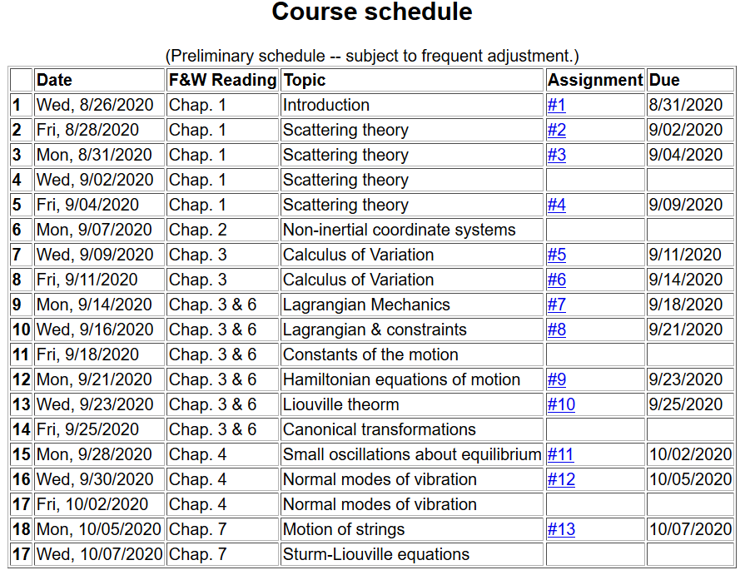
Notes:
Start reading Chapter 7. The homework problem concerns one dimensional wave motion using methods discussed in this lecture.

Slide 3
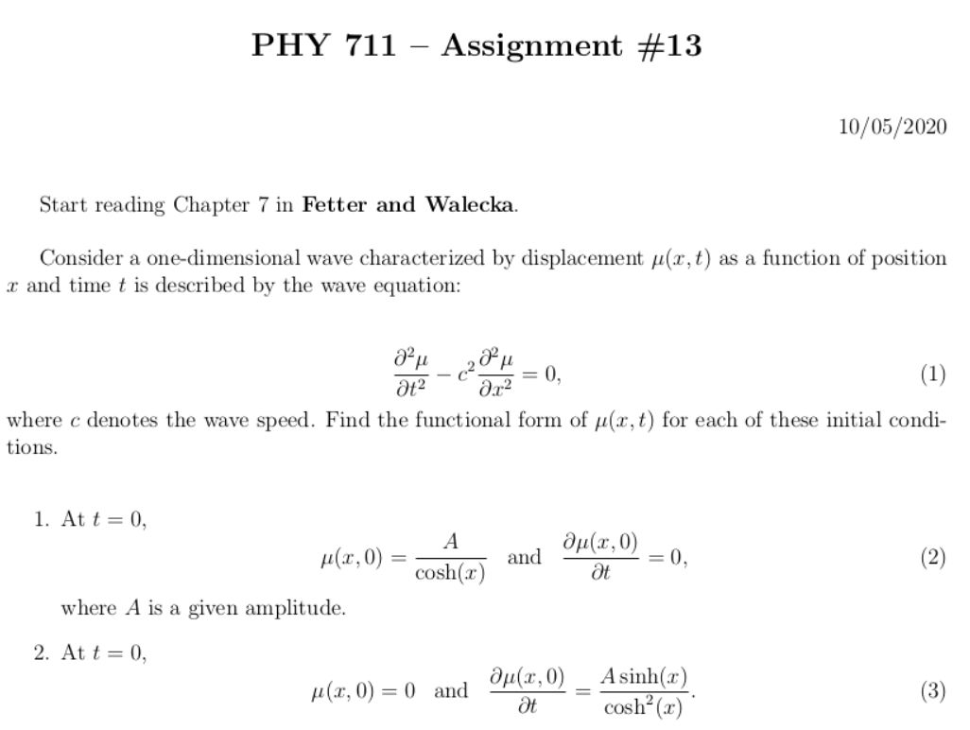
Notes:
Homework problem is due Wednesday.

Slide 4
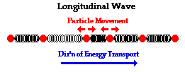
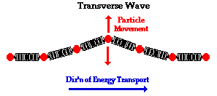
Continuum limit of masses and springs --
Longitudinal versus transverse vibrations
Images from web page:
http://www.physicsclassroom.com/class/waves/u10l1c.cfm
Notes:
Visualization (taken from the web) of wave motion, showing the difference between longitudinal and transverse waves.

Slide 5
Longitudinal case: a system of masses and springs:
m
m
m
Notes:
Showing how the case of the infinite mass and spring system approximates the continuous elastic string.

Slide 6
system parameter with units of (velocity)²
Notes:
Regrouping constants in terms of spring constant times increment of length and mass per unit length which combine to give a squared velocity for the longitudinal case. For the transverse case, string tension is involved.

Slide 7
Transverse displacement:
τ
μ(x,t)
Notes:
The diagram shows how the y component of the net tension contributes to the transverse motion.

Slide 8
Notes:
It is possible to adapt the Lagrangian formalism to this continuous system.

Slide 9
Notes:
The continuum version of the Euler-Lagrange equations result in the wave equation for this example.

Slide 10
Notes:
In the next several slides we will discuss solutions to the wave equation. Note that the one dimensional wave equation has some special properties.

Slide 11
Notes:
This method by D’Alembert is based on the special property of the wave equation.

Slide 12
Notes:
D’Alembert’s method continued.

Slide 13
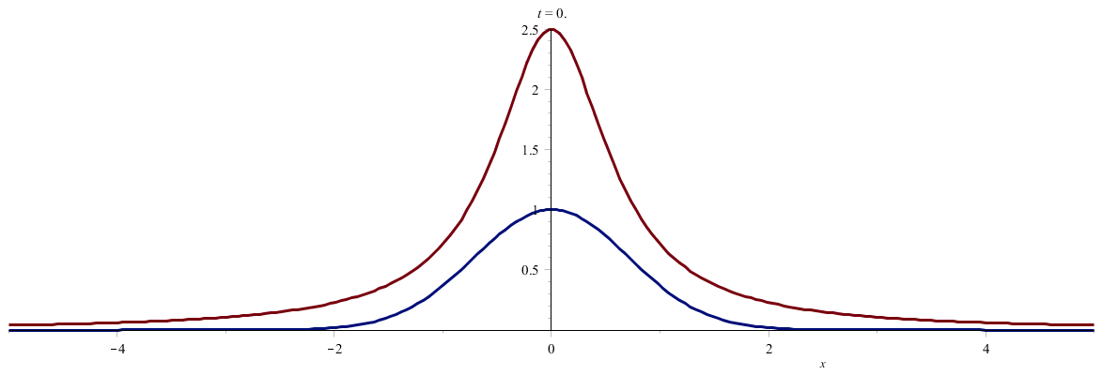
Notes:
An example. (Use slide show to see animation.)

Slide 14
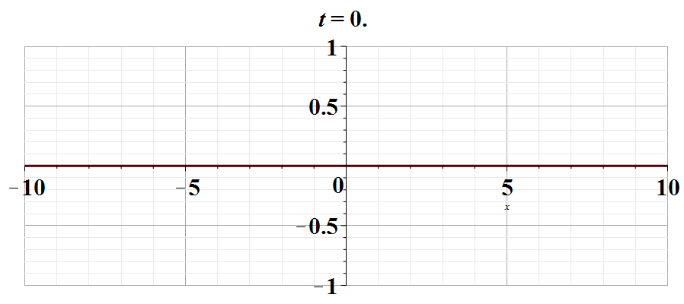
Notes:
Another example. Use slide show to see animation.

Slide 15
Notes:
Digression on the special properties of linear equations in contrast to complications for non-linear equations.

Slide 16
Notes:
An example of the effects of non-linearity.

Slide 17
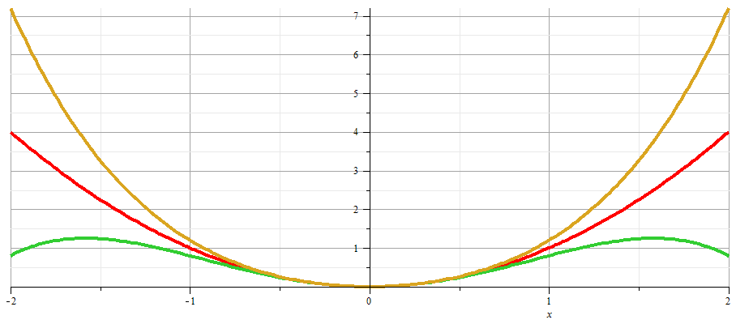
x
Notes:
Plot of nonlinear potentials.

Slide 18
Notes:
Approximate solution to example non-linear equation.

Slide 19
Notes:
Non-linear equation continued.

Slide 20
Notes:
More details.

Slide 21
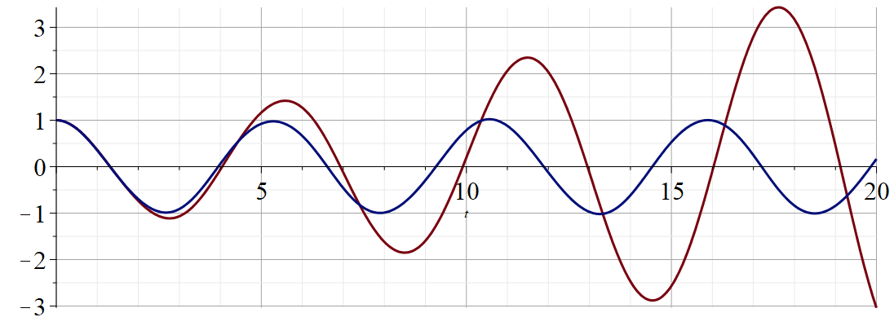
Regrouped expansion
x
t
Original perturbation expansion
Numerical solution according to Maple
Notes:
Plot of results.

