Slide 1
PHY 711 Classical Mechanics and Mathematical Methods
10-10:50 AM MWF online or (occasionally) in Olin 103
Discussion for Lecture 19 – Chap. 7 (F&W)
Solutions of differential equations
The wave equation
Sturm-Liouville equation
Green’s function solution methods
Notes:
In this lecture, we follow the textbook to use the example of the one-dimensional wave equation to discuss ordinary differential equations more generally and develop some solution methods.

Slide 2
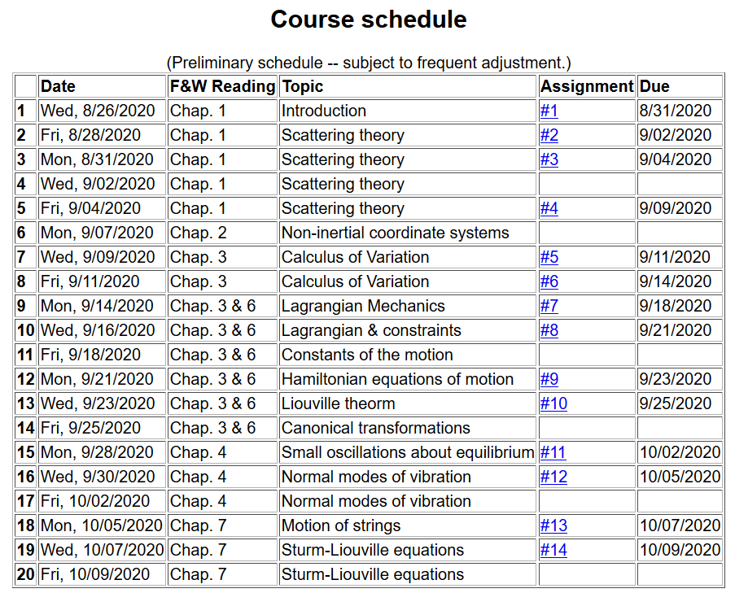
Notes:
The schedule continues to cover material in Chap. 7

Slide 3
Next week, it is likely that we will have a take home exam instead of homework.
Perhaps distributed Monday 10/12/2020
due Monday 10/19/2020
Notes:
Homework due Friday. Note the mid term take home scheduling.

Slide 4
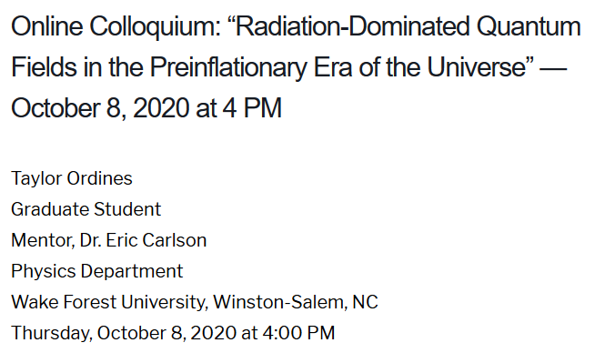
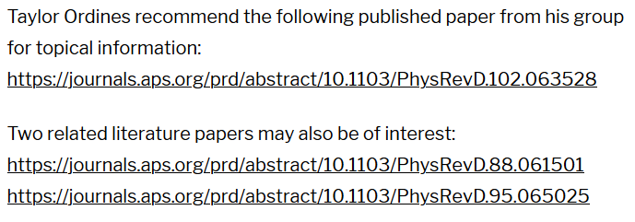
Physics Colloquium Thursday, October 8, 2020
Notes:
Colloquium this will take us out of this world. Taylor Ordines is a senior graduate student who is reporting on his project under the mentorship of Professor Eric Carlson.

Slide 5
Schedule for weekly one-on-one meetings
Nick – 11 AM Monday (ED/ST)
Tim – 9 AM Tuesday
Zhi– 9 PM Tuesday
Jeanette – 11 AM Wednesday
Derek – 4 PM Wednesday
Bamidele – 7 PM Thursday
Derek – 12 PM Friday?

Slide 6
Your questions
From Tim –
1. What does the extra potential energy density have to do with motion on a string?When you say an applied force, is that like plucking the string or somehow putting a force on the string?
From Nick –
Can you elaborate on slide 14. I think I’m missing something on how Cm minimizes eps^2.
From Gao –
1. In slide 14, is Cn expression from what transformation? Similar to Fourier transformation? Thank you.

Slide 7
One-dimensional wave equation
representing longitudinal or transverse displacements as a function of x and t , an example of a partial differential equation --
Notes:
Review of wave equation.

Slide 8
The wave equation and related linear PDE’s
Notes:
Generalization of the wave equation. Equations in this class are separable in the time variables and the spatial variable satisfies a generalized eigenvalue problem of this form.

Slide 9
Linear second-order ordinary differential equations
Sturm-Liouville equations
given functions
applied force
When applicable, it is assumed that the form of the applied force is known.
solution to be determined
Homogenous problem: F(x)=0
Notes:
We will sometimes want to generalize even further with an “inhomogeneous” term such as an applied force.

Slide 10
Your question -- What does the extra potential energy density have to do with motion on a string?
Comment – In my opinion, v(x) has nothing to do with motion on a spring, but F & W are using the one- dimensional wave equation to motivate a more general discussion of second order differential equations. In this lecture, we will briefly review/introduce many related ideas. These will be also (and perhaps more systematically) covered in PHY 712.

Slide 11
Examples of Sturm-Liouville eigenvalue equations --
Notes:
For now, we will focus on eigenvalues of the homogeneous equations.

Slide 12
Solution methods of Sturm-Liouville equations (assume all functions and constants are real):
Notes:
The eigenfunctions of these equations have very useful properties such as completeness.

Slide 13
Why all of the fuss about eigenvalues and eigenvectors?
They are always necessary for solving differential equations
Not all eigenfunctions have analytic forms.
It is possible to solve a differential equation without the use of eigenfunctions.
Eigenfunctions have some useful properties.

Slide 14
Comment on orthogonality of eigenfunctions
Notes:
Orthogonality of eigenfunctions.

Slide 15
Comment on orthogonality of eigenfunctions -- continued
Vanishes for various boundary conditions at x=a and x=b
Notes:
Orthogonality continued.

Slide 16
Comment on orthogonality of eigenfunctions -- continued
Notes:
Orthogonality continued.

Slide 17
Comment on “completeness”
It can be shown that for any reasonable function h(x), defined within the interval a < x <b, we can expand that function as a linear combination of the eigenfunctions f_{n}(x)
These ideas lead to the notion that the set of eigenfunctions f_{n}(x) form a ``complete'' set in the sense of ``spanning'' the space of all functions in the interval
a < x <b, as summarized by the statement:
Notes:
Notion of completeness.

Slide 18
Comment on “completeness” -- continued
Notes:
Notion of completeness and practical applications.

Slide 19
Your question -- Can you elaborate on slide 14. I think I’m missing something on how Cm minimizes eps^2. Also -- In slide 14, is Cn expression from what transformation? Similar to Fourier transformation?
Comment – This could be similar to a Fourier transformation if the eigenfunctions f_{m}(x) were sinusoidal (a particular choice of the Sturm-Liouville form). About the minimization of epsilon^2 – solving for the 0 of the derivative of the expression is a necessary condition for finding a minimum.

Slide 20
Variation approximation to lowest eigenvalue
In general, there are several techniques to determine the eigenvalues λ_{n} and eigenfunctions f_{n}(x). When it is not possible to find the ``exact'' functions, there are several powerful approximation techniques. For example, the lowest eigenvalue can be approximated by minimizing the function
where is a variable function which satisfies the
correct boundary values. The ``proof'' of this inequality is
based on the notion that can in principle be expanded
in terms of the (unknown) exact eigenfunctions f_{n}(x):
where the coefficients C_{n} can be
assumed to be real.
Notes:
A very useful property of eigenfunctions related to homework problem

Slide 21
Estimation of the lowest eigenvalue – continued:
From the eigenfunction equation, we know that
It follows that:
Notes:
Proof of theorem continued.

Slide 22
Rayleigh-Ritz method of estimating the lowest eigenvalue
Notes:
Example of the Rayleigh Ritz method.

Slide 23
Green’s function solution methods -- note the following slides were note yet covered.
Recall:
Notes:
The following slides present solution methods for differential equations involving the use of eigenvalues.

Slide 24
Solution to inhomogeneous problem by using Green’s functions
Solution to homogeneous problem
Notes:
From a knowledge of the Green’s function we can find solutions of related inhomogeneous equations.

Slide 25
Example Sturm-Liouville problem:
Notes:
Example.

Slide 26
Notes:
Solution using eigenfunctions.

Slide 27
Notes:
Continued.

Slide 28
Notes:
In this case, the solution simplifies.

Slide 29
Notes:
Another method of finding a Green’s function.

Slide 30
General method of constructing Green’s functions using homogeneous solution
Notes:
Green’s function based on homogeneous solutions (not eigenfuntions).

Slide 31
Notes:
Some details.

Slide 32
Notes:
More details. To be continued.

