Slide 1
PHY 711 Classical Mechanics and Mathematical Methods
10-10:50 AM MWF online or (occasionally) in Olin 103
Plan for Lecture 19 – Chap. 7 (F&W)
Solutions of differential equations
The wave equation
Sturm-Liouville equation
Green’s function solution methods
Notes:
In this lecture, we follow the textbook to use the example of the one-dimensional wave equation to discuss ordinary differential equations more generally and develop some solution methods.

Slide 2
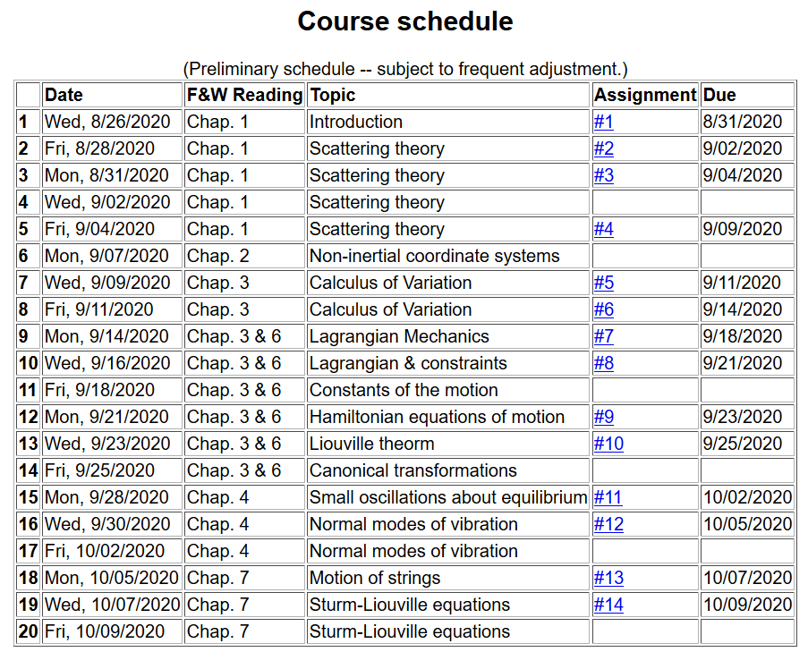
Notes:
The schedule continues to cover material in Chap. 7

Slide 3
Next week, it is likely that we will have a take home exam instead of homework.
Perhaps distributed Monday 10/12/2020
due Monday 10/19/2020
Notes:
Homework due Friday. Note the mid term take home scheduling.

Slide 4
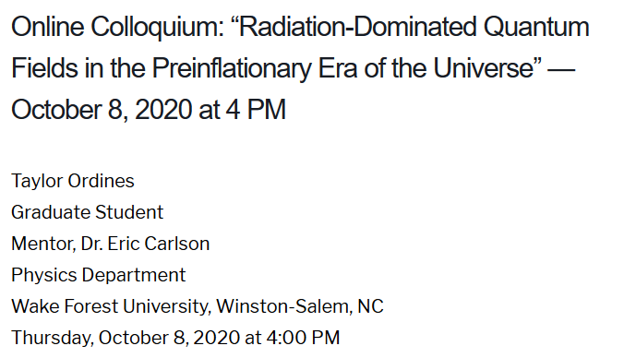
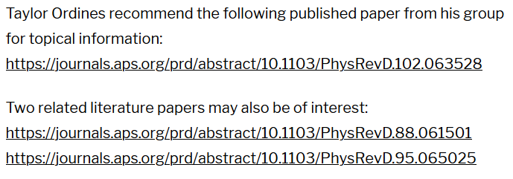
Physics Colloquium Thursday, October 8, 2020
Notes:
Colloquium this will take us out of this world. Taylor Ordines is a senior graduate student who is reporting on his project under the mentorship of Professor Eric Carlson.

Slide 5
One-dimensional wave equation
representing longitudinal or transverse displacements as a function of x and t , an example of a partial differential equation --
Notes:
Review of wave equation.

Slide 6
The wave equation and related linear PDE’s
Notes:
Generalization of the wave equation. Equations in this class are separable in the time variables and the spatial variable satisfies a generalized eigenvalue problem of this form.

Slide 7
Linear second-order ordinary differential equations
Sturm-Liouville equations
given functions
applied force
solution to be determined
Homogenous problem: F(x)=0
Notes:
We will sometimes want to generalize even further with an “inhomogeneous” term such as an applied force.

Slide 8
Examples of Sturm-Liouville eigenvalue equations --
Notes:
For now, we will focus on eigenvalues of the homogeneous equations.

Slide 9
Solution methods of Sturm-Liouville equations (assume all functions and constants are real):
Notes:
The eigenfunctions of these equations have very useful properties such as completeness.

Slide 10
Comment on orthogonality of eigenfunctions
Notes:
Orthogonality of eigenfunctions.

Slide 11
Comment on orthogonality of eigenfunctions -- continued
Vanishes for various boundary conditions at x=a and x=b
Notes:
Orthogonality continued.

Slide 12
Comment on orthogonality of eigenfunctions -- continued
Notes:
Orthogonality continued.

Slide 13
Comment on “completeness”
It can be shown that for any reasonable function h(x), defined within the interval a < x <b, we can expand that function as a linear combination of the eigenfunctions f_{n}(x)
These ideas lead to the notion that the set of eigenfunctions f_{n}(x) form a ``complete'' set in the sense of ``spanning'' the space of all functions in the interval
a < x <b, as summarized by the statement:
Notes:
Notion of completeness.

Slide 14
Comment on “completeness” -- continued
Notes:
Notion of completeness and practical applications.

Slide 15
Variation approximation to lowest eigenvalue
In general, there are several techniques to determine the eigenvalues λ_{n} and eigenfunctions f_{n}(x). When it is not possible to find the ``exact'' functions, there are several powerful approximation techniques. For example, the lowest eigenvalue can be approximated by minimizing the function
where is a variable function which satisfies the
correct boundary values. The ``proof'' of this inequality is
based on the notion that can in principle be expanded
in terms of the (unknown) exact eigenfunctions f_{n}(x):
where the coefficients C_{n} can be
assumed to be real.
Notes:
A very useful property of eigenfunctions related to homework problem

Slide 16
Estimation of the lowest eigenvalue – continued:
From the eigenfunction equation, we know that
It follows that:
Notes:
Proof of theorem continued.

Slide 17
Rayleigh-Ritz method of estimating the lowest eigenvalue
Notes:
Example of the Rayleigh Ritz method.

Slide 18
Green’s function solution methods
Recall:
Notes:
The following slides present solution methods for differential equations involving the use of eigenvalues.

Slide 19
Solution to inhomogeneous problem by using Green’s functions
Solution to homogeneous problem
Notes:
From a knowledge of the Green’s function we can find solutions of related inhomogeneous equations.

Slide 20
Example Sturm-Liouville problem:
Notes:
Example.

Slide 21
Notes:
Solution using eigenfunctions.

Slide 22
Notes:
Continued.

Slide 23
Notes:
In this case, the solution simplifies.

Slide 24
Notes:
Another method of finding a Green’s function.

Slide 25
General method of constructing Green’s functions using homogeneous solution
Notes:
Green’s function based on homogeneous solutions (not eigenfuntions).

Slide 26
Notes:
Some details.

Slide 27
Notes:
More details. To be continued.

