Slide 1
PHY 711 Classical Mechanics and Mathematical Methods
10-10:50 AM MWF online or (occasionally) in Olin 103
Discussion for Lecture 20 – Chap. 7 (F&W)
Solutions of differential equations
Green’s function solution methods based on eigenfunction expansions
Green’s function solution methods based on solutions of the homogeneous equations
Notes:
In this lecture, we will continue our discussion of one dimensional ordinary differential equations.

Slide 2
Schedule for weekly one-on-one meetings
Nick – 11 AM Monday (ED/ST)
Tim – 9 AM Tuesday
Bamidele – 7 PM Tuesday
Zhi– 9 PM Tuesday
Jeanette – 11 AM Wednesday
Derek – 12 PM Friday?

Slide 3
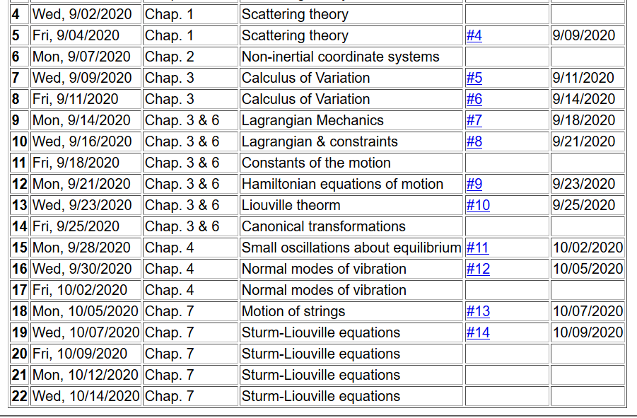
Notes:
The schedule continues to cover material in Chap. 7

Slide 4
Plan for next week. Take home exam will be available on Monday 10/12/2020 and due Monday 10/19/2020. It is an open book/open note exam. According to the honor code, it must be your own work. You may consult with me, but NO ONE ELSE. The problems are likely to be similar to those you have had for homework. The synchronous lectures will continue through this period, but no additional homework will be assigned.
Notes:
Comment on take home exam for next week.

Slide 5
Your questions –
From Tim –
I used three different test functions for Assignment 14 and only one worked out. Is it not guaranteed that the Raleigh-Ritz estimate will always be greater than the smallest eigenvalue?
On slide 17, what is the homogeneous equation psi_0(x)?
From Nick –
For tomorrow there are a few steps where I'm having trouble connecting the dots. How do we arrive at the formal solution on slide 11?
I'm also not following how we arrive at the solution for G on slide 13.
Lastly, what's the motivation behind a Green's function, is it just putting all the weight on the forcing term?
From Zhi –
In slide 4 what's the difference between the solution to homogeneous function and eigenfunctions?
And in slide 11 how the formal solution comes out?

Slide 6
Review – Sturm-Liouville equations defined over a range of x.
Note that, because Sturm-Liouville operator is Hermitian, the eigenvalues are real and the eigenfunctions are orthogonal. In the last lecture, we argued that the eigenfunctions form a “complete” set over the range of x defined for the particular system.
Notes:
Review of the class problems considered.

Slide 7
Your question -- In slide 4 what's the difference between the solution to homogeneous function and eigenfunctions?
Note that for the homogeneous equation l is fixed (known) and can be 0. For the eigenfunction equations the eigenvalues λ_{n} and eigenfunctions f_{n} need to be determined.

Slide 8
Eigenvalues and eigenfunctions of Sturm-Liouville equations
Notes:
General properties.

Slide 9
Variation approximation to lowest eigenvalue
In general, there are several techniques to determine the eigenvalues λ_{n} and eigenfunctions f_{n}(x). When it is not possible to find the ``exact'' functions, there are several powerful approximation techniques. For example, the lowest eigenvalue can be approximated by minimizing the function
where is a variable function which satisfies the
correct boundary values. The ``proof'' of this inequality is
based on the notion that can in principle be expanded
in terms of the (unknown) exact eigenfunctions f_{n}(x):
where the coefficients C_{n} can be
assumed to be real.
Notes:
Comment on the Raleigh-Ritz approximation for the lowest eigenvalues.

Slide 10
Estimation of the lowest eigenvalue – continued:
From the eigenfunction equation, we know that
It follows that:
Notes:
Proof of the Rayleigh-Ritz theorem.

Slide 11
Rayleigh-Ritz method of estimating the lowest eigenvalue
Notes:
Review of example from last lecture.

Slide 12
Your question – I used three different test functions for Assignment 14 and only one worked out. Is it not guaranteed that the Raleigh-Ritz estimate will always be greater than the smallest eigenvalue?
Comment – The proof is compelling. I am now thinking that the problem is not as well posed as it should be. Nick pointed out that the lowest eigenvalue is 0 for a constant function. In order to get the next eigenvalue of pi^2, you need to modify the method to choose functions orthogonal to the lowest eigenfunction.

Slide 13
Rayleigh-Ritz method of estimating the lowest eigenvalue
Another example – this time with a variable parameter
Notes:
Another example.

Slide 14
Recap -- Rayleigh-Ritz method of estimating the lowest eigenvalue
Exact answer
Do you think that there is a reason for getting the correct answer from this method?
Chance only
Skill
Notes:
In this case, the minimization process yield’s the exact answer.

Slide 15
Solution to inhomogeneous problem by using Green’s functions
Solution to homogeneous problem
Notes:
From a knowledge of the Green’s function we can find solutions of related inhomogeneous equations.

Slide 16
Solution to homogeneous problem
Your question -- On slide 17, what is the homogeneous equation psi_0(x)?
In this lecture, we will discuss several methods of finding this Green’s function. This topic will also
appear in PHY 712

Slide 17
Your question -- How do we arrive at the formal solution on slide 11?

Slide 18
Recall:
By construction
Notes:
The following slides present solution methods for differential equations involving the use of eigenvalues.

Slide 19
Example Sturm-Liouville problem:
Notes:
Example.

Slide 20
Notes:
Solution using eigenfunctions appropriate for this example.

Slide 21
Notes:
Continued.

Slide 22
Notes:
In this case, the solution simplifies.

Slide 23
Hurray! Same as before.
Notes:
Another method of finding a Green’s function.

Slide 24
More details on the general method of constructing Green’s functions using homogeneous solution
Notes:
Green’s function based on homogeneous solutions (not eigenfuntions).

Slide 25
Notes:
Some details.

Slide 26
Note that the integral has to be performed in two parts. While the eigenfunction expansion method can be generalized to 2 and 3 dimensions, this method only works for one dimension.
Notes:
More details.

Slide 27
Notes:
Another example, this time taken from electrostatics.

Slide 28
Notes:
Solutions for a particular charge distribution.

Slide 29
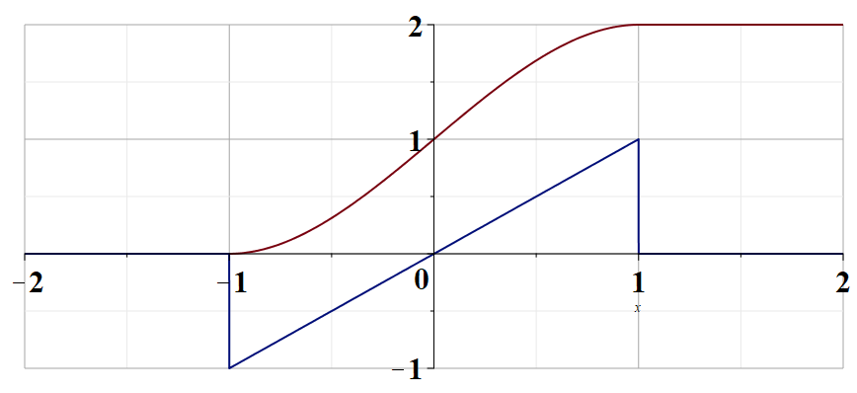
Notes:
Plot of the change distribution and of the electrostatic potential.

