Slide 1
PHY 711 Classical Mechanics and Mathematical Methods
10-10:50 AM MWF online or (occasionally) in Olin 103
Plan for Lecture 20 – Chap. 7 (F&W)
Solutions of differential equations
Green’s function solution methods based on eigenfunction expansions
Green’s function solution methods based on solutions of the homogeneous equations
Notes:
In this lecture, we will continue our discussion of one dimensional ordinary differential equations.

Slide 2
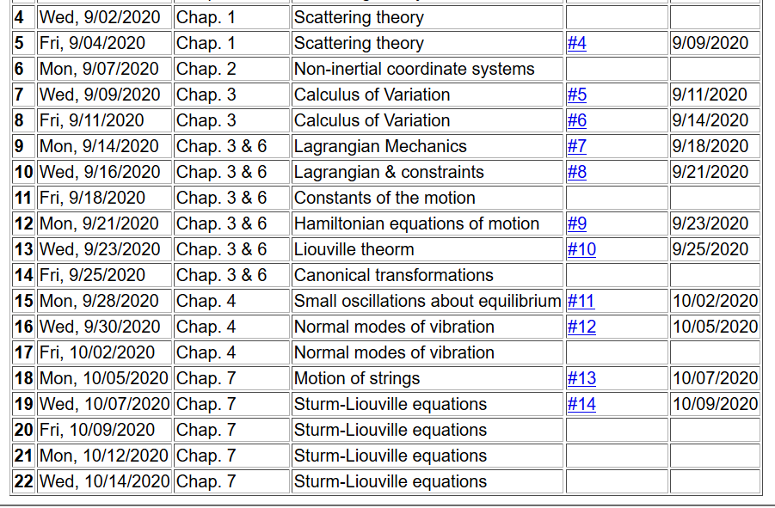
Notes:
The schedule continues to cover material in Chap. 7

Slide 3
Plan for next week. Take home exam will be available on Monday 10/12/2020 and due Monday 10/19/2020. It is an open book/open note exam. According to the honor code, it must be your own work. You may consult with me, but NO ONE ELSE. The problems are likely to be similar to those you have had for homework. The synchronous lectures will continue through this period, but no additional homework will be assigned.
Notes:
Comment on take home exam for next week.

Slide 4
Review – Sturm-Liouville equations defined over a range of x.
Note that, because Sturm-Liouville operator is Hermitian, the eigenvalues are real and the eigenfunctions are orthogonal. In the last lecture, we argued that the eigenfunctions form a “complete” set over the range of x defined for the particular system.
Notes:
Review of the class problems considered.

Slide 5
Eigenvalues and eigenfunctions of Sturm-Liouville equations
Notes:
General properties.

Slide 6
Variation approximation to lowest eigenvalue
In general, there are several techniques to determine the eigenvalues λ_{n} and eigenfunctions f_{n}(x). When it is not possible to find the ``exact'' functions, there are several powerful approximation techniques. For example, the lowest eigenvalue can be approximated by minimizing the function
where is a variable function which satisfies the
correct boundary values. The ``proof'' of this inequality is
based on the notion that can in principle be expanded
in terms of the (unknown) exact eigenfunctions f_{n}(x):
where the coefficients C_{n} can be
assumed to be real.
Notes:
Comment on the Raleigh-Ritz approximation for the lowest eigenvalues.

Slide 7
Estimation of the lowest eigenvalue – continued:
From the eigenfunction equation, we know that
It follows that:
Notes:
Proof of the Rayleigh-Ritz theorem.

Slide 8
Rayleigh-Ritz method of estimating the lowest eigenvalue
Notes:
Review of example from last lecture.

Slide 9
Rayleigh-Ritz method of estimating the lowest eigenvalue
Notes:
Another example.

Slide 10
Recap -- Rayleigh-Ritz method of estimating the lowest eigenvalue
Exact answer
Notes:
In this case, the minimization process yield’s the exact answer.

Slide 11
Solution to inhomogeneous problem by using Green’s functions
Solution to homogeneous problem
Notes:
From a knowledge of the Green’s function we can find solutions of related inhomogeneous equations.

Slide 12
In this lecture, we will discuss several methods of finding this Green’s function. This topic will also
appear in PHY 712

Slide 13
Recall:
Notes:
The following slides present solution methods for differential equations involving the use of eigenvalues.

Slide 14
Example Sturm-Liouville problem:
Notes:
Example.

Slide 15
Notes:
Solution using eigenfunctions appropriate for this example.

Slide 16
Notes:
Continued.

Slide 17
Notes:
In this case, the solution simplifies.

Slide 18
Hurray! Same as before.
Notes:
Another method of finding a Green’s function.

Slide 19
More details on the general method of constructing Green’s functions using homogeneous solution
Notes:
Green’s function based on homogeneous solutions (not eigenfuntions).

Slide 20
Notes:
Some details.

Slide 21
Note that the integral has to be performed in two parts; the method only works for one dimension.
Notes:
More details.

Slide 22
Notes:
Another example, this time taken from electrostatics.

Slide 23
Notes:
Solutions for a particular charge distribution.

Slide 24
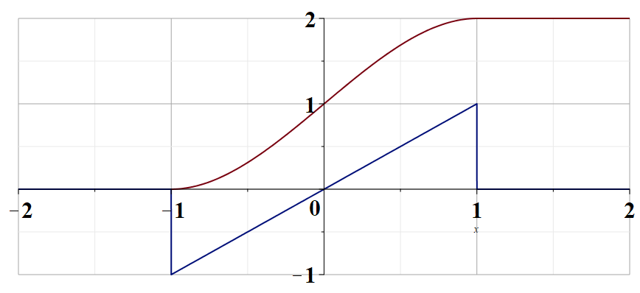
Notes:
Plot of the change distribution and of the electrostatic potential.

