Slide 1
PHY 711 Classical Mechanics and Mathematical Methods
10-10:50 AM MWF online or (occasionally in Olin 103
Plan for Lecture 22: Chap. 7 & App. A-D (F&W)
Generalization of the one dimensional wave equation ➔ various mathematical problems and techniques including:
Fourier transforms
Laplace transforms
Complex variables
Contour integrals
Notes:
In this lecture, we will focus on the mathematics of complex variables.

Slide 2
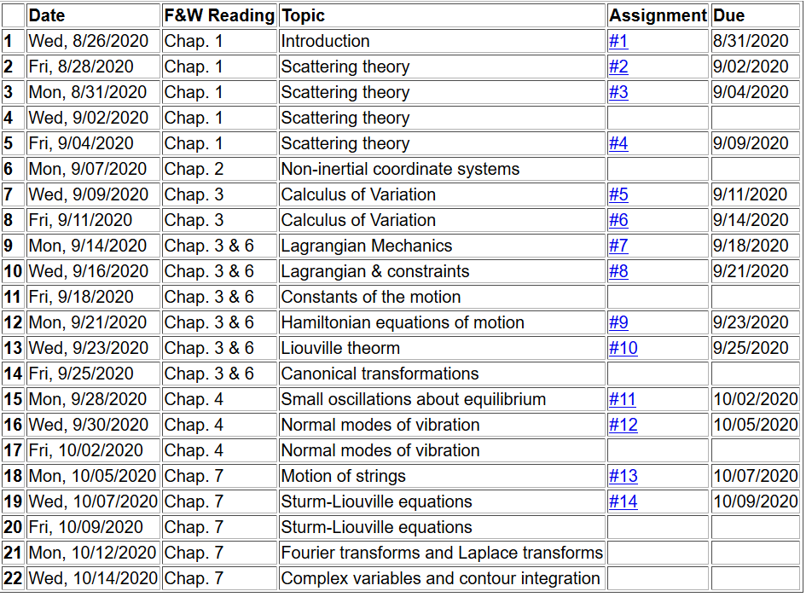
Notes:
No new homework while working on mid term exam.

Slide 3
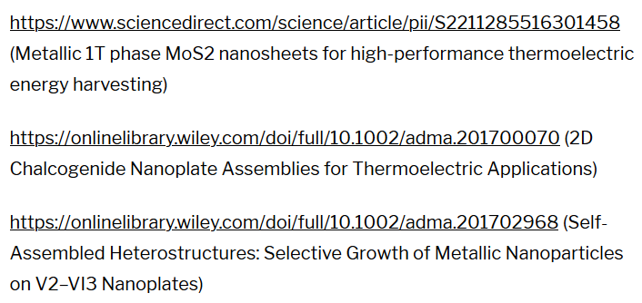
https://www.physics.wfu.edu/wfu-phy-news/seminars-2020-fall/
Notes:
Colloquium by senior graduate student who is working with Professor Carroll.

Slide 4
Introduction to complex variables
Basic properties
Notion of an analytic complex function
Cauchy integral theory
Evaluating integrals of functions in the complex plane
Notes:
We will review/introduce the basic ideas associated with complex variables.

Slide 5
Complex numbers
Functions of complex variables
Derivatives:
Cauchy-Riemann equations
Notes:
First we consider the basic definitions and representations of a complex number. Then we consider a function of complex numbers. The Cauchy relationships follow from the notion that a function that is differentiable in the complex plane must have consistent partial derivatives along the real and imaginary axes.

Slide 6
Analytic function
Examples of analytic functions
Notes:
Notion of an analytic function and an example that satisfies the conditions.

Slide 7
Examples of non-analytic functions
Notes:
Examples of non-analytic functions. Special property of contour integrals about a function with a simple “pole”.

Slide 8
No contribution
C
Notes:
Contributions to a closed contour from various contributions.

Slide 9
Notes:
Residue theorem

Slide 10
Example:
Im(z)
Re(z)
Note:
m=1
Notes:
Example of a contour integral using the residue theorem.

Slide 11
Some details:
Notes:
Some details.

Slide 12
Another example:
Note:
m=1
Im(z)
Re(z)
Notes:
Another example.

Slide 13
Notes:
Some details.

Slide 14
Another example:
Im(z)
ia
Re(z)
10/30/2017
PHY 711 Fall 2017 -- Lecture 25
14
Notes:
Another example

Slide 15
Notes:
More details.

Slide 16
Im(z)
Re(z)

Slide 17
Notes:
Another example from the Drude model.

Slide 18
Cauchy integral theorem for analytic function f(z):
Notes:
Another useful theorem from Cauchy.

Slide 19
Example
Im(z)
Re(z)
Notes:
Considering real and imaginary parts.

Slide 20
Example -- continued
Im(z)
Re(z)
Notes:
Real and imaginary parts for Cauchy’s integral relation.

Slide 21
Example -- continued
Im(z’)
x
Re(z’)
Notes:
Detail of how to evaluate the point x=x’ in terms of the principal parts integral.

Slide 22
Im(z’)
x
Re(z’)
Notes:
Some details.

Slide 23
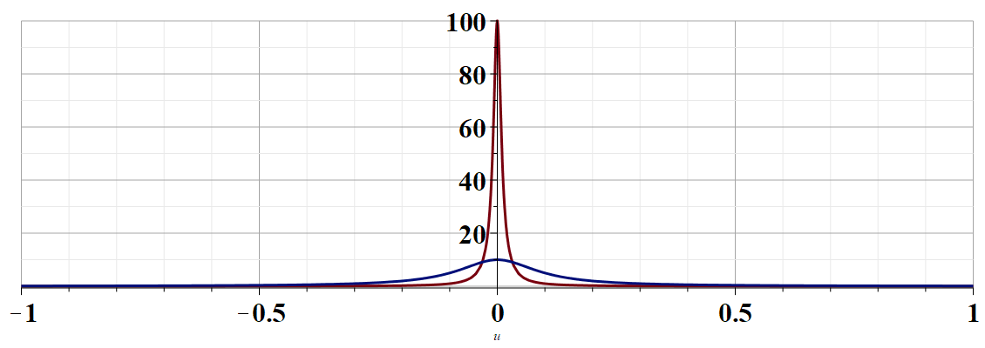
More details --
u
Notes:
Justification of the delta function result.

Slide 24
Example -- continued
Kramers-Kronig relationships
Notes:
Final result relating real and imaginary parts of complex function.

Slide 25
Comment on evaluating principal parts integrals
y’
x’
Notes:
Some details.

Slide 26
b(x’)
-2L
-L
L
2L
x’
Notes:
Simple example for complex function.

Slide 27
Notes:
For given imaginary function, this is the form of the real function.

Slide 28
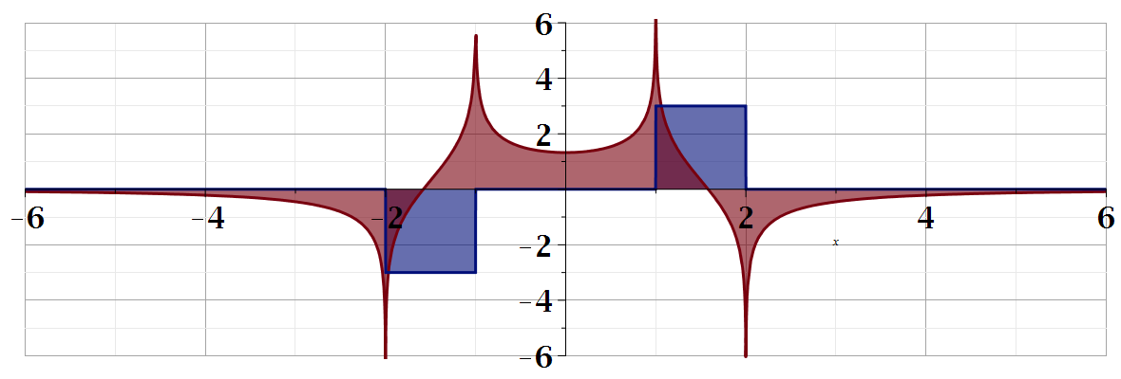
For our example:
b(x)
a(x)
Notes:
Summary of results.

Slide 29
Summary
?
Notes:
Summary.

Slide 30
Continued:

