Slide 1
PHY 711 Classical Mechanics and Mathematical Methods
10-10:50 AM MWF online or (occasionally) in Olin 103
Discussion for Lecture 23: Rigid bodies –
Chap. 5 (F &W)
Rigid body motion
Moment of inertia tensor
Torque free motion

Slide 2
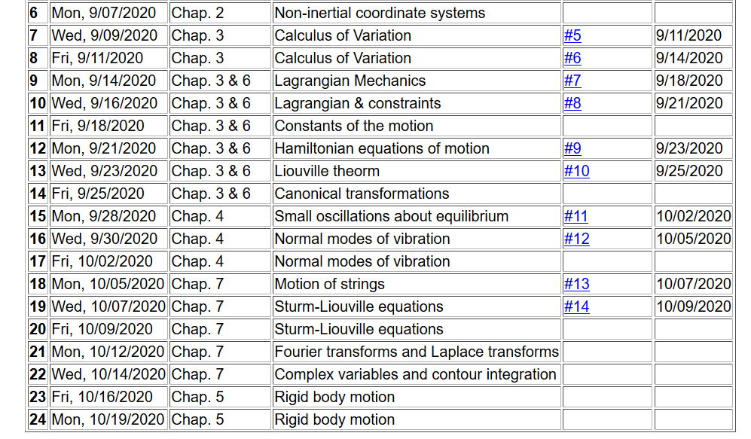
Notes:
In this lecture we will consider the rotational motion of rigid bodies as presented in Chapter 5 of your textbook.

Slide 3
Schedule for weekly one-on-one meetings
Nick – 11 AM Monday (ED/ST)
Tim – 9 AM Tuesday
Gao – 9 PM Tuesday
Jeanette – 11 AM Wednesday
Derek – 12 PM Friday

Slide 4
Reminder –
Your midterm exam is due on Monday. If you have questions, please send me email as soon as possible.
Your questions on today’s lecture –
From Gao –
Does the moment of inertia tensor happen to be diagonal or always when shifting into the center of mass frame?
Comment – The moment of inertia tensor is not necessarily diagonal in the center of mass coordinate system. Our example is a very special case.

Slide 5
Recap --
The physics of rigid body motion; body fixed frame vs inertial frame; results from Chapter 2:
Notes:
Determining the relationship between the inertial and body frames.

Slide 6
Recall from Chapter 2 -- Comparison of analysis in “inertial frame” versus “non-inertial frame”
Notes:
Recall our previous discussion of rotating frames of reference.

Slide 7
Properties of the frame motion (rotation):
dΘ
dΘ
Notes:
Consider an infinitesimal rotation.

Slide 8
Effects on acceleration:
Notes:
Rotational acceleration.

Slide 9
ω
r
=0 for rigid body
➔
Notes:
For a rigid body, internal motions are negligible.

Slide 10
Notes:
It is convenient to group terms that depend on the body geometry – leading to the definition of the moment of inertia tensor.

Slide 11
Note: For a given object and a given coordinate system, one can find the moment of inertia matrix
z
y
x

Slide 12
z’
z
y’
y
x
x’
(x’,y’,z’)

Slide 13
ω
r
=0 for rigid body
➔
Notes:
The angular momentum can also be calculated.

Slide 14
z
Example:
c
y
a
b
x
Notes:
Consider a simple rectangular solid with a coordinate system at the edge of the system.

Slide 15
Properties of moment of inertia tensor:
Symmetric matrix ➔real eigenvalues I₁,I₂,I₃
➔orthogonal eigenvectors
Notes:
The moment of inertia tensor in matrix form is a symmetric matrix and therefore can be diagonalized. The eigenvalues are known as principal moments of inertia and the eigenvectors are known as principal axes.

Slide 16
Changing origin of rotation
z
z’
r_{p}
r’_{p}
c
R
y’
y
a
x’
b
x
Notes:
Here we consider what happens when we evaluate the moment of inertia tensor about a different origin. In this case, the new origin happens to be at the center of mass.

Slide 17
z
z’
r_{p}
r’_{p}
c
R
y’
y
a
x’
b
x
Notes:
Some details.

Slide 18
z
z’
Note: This is a special case; changing the center of rotation does not necessarily result in a diagonal I’
r_{p}
r’_{p}
c
R
y’
y
a
x’
b
x
Notes:
When the dust clears for this case. Note that I’ happens to be diagonal already, however it is not generally true that shifting the origin for the moment of inertia would result in a diagonal matrix.

Slide 19
Descriptions of rotation about a given origin
ω
Notes:
In the next slides we will focus on the fact that each rigid body has 3 principal axes and 3 moments of inertia for a given origin. It is often convenient to use that coordinate system to analyze rigid body motion.

Slide 20
Descriptions of rotation about a given origin -- continued
Notes:
Here we consider the angular moment expressed in the diagonalized body fixed frame of reference.

Slide 21
Descriptions of rotation about a given origin -- continued
Notes:
While it is very difficult to express torque in this reference frame, we can readily solve problems with zero torque.

Slide 22
➔
Notes:
For the general system with three distinct moment of inertia, the solutions are difficult, but simplifications occur when two moments are the same, in this I1=I2.

Slide 23
Solution of Euler equations for a symmetric top -- continued
Notes:
Time dependence of the symmetric top in free space

Slide 24
➔
Notes:
Now consider the more general case.

Slide 25
Notes:
Reasonable approximations.

Slide 26
Euler equations for asymmetric top -- continued
Notes:
We see that there are conditions that allow stability for this system,. --- to be continued.

