Slide 1
PHY 711 Classical Mechanics and Mathematical Methods
10-10:50 AM MWF online or (occasionally) in Olin 103
Plan for Lecture 23: Rigid bodies -- Chap. 5 (F &W)
Rigid body motion
Moment of inertia tensor
Torque free motion

Slide 2
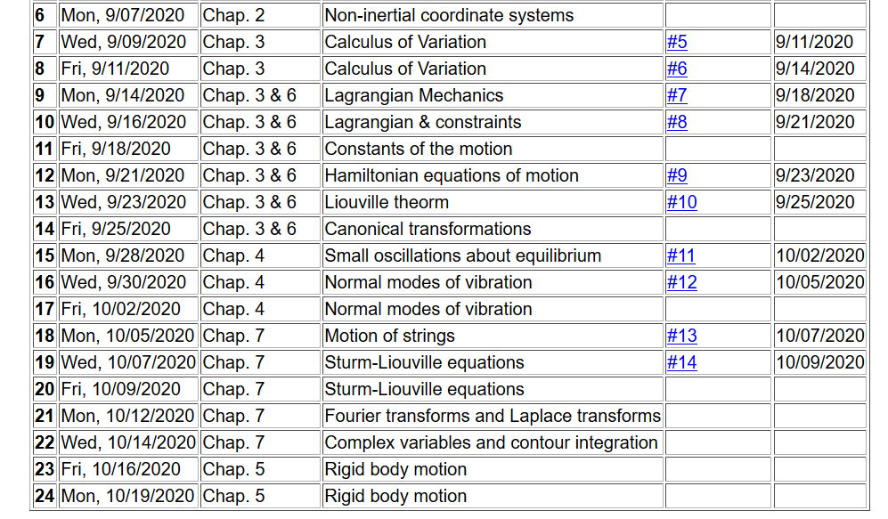
Notes:
In this lecture we will consider the rotational motion of rigid bodies as presented in Chapter 5 of your textbook.

Slide 3
Comparison of analysis in “inertial frame” versus “non-inertial frame”
Notes:
Recall our previous discussion of rotating frames of reference.

Slide 4
The physics of rigid body motion; body fixed frame vs inertial frame; results from Chapter 2:
Notes:
Determining the relationship between the inertial and body frames.

Slide 5
Properties of the frame motion (rotation):
dΘ
dΘ
Notes:
Consider an infinitesimal rotation.

Slide 6
Effects on acceleration:
Notes:
Rotational acceleration.

Slide 7
ω
r
=0 for rigid body
➔
Notes:
For a rigid body, internal motions are negligible.

Slide 8
Notes:
It is convenient to group terms that depend on the body geometry – leading to the definition of the moment of inertia tensor.

Slide 9
ω
r
=0 for rigid body
➔
Notes:
The angular momentum can also be calculated.

Slide 10
z
Example:
c
y
a
b
x
Notes:
Consider a simple rectangular solid with a coordinate system at the edge of the system.

Slide 11
Properties of moment of inertia tensor:
Symmetric matrix ➔real eigenvalues I₁,I₂,I₃
➔orthogonal eigenvectors
Notes:
The moment of inertia tensor in matrix form is a symmetric matrix and therefore can be diagonalized. The eigenvalues are known as principal moments of inertia and the eigenvectors are known as principal axes.

Slide 12
Changing origin of rotation
z
z’
r_{p}
r’_{p}
c
R
y’
y
a
x’
b
x
Notes:
Here we consider what happens when we evaluate the moment of inertia tensor about a different origin. In this case, the new origin happens to be at the center of mass.

Slide 13
z
z’
r_{p}
r’_{p}
c
R
y’
y
a
x’
b
x
Notes:
Some details.

Slide 14
z
z’
Note: This is a special case; changing the center of rotation does not necessarily result in a diagonal I’
r_{p}
r’_{p}
c
R
y’
y
a
x’
b
x
Notes:
When the dust clears for this case. Note that I’ happens to be diagonal already, however it is not generally true that shifting the origin for the moment of inertia would result in a diagonal matrix.

Slide 15
Descriptions of rotation about a given origin
ω
Notes:
In the next slides we will focus on the fact that each rigid body has 3 principal axes and 3 moments of inertia for a given origin. It is often convenient to use that coordinate system to analyze rigid body motion.

Slide 16
Descriptions of rotation about a given origin -- continued
Notes:
Here we consider the angular moment expressed in the diagonalized body fixed frame of reference.

Slide 17
Descriptions of rotation about a given origin -- continued
Notes:
While it is very difficult to express torque in this reference frame, we can readily solve problems with zero torque.

Slide 18
➔
Notes:
For the general system with three distinct moment of inertia, the solutions are difficult, but simplifications occur when two moments are the same, in this I1=I2.

Slide 19
Solution of Euler equations for a symmetric top -- continued
Notes:
Time dependence of the symmetric top in free space

Slide 20
➔
Notes:
Now consider the more general case.

Slide 21
Notes:
Reasonable approximations.

Slide 22
Euler equations for asymmetric top -- continued
Notes:
We see that there are conditions that allow stability for this system,. --- to be continued.

