Slide 1
PHY 711 Classical Mechanics and Mathematical Methods
10-10:50 AM MWF online or (occasionally in Olin 103
Discussion for Lecture 24 – Chap. 5 (F &W)
    Rotational motion
    Torque free motion of a rigid body
    Rigid body motion in body fixed frame
    Conversion between body and inertial reference frames
    Symmetric top motion
Notes:
In this lecture, we continue our discussion of rigid body motion.

Slide 2
Reminder – take-home due at 5 PM this evening
Schedule for weekly one-on-one meetings
Nick – 11 AM Monday (ED/ST)
Tim – 9 AM Tuesday
Gao – 9 PM Tuesday
Jeanette – 11 AM Wednesday
Derek – 12 PM Friday

Slide 3
Your questions –
From Tim –
So for the problem on slide 23, if there is no initial movement/rotation of the top then the effective potential would stay as Mglcos(beta).
From Nick –
1. Can you explain the green line N in the diagram? I looked it up and it's called the line of nodes.
Are the Euler angles a representation of how the basis axes in the inertial frame are rotated? And what is the direction of the rotation?
From Gao –
1. How to decide stable/unstable solutions in slide 25?

Slide 4
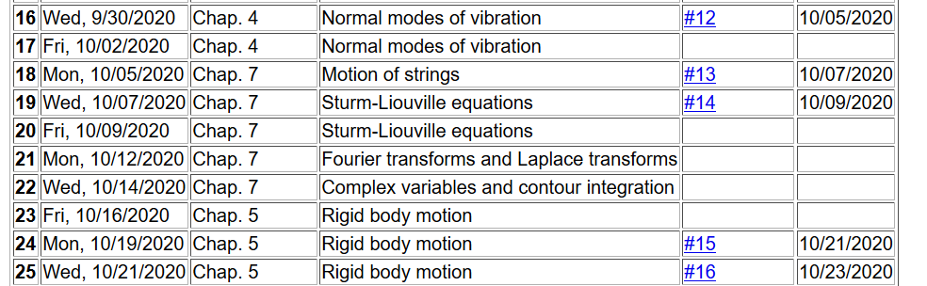
Notes:
Since you will be turning in your exams today, we will resume the homework assignments.

Slide 5
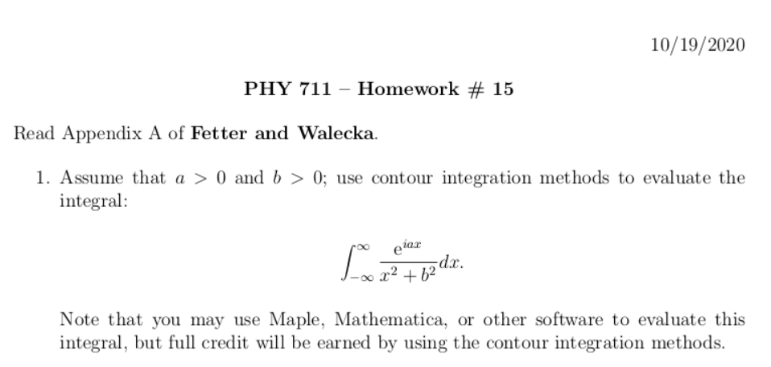
Due Wednesday
Notes:
This is a simple exercise using contour integration.

Slide 6
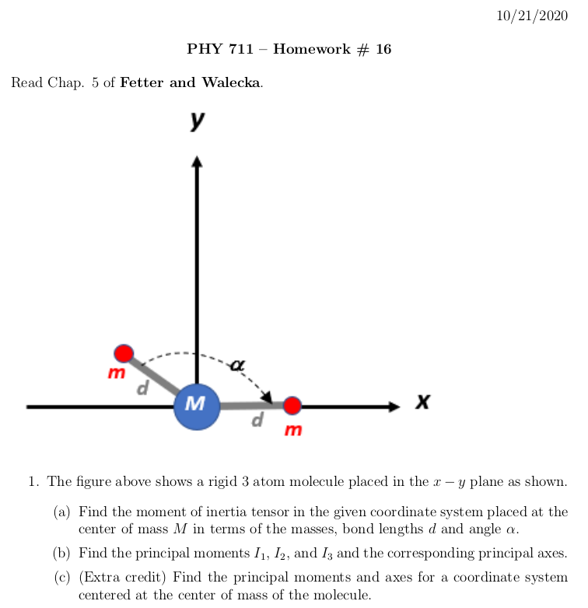
Due Friday
Notes:
This is an exercise to compute the moment of inertia tensor and diagonalize it.

Slide 7
Summary of previous results
describing rigid bodies rotating
about a fixed origin
ω
r
Notes:
Review of notions of rigid body motion.

Slide 8
Moment of inertia tensor
Notes:
In general there is a symmetric tensor which defines the moment of inertia. By rotating the coordinates about a fixed origin we can find the matrix in diagonal form.

Slide 9
Continued -- summary of previous results describing rigid bodies rotating about a fixed origin
ω
r
Notes:
In addition to the kinetic energy, the angular momentum also can be expressed in terms of the moment of inertia tensor.

Slide 10
Descriptions of rotation about a given origin -- continued
Notes:
It is convenient to express the angular moment in terms of the principal moments .

Slide 11
Descriptions of rotation about a given origin -- continued
Notes:
When there is zero torque acting on the system, the angular velocity components are coupled through these Euler equations.

Slide 12
Notes:
The solution to the coupled angular velocity components is in general complicated, but simplifies when two of the principal moments are equal for a “symmetric top”.

Slide 13
Solution of Euler equations for a symmetric top -- continued
Notes:
Details of the solution for a symmetric top.

Slide 14
For example, the object starts spinning along the 3 axis.
Notes:
Now consider the case where all of the principal moments are unequal.

Slide 15
Euler equations for asymmetric top -- continued
Notes:
We can find approximate stable solutions in certain cases.

Slide 16
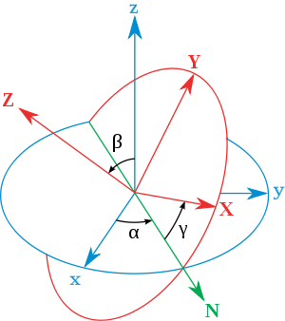
Transformation between body-fixed and inertial coordinate systems – Euler angles
inertial
body
x
y
y
x
http://en.wikipedia.org/wiki/Euler_angles
Notes:
In order to consider motion of a rigid body more generally, in the presence of torque, it will be necessary to consider how to relate the body – fixed coordinates that diagonalize the moment of inertia tensor to another coordinate system which in general be an inertial coordinate system. Here again, we use ideas of Euler. This notation or it is equivalent is typically consistent with quantum mechanics text books.

Slide 17
Your questions -- Can you explain the green line N in the diagram? I looked it up and it's called the line of nodes.
Are the Euler angles a representation of how the basis axes in the inertial frame are rotated? And what is the direction of the rotation?
Comment – Since this is an old and intriguing subject, there are a lot of terminologies and conventions, not all of which are compatible. We are following the convention found in most quantum mechanics texts and NOT the convention found in most classical mechanics texts. Euler’s main point is that any rotation can be described by 3 successive rotations about 3 different (not necessarily orthogonal) axes. In this case, one is along the inertial 3 axis and another is along the body fixed 3 axis. The middle rotation is along an intermediate 2 axis.

Slide 18
x
Need to express all components in body-fixed frame:
y
y
x
Notes:
Euler said that the transformation of body-fixed → inertial frames can be accomplished in 3 steps and the corresponding angles are alpha, beta, and gamma. In this case, we want to express all results in the body fixed frame.

Slide 19
x
y
y
x
Notes:
We can express the angular velocities in terms of the time rate of change of the alpha, beta, and gamma Euler angles. We can also express the rotation axes in terms of the instantaneous Euler angles as well. Here is the transformation of the middle axis.

Slide 20
x
y
y
x
Notes:
Here is the transformation of the inertial 3 axis.

Slide 21
Notes:
Putting all of the transformations together, we now have expressions for the angular velocity components referenced to the body fixed frame.

Slide 22
x
y
y
x
Notes:
Result to remember.

Slide 23
Rotational kinetic energy
Notes:
General expression of the rotational kinetic energy and the special case of the symmetric top.

Slide 24
Transformation between body-fixed and inertial coordinate systems – Euler angles
inertial
body
x
y
y
x
http://en.wikipedia.org/wiki/Euler_angles
Notes:
In addition to the dynamic transformation needed for rigid body mechanics, this formalism is more generally useful when relating coordinate systems of different orientations.

Slide 25
General transformation between rotated coordinates – Euler angles
inertial
body
x
y
y
x
http://en.wikipedia.org/wiki/Euler_angles
Notes:
In general any transformation can be expressed in terms of the three Euler angles.

Slide 26
Motion of a symmetric top under the influence of the torque of gravity:
γ
β
Mg
α
Notes:
Now consider the motion of a symmetric top in which the pivot point is fixed and torque is applied by gravity acting at the center of mass of the top. Here l denotes the distance of the pivot point to the center of mass.

Slide 27
Notes:
Lagrangian and its solution.

Slide 28
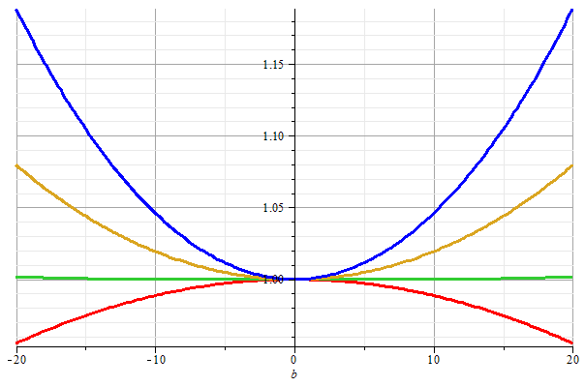
Stable/unstable solutions near
β=0
Notes:
Special case where top is spinning nearly vertically.

Slide 29
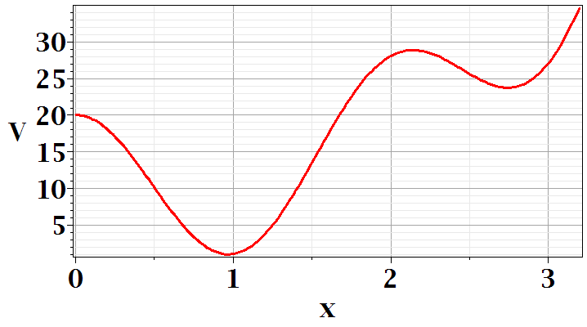
Your questions --How to decide stable/unstable solutions in slide 25? So for the problem on slide 23, if there is no initial movement/rotation of the top then the effective potential would stay as Mglcos(beta).
Comment – When we discussed one dimensional motion, we discussed stable and unstable equilibrium points. At equilibrium dV/dx=0, but only when V(x) has a minimum at that point, is the system stable in the sense that for small displacements from equilibrium, there are restoring forces to move the system back to the equilibrium point.
Minimization of a simple function
maximum
local minimum
global minimum

Slide 30
Notes:
Approximate solution for that case.

Slide 31
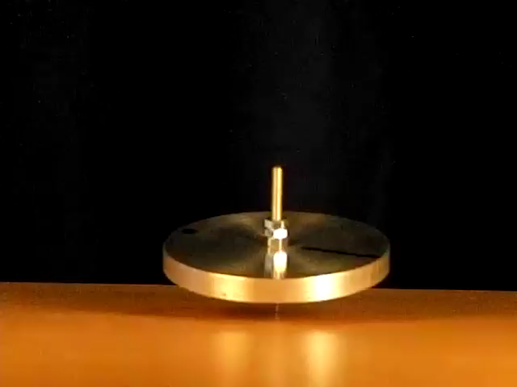

http://www.physics.usyd.edu.au/~cross/SPINNING%20TOPS.htm
See also --

Slide 32
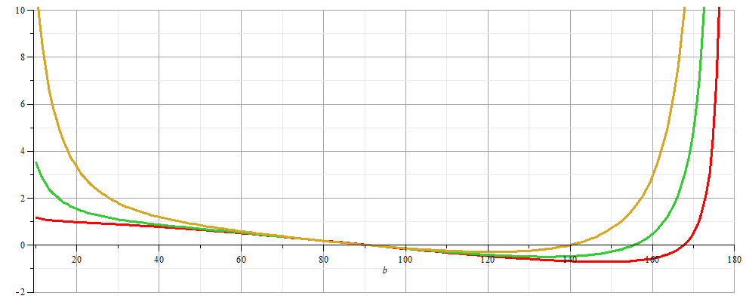
More general case:
Notes:
For a spinning bicycle suspended by a rope, the beta angle can be greater than 90 degress

Slide 33
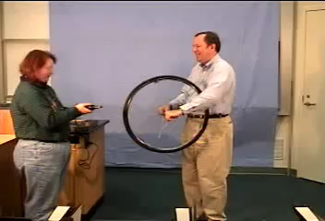
https://drive.google.com/file/d/0B14RyYwpwSDNcXdxTWl3OExHX1k/view

Slide 34
β
Mg
α
Notes:
Summary of results.

