Slide 1
PHY 711 Classical Mechanics and Mathematical Methods
10-10:50 AM MWF online or (occasionally) in Olin 103
Discussion for Lecture 25 – Chap. 8 (F & W)
    Motions of elastic membranes
      Review of standing waves on a string
      Standing waves on a two dimensional membrane.
      Boundary value problems
Notes:
In this lecture, we will resume our consideration of elastic media, extending the one dimensional analysis of a string to a two dimensional membrane.

Slide 2
Schedule for weekly one-on-one meetings
Nick – 11 AM Monday (ED/ST)
Tim – 9 AM Tuesday
Gao – 9 PM Tuesday
Jeanette – 11 AM Wednesday
Derek – 12 PM Friday

Slide 3
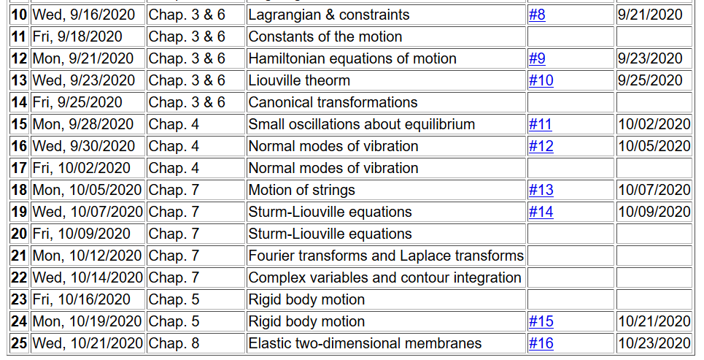
Friday – Review?? Monday -- Fluids
Notes:
The homework assignment relate to rigid body motion.

Slide 4
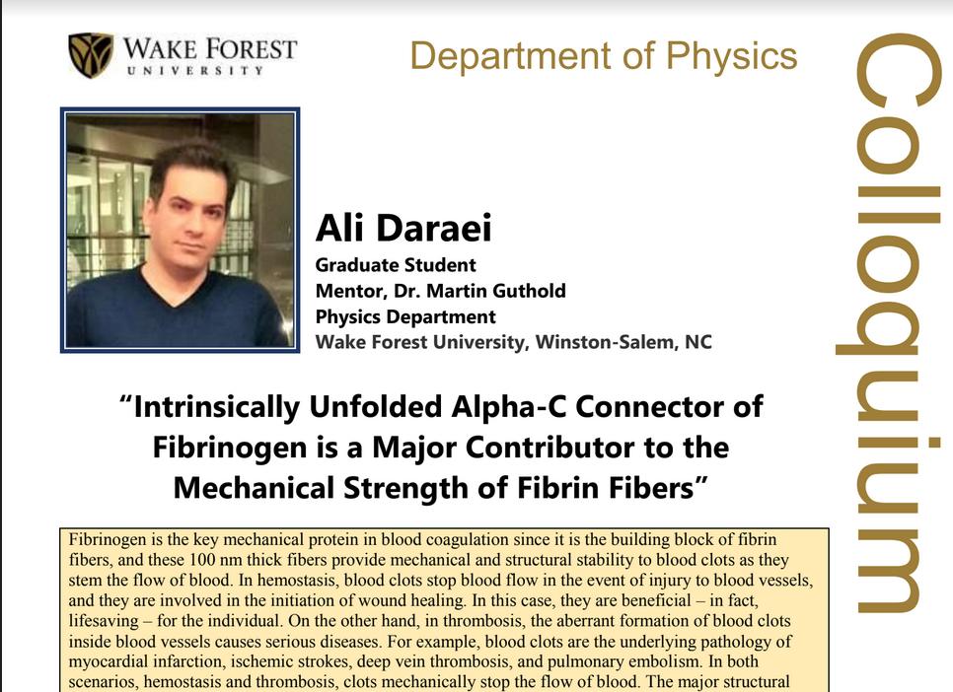
Thursday’s Physics Online Colloquium
https://www.physics.wfu.edu/wfu-phy-news/seminars-2020-fall/
Oct. 22, 2020
at 4 PM
Notes:
Thursday’s lecture is by a senior biophysics graduate student. Please consult the webpage for details including relevant references on the topic.

Slide 5

Your questions
From Nick –
For the lecture, where does this term come from? For a standing wave, is the time derivative 0? Is there a systematic way to solve the boundary problems. I get that the solutions work, but it seems like it was just a good guess. How do we actually set up the system to solve?
From Gao –
1. About today's lecture, could you explain why standing waves have the form of R[(e-iwt)ρ(r)]?

Slide 6
Elastic media in two or more dimensions --
Review of wave equation in one-dimension – here μ(x,t) can describe either a longitudinal or transverse wave.
Traveling wave solutions --
Notes:
Review of the wave equation in one special dimension.

Slide 7
Notes:
Review continued.

Slide 8
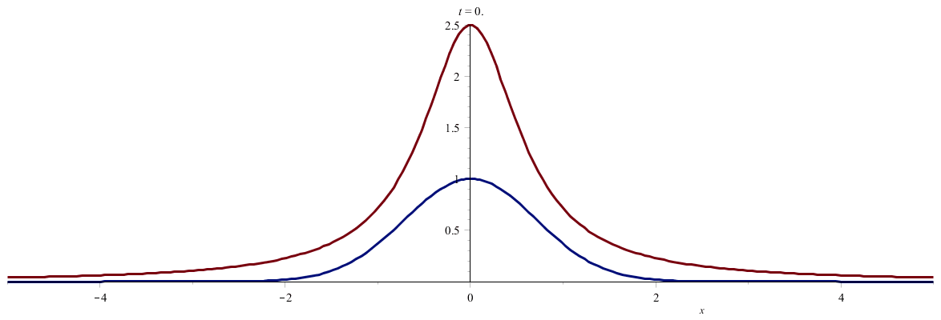
Notes:
Two examples of traveling waves.

Slide 9
Standing wave solutions of wave equation:
Notes:
Standing wave solutions for constrained string.

Slide 10
Your questions -- About today's lecture, could you explain why standing waves have the form of R[(e-iwt)ρ(r)]?
For the lecture, where does this term come from? For a standing wave, is the time derivative 0? Is there a systematic way to solve the boundary problems. I get that the solutions work, but it seems like it was just a good guess. How do we actually set up the system to solve?
Comment -- The basic idea is a “separable” partial differential equation which allows us to seek solutions that are products of functions of each variable alone.

Slide 11
How can this work?

Slide 13
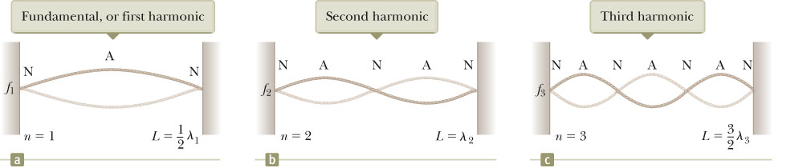
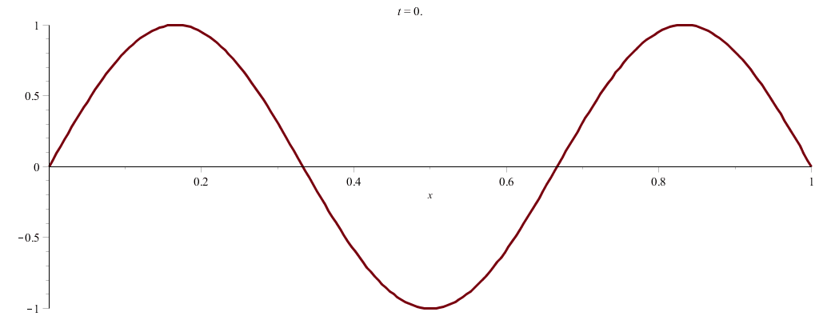
Notes:
Some more details of standing waves.

Slide 14
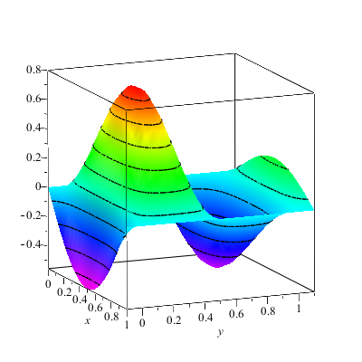
Wave motion on a two-dimensional surface – elastic membrane (transverse wave; linear regime).
Note that here we are visualizing transverse waves. Longitudinal waves can also exist.
Notes:
Now consider, the same idea, generalized to two spatial dimensions. Here we will focus on standing wave solutions.

Slide 16
Notes:
It is possible to formulate the treatment using a continuous Lagrangian.

Slide 17
Notes:
Some details.

Slide 18
Consider a rectangular boundary:
b
a
Notes:
An example of the rectangular membrane clamped on all edges.

Slide 19
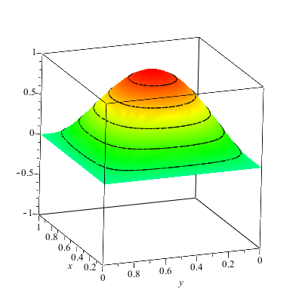
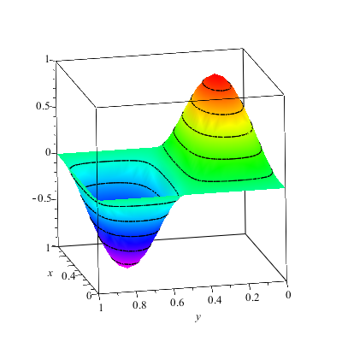
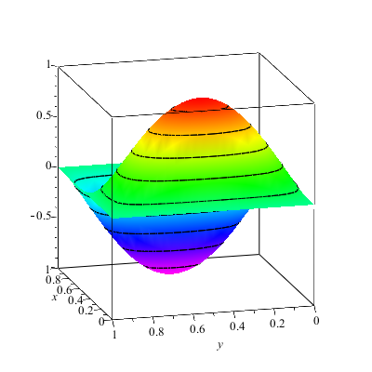
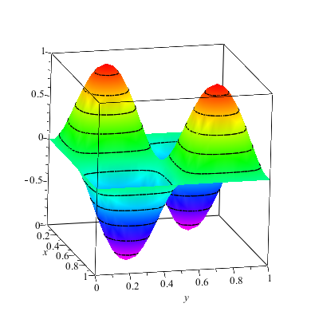
Notes:
Some two dimensional standing waves.

Slide 20
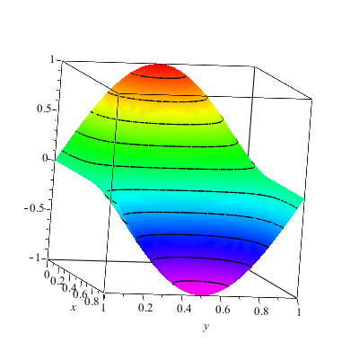
More general boundary conditions:
Notes:
Other possible boundary conditions.

Slide 21
Consider a circular boundary:
R
Notes:
Another example of a membrane, this time clamped at the boundary of a circle. (Such as in a drum for example.) It is convenient to polar coordinates.

Slide 22
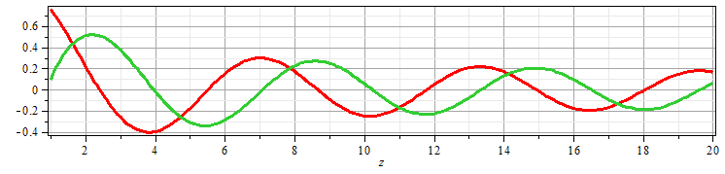
Consider circular boundary -- continued
Notes:
The radial equation has this special form which is conveniently expressed in terms of Bessel functions.

Slide 23
Some properties of Bessel functions
Notes:
Some properties of Bessel functions of integer order.

Slide 24
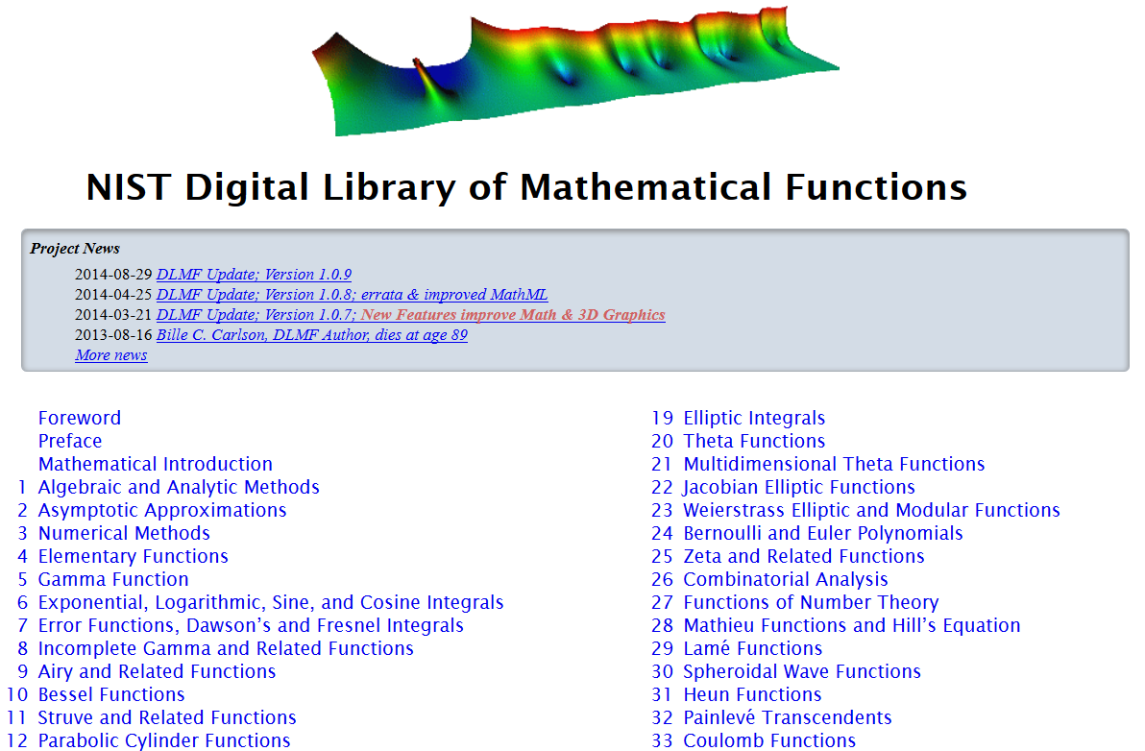
http://dlmf.nist.gov/
Notes:
A resource for finding properties of special functions including Bessel functions.

Slide 25
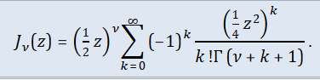
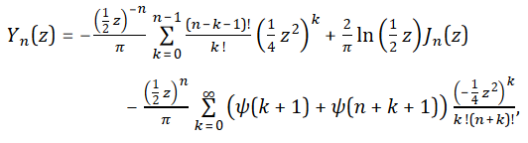
Series expansions of Bessel and Neumann functions
Notes:
Some details.

Slide 26
Some properties of Bessel functions -- continued
Notes:
Patient mathematicians worked out lots of useful relationships. We are particularly interested in aligning the zeros of the Bessel functions with the boundaries of our membrane.

Slide 27
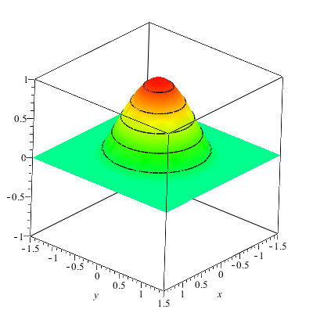
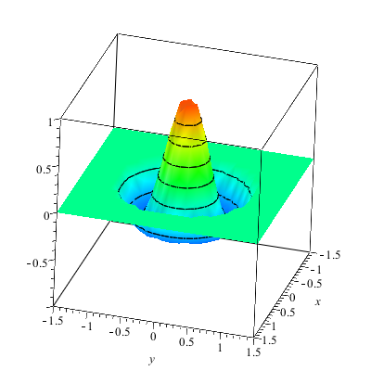
Notes:
Some examples.

Slide 28
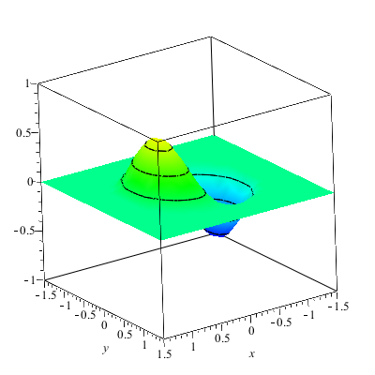
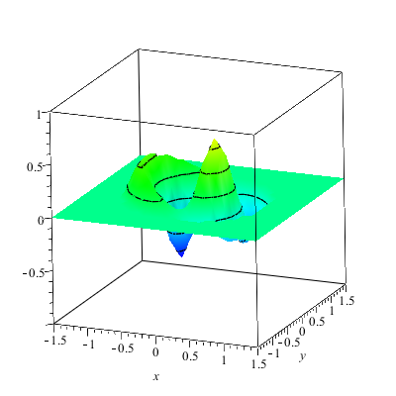
Notes:
More examples.

Slide 29
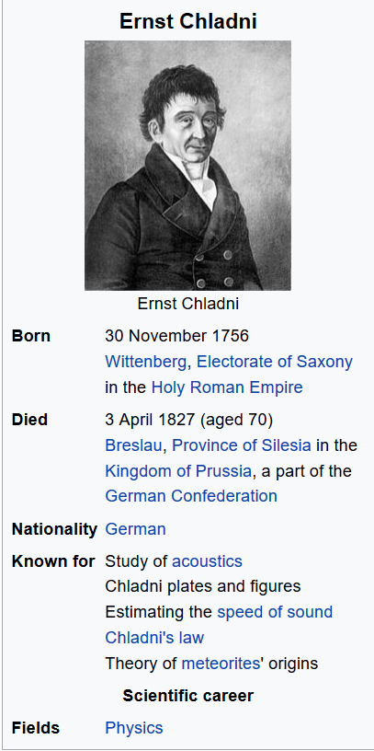
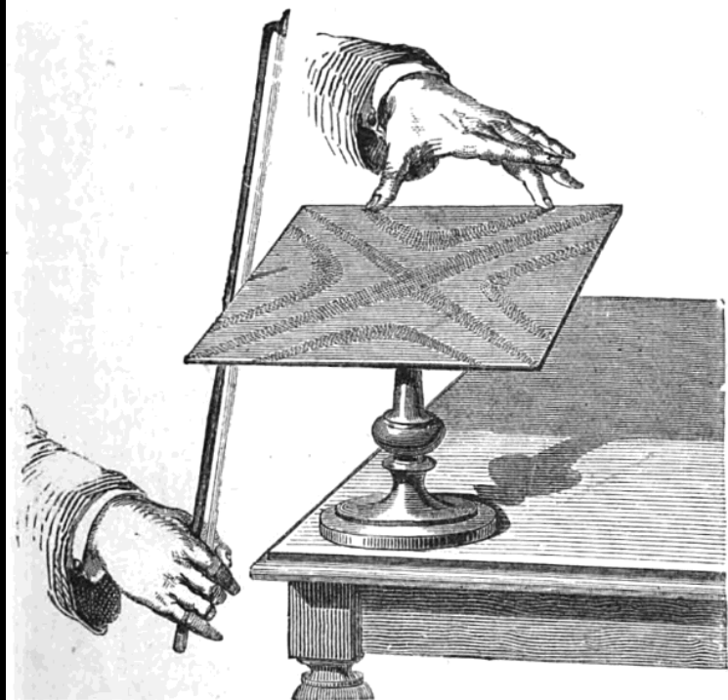
Notes:
A very nice demonstration of these standing waves was invented by Chladni

Slide 30
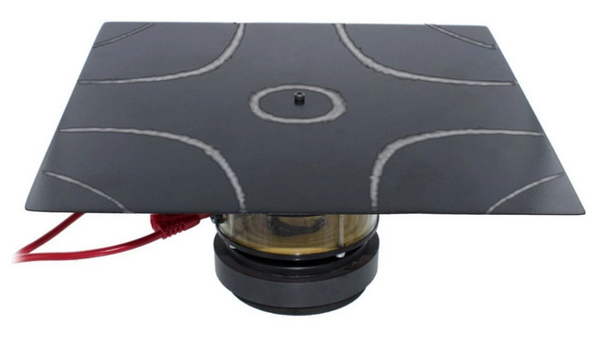
Demonstration with motor in the middle – (PASCO)
Notes:
A picture of the demo we have in Olin.

Slide 31
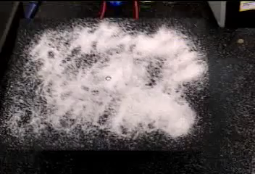
http://www.physics.wfu.edu/resources/education-resources/demo-videos/waves/
Notes:
Movie thanks to Eric Chapman.

Slide 32
More complicated geometry – annular membrane
a
b
Notes:
A non-trivial example with two boundaries.

Slide 33
Consider circular boundary -- continued
Notes:
In this case, both Bessel and Neumann functions are needed.

Slide 34
Normal modes of an annular membrane -- continued
a
b
Notes:
We need to find the linear coefficients A and B and the wavevector k.

Slide 35
Normal modes of an annular membrane -- continued
a
b
Notes:
A method of solving this problem.

Slide 36
Normal modes of an annular membrane -- continued
a
b

Slide 37
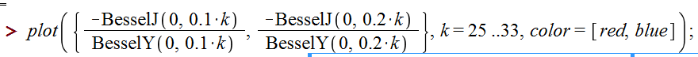
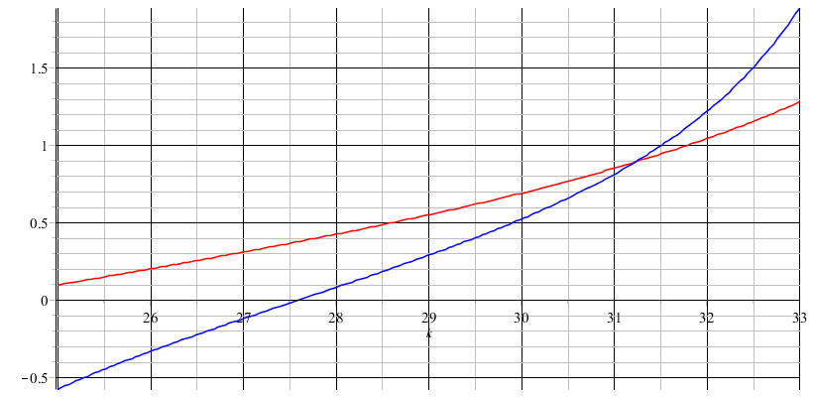
Analysis for m=0 and a=0.1, b=0.2:
Notes:
Finding a solution graphically.

Slide 38
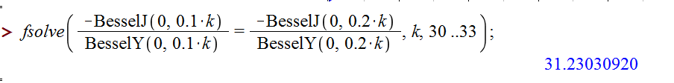

Slide 39
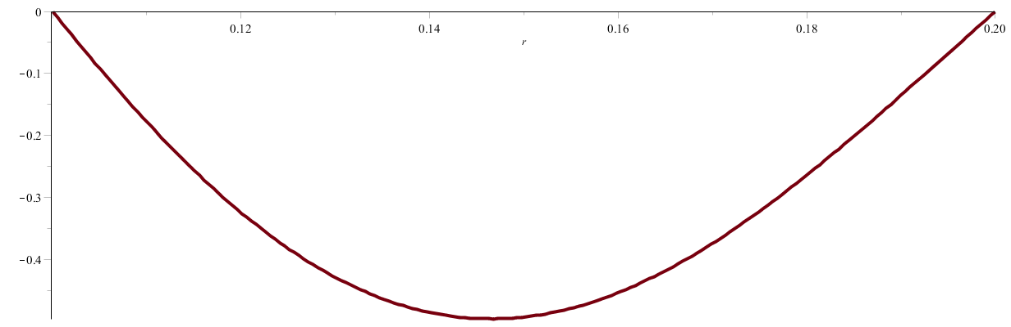
a
b
Notes:
Solution for this case.

