Slide 1
PHY 711 Classical Mechanics and Mathematical Methods
10-10:50 AM MWF online or (occasionally) in Olin 103
Discussion for Lecture 26 – Chaps. 5,7,8 (F & W)
Review
Moments of inertia and rigid body motion
Contour integration
Wave equation in one special dimension
Wave equation in two special dimensions
Special transcendental functions such as Bessel functions
Notes:
In this lecture, we will resume our consideration of elastic media, extending the one dimensional analysis of a string to a two dimensional membrane.

Slide 2
Schedule for weekly one-on-one meetings
Nick – 11 AM Monday (ED/ST)
Tim – 9 AM Tuesday
Gao – 9 PM Tuesday
Jeanette – 11 AM Wednesday
Derek – 12 PM Friday

Slide 3
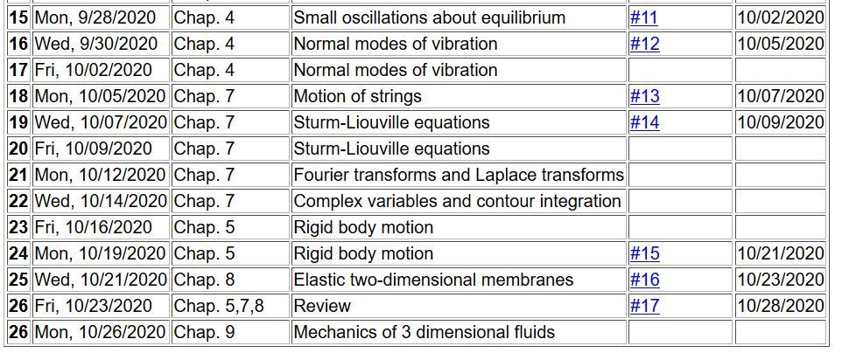
Notes:
The homework assignment relate to rigid body motion.

Slide 4
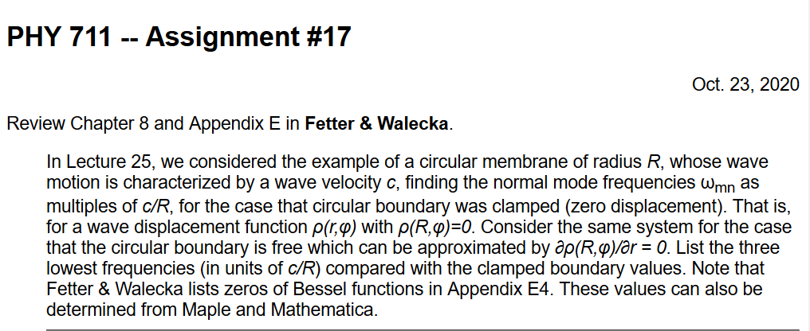

Slide 5
Rigid body motion – moments of inertia tensors

Slide 6
Summary of previous results
describing rigid bodies rotating
about a fixed origin
ω
r

Slide 7
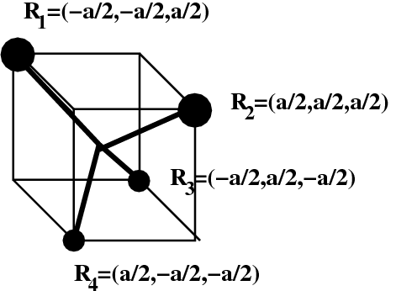
Moment of inertia tensor
z
3m
Example of 5 atom
molecule with origin at central atom.
3m
y
m
x
m

Slide 8
z
3m
3m
y
m
x
m
What happens when all masses are equal?
Is it an accident that the principal axes are related to the symmetry of the system?

Slide 9
Functions of complex variables, contour integration

Slide 10
Contour integrals --

Slide 11
Example --
For a>0
Im(z)
i
Re(z)
Note that for a>0 only the pole at z_{p}=i contributes and m=2
Note also that complex variables have other considerations such as “branch cuts” to avoid multiple values and essential singularities.

Slide 12
Wave motion in one special dimension

Slide 13
Elastic media in two or more dimensions --
Review of wave equation in one-dimension – here μ(x,t) can describe either a longitudinal or transverse wave.
Traveling wave solutions --
Notes:
Review of the wave equation in one special dimension.

Slide 14
Notes:
Review continued.

Slide 15
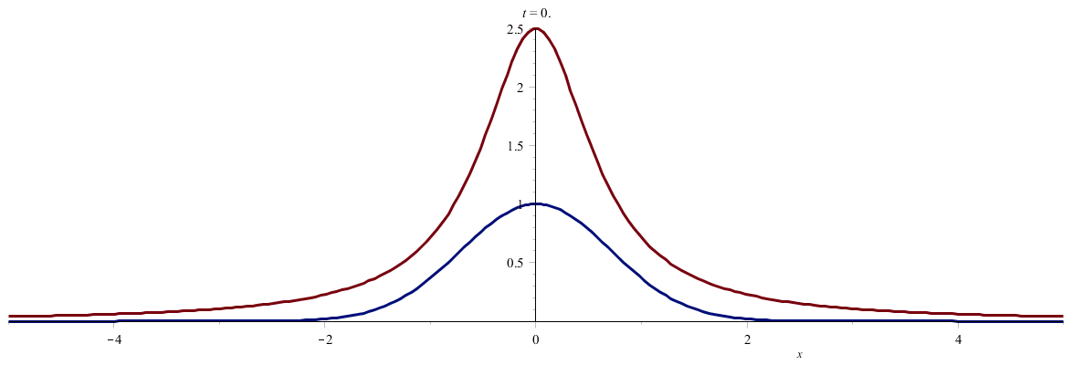
Notes:
Two examples of traveling waves.

Slide 16
Standing wave solutions of wave equation:
Notes:
Standing wave solutions for constrained string.

Slide 17
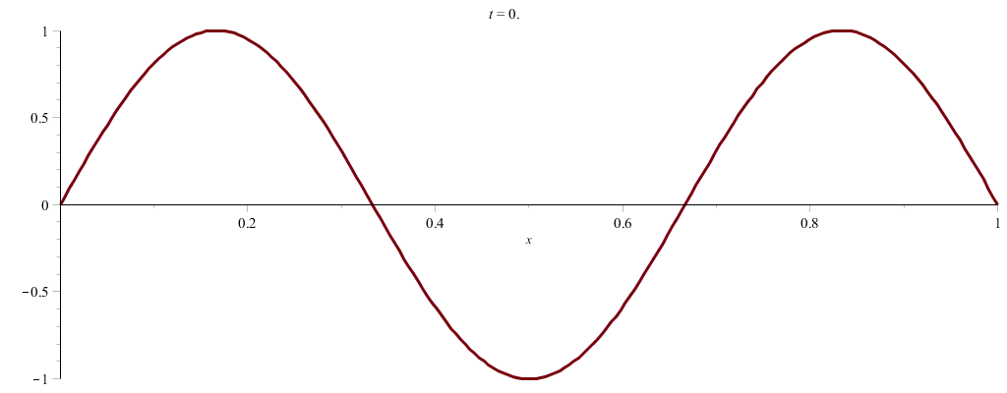
Notes:
Some more details of standing waves.

Slide 18
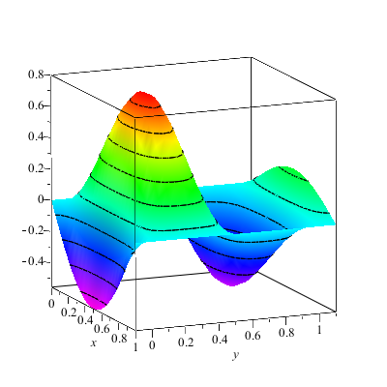
Wave motion on a two-dimensional surface – elastic membrane (transverse wave; linear regime).
Note that here we are visualizing transverse waves. Longitudinal waves can also exist.
Notes:
Now consider, the same idea, generalized to two spatial dimensions. Here we will focus on standing wave solutions.

Slide 20
Consider a rectangular boundary:
b
a
Notes:
An example of the rectangular membrane clamped on all edges.

Slide 21
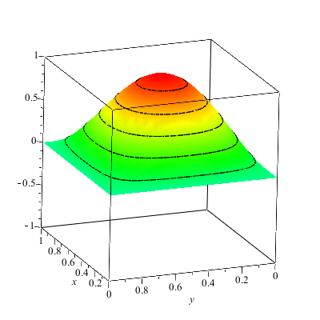
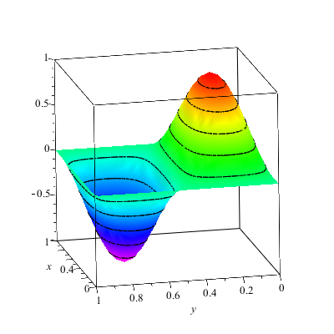
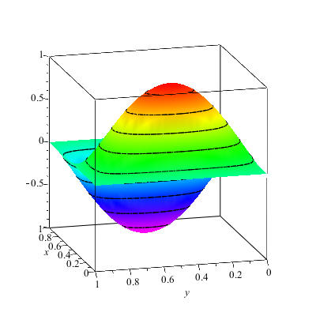
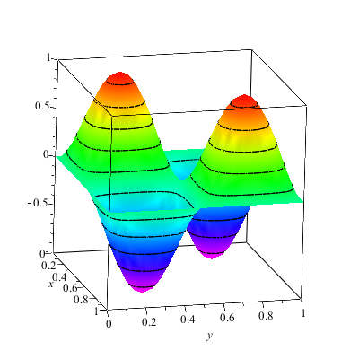
Notes:
Some two dimensional standing waves.

Slide 22
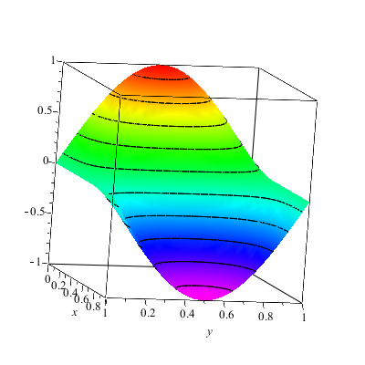
More general boundary conditions:
Notes:
Other possible boundary conditions.

Slide 23
Consider a circular boundary:
R
Notes:
Another example of a membrane, this time clamped at the boundary of a circle. (Such as in a drum for example.) It is convenient to polar coordinates.

Slide 24
Consider circular boundary -- continued
Notes:
The radial equation has this special form which is conveniently expressed in terms of Bessel functions.

Slide 25
Some properties of Bessel functions
Notes:
Some properties of Bessel functions of integer order.

Slide 26
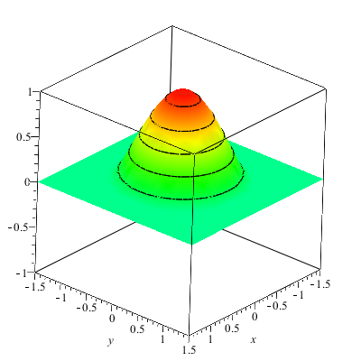
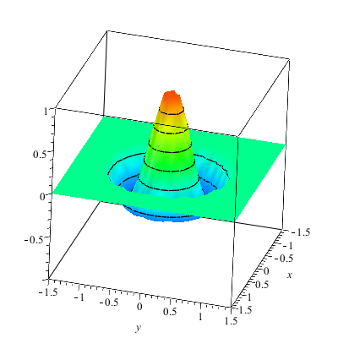
Notes:
Some examples.

Slide 27
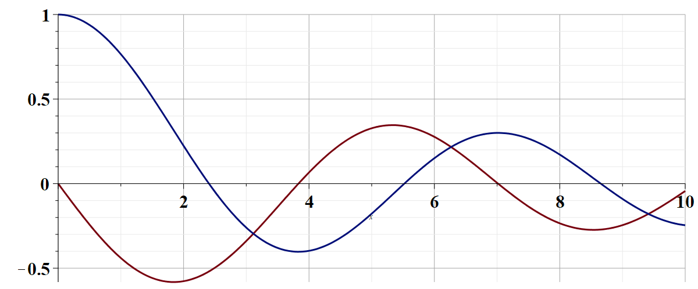
Some details for m=0
J₀(x)
Zeroes for clamped bd.
x
J’₀(x)
Zeroes for free boundary

