Slide 1
PHY 711 Classical Mechanics and Mathematical Methods
10-10:50 AM MWF online or (occasionally) in Olin 103
Discussion for Lecture 27 – Chap. 9 in F & W
Introduction to hydrodynamics
Motivation for topic
Newton’s laws for fluids
Conservation relations
Notes:
In this lecture we will begin an introductory treatment of the mechanics of fluis.

Slide 2
Schedule for weekly one-on-one meetings
Nick – 11 AM Monday (ED/ST)
Tim – 9 AM Tuesday
Gao – 9 PM Tuesday
Jeanette – 11 AM Wednesday
Derek – 12 PM Friday

Slide 3
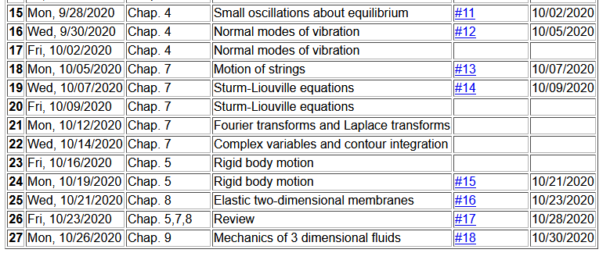
Notes:
There is a homework problem based on today’s lecture material

Slide 4
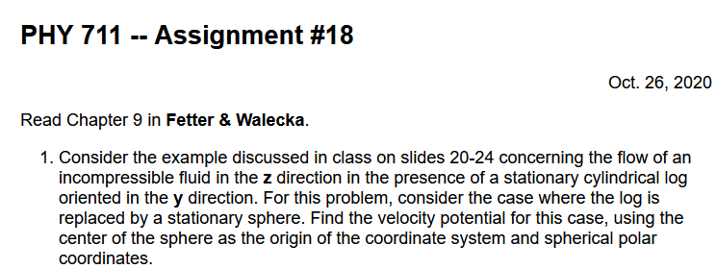
Homework #18
Notes:
This problem involves a description of simple fluid motion.

Slide 5
Hydrodynamic analysis
Motivation
Natural progression from strings, membranes, fluids; description of 1, 2, and 3 dimensional continua
Interesting and technologically important phenomena associated with fluids
Plan
Newton’s laws for fluids
Continuity equation
Stress tensor
Energy relations
Bernoulli’s theorem
Various examples
Sound waves
Notes:
Here is a list of topics that will be covered in the next few lectures.

Slide 6
Your questions –
From Tim
How come the pressure at point 1 on pg.14 includes p_atm? Is it because the atmosphere pushes on the syringe back, which then pushes on the fluid?
From Nick
1. What is the difference between F_applied and f_applied? 2. What is \Phi representing?
Is irrotational flow allowed to oscillate up and down or side to side, or pulse? but just not spin?
From Gao
1. What aspects do over simplified Bernoulli's equation not include in studying fluid dynamics?

Slide 7
Newton’s equations for fluids
Use Euler formulation; following “particles” of fluid
Notes:
Newton’s laws need to be adapted to describe the physics of fluids. Here pressure is important and more generally, the functions used to describe fluids depend on position and time.

Slide 8
p(x)
p(x+dx)
Notes:
Pressure acts in all directions. Here we argue that the spatial derivative of the pressure applies a force to a volume of fluid.

Slide 9
Newton’s equations for fluids -- continued
Notes:
It is convenient to write Newton’s law in terms of the mass density, velocity, and pressure of the fluid.

Slide 10
Notes:
Because of the continuous nature of the velocity, the total time derivative of the fluid velocity depends both or the partial derivates with respect to space and with respect to time as derived here.

Slide 11
Newton’s equations for fluids -- continued
Notes:
Some alternative expressions for the velocity terms.

Slide 12
Your question – What is irrotational flow?

Slide 13
Solution of Euler’s equation for fluids
Notes:
The restricted equations have some interesting properties.

Slide 14
Bernoulli’s integral of Euler’s equation for irrotational and incompressible fluid
Notes:
This result is known as Bernoulli’s equation

Slide 15
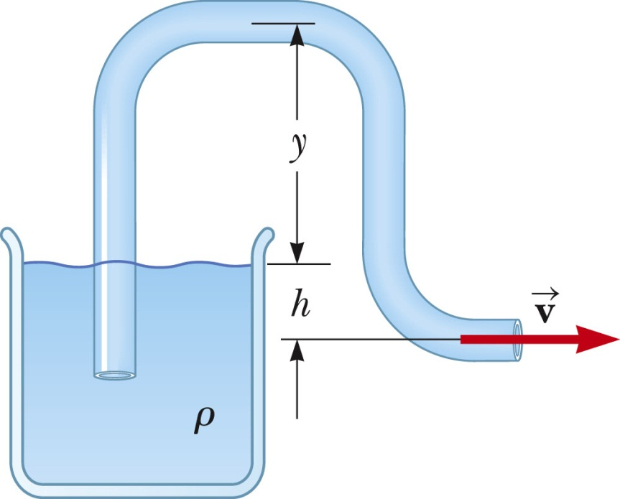
Examples of Bernoulli’s theorem
1
2
Notes:
This is a problem illustrating Bernoulli’s equation as a syphon.

Slide 16
Examples of Bernoulli’s theorem -- continued
1
2
Notes:
This example is taken from the PHY 114 textbook

Slide 17
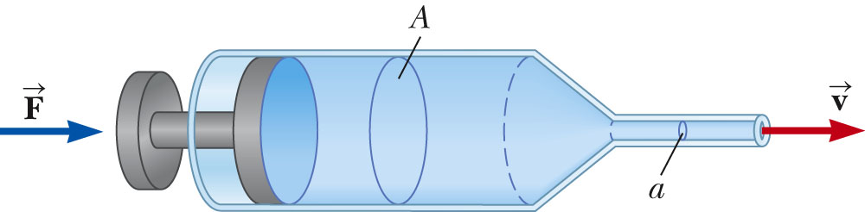
Examples of Bernoulli’s theorem -- continued
2
1
Notes:
Another ezample of Bernoulli’s equation for a syringe.

Slide 18
Your question -- How come the pressure at point 1 on pg.14 includes p_atm? Is it because the atmosphere pushes on the syringe back, which then pushes on the fluid?
Comment – All surfaces open to the air is in equilibrium with the atmospheric pressure.

Slide 19
Examples of Bernoulli’s theorem -- continued
2
1
Notes:
Syringe fluid continued.

Slide 20
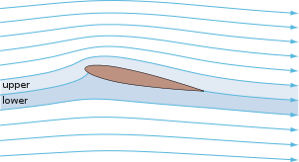
Examples of Bernoulli’s theorem – continued
Approximate explanation of airplane lift
Cross section view of airplane wing
http://en.wikipedia.org/wiki/Lift_%28force%29
1
2
Notes:
This example of Bernoulli’s equation is oversimplified. It appeared in most of the old textbook, but seems now to be deemphasized. It is given here since it shows some aspects of fluid flow, although apparently not good enough.

Slide 21
Your question -- What aspects do over simplified Bernoulli's equation not include in studying fluid dynamics?
According to a Scientific American article, the conclusion that v₂>v₁ because of the shape of the airplane wing is not quite true. Numerical modeling reveal a more complicated picture.
https://www.scientificamerican.com/article/no-one-can-explain-why-planes-stay-in-the-air/

Slide 22
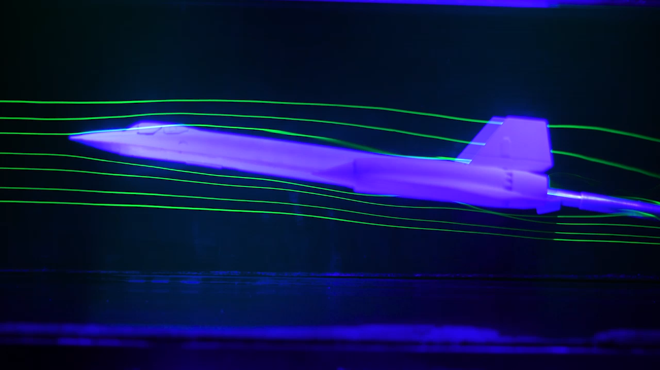
At NASA Ames Fluid Mechanics Laboratory, streamlines of dye in a water channel interact with a model airplane. Credit: Ian Allen
(copied from Scientific American page mentioned above).

Slide 23
Continuity equation connecting fluid density and velocity:
Notes:
The continuity equation is an important aspect of fluid flow.

Slide 24
Some details on the velocity potential
Notes:
For an incompressible and irrotational fluid, it is mathematically convenient to express the velocity field in terms of a velocity potential field.

Slide 25
Example – uniform flow
b
a
z
Notes:
For a uniformly fluid flowing along the z direction, the velocity potential and velocity field are easily written as shown.

Slide 26
Example – flow around a long cylinder (oriented in the Y direction)
^
X
^
v₀ Z
r=a
^
θ
v₀ Z
^
Z
Notes:
Now consider the uniform fluid in the presence of an impediment. In the is case we consider a cylindrical log.

Slide 27
Notes:
We need to consider solutions of the Laplace equation.

Slide 28
Notes:
Particular equations for this geometry and the application of the boundary values.

Slide 29
to be continued …
Notes:
More details.

