Slide 1
PHY 711 Classical Mechanics and Mathematical Methods
10-10:50 AM MWF online or (occasionally) in Olin 103
Discussion on Lecture 27 -- Chap. 9 in F & W
Introduction to hydrodynamics
Newton’s laws for fluids and the continuity equation
Irrotational and incompressible fluids
Irrotational and isentropic fluids
Approximate solutions in the linear limit – next time
Notes:
In this lecture, we will continue our discussion of hydrodynamics which is presented in Chapter 9 of your textbook.

Slide 2
Schedule for weekly one-on-one meetings
Nick – 11 AM Monday (ED/ST)
Tim – 9 AM Tuesday
Gao – 9 PM Tuesday
Tim – 11 AM Wednesday
Jeanette – 11 AM Friday
Derek – 12 PM Friday

Slide 3
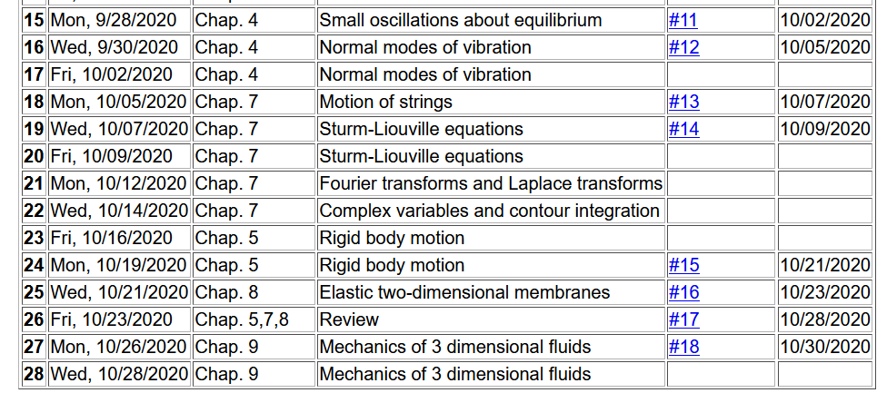
Notes:
Homework 18 is due Friday.

Slide 4
Thursday Oct. 29, 2020 at 4 PM
Notes:
Our colloquium for this week features our three newest faculty members presenting snapshots of their research programs.

Slide 6
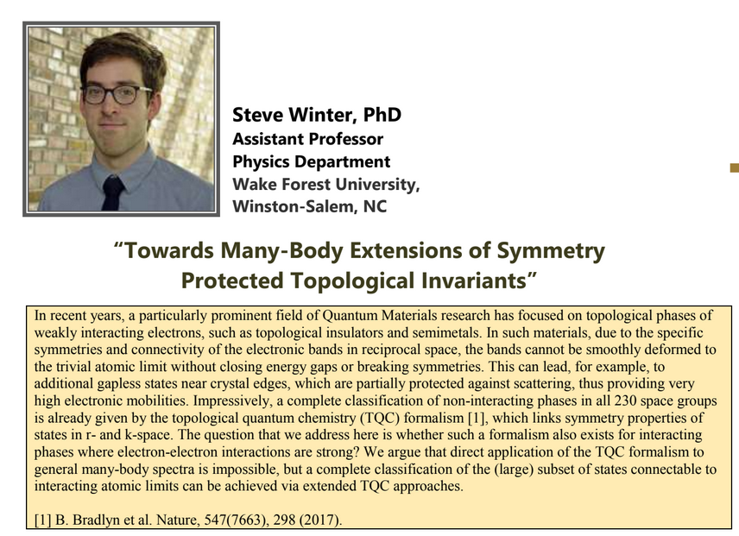

Slide 7
Your questions –
From Tim
Is there any physical relationship with the variable epsilon on slide 19?
From Nick
Can you spend some time going over the big picture of the continuity equation, and where it comes from and what is means? Are we just working with an example of a continuity equation here, or is this same one applied elsewhere?
From Gao
About today's lecture, Why do zero velocity curl lead to velocity potential?

Slide 8
Newton’s equations for fluids
Use Euler formulation; properties described in terms of
stationary spatial grid
t’
t
Notes:
Resuming our discussion of Newton’s equations for fluids. For reference, this approach is named for Euler and is based on the continuous fluid being represented within an infinitesimal volume.

Slide 9
Euler analysis -- continued
It can be shown that:
Notes:
While the infinitesimal volume moves from t to t’, the spatial position moves from r to r+v δt

Slide 12
The notion of the continuity is a common feature of continuous closed systems. Here we assume that there are no mechanisms for creation or destruction of the fluid.

Slide 13
velocity potential
Notes:
Another aspect of the fluid is the continuity equation. This simplifies to a velocity field which has zero divergence.
For irrotational flow the velocity field has zero curl and therefore can be written in terms of the velocity potential. Irrotational flow of an incompressible fluid satisfies the Laplace equation.

Slide 14
Your question

Slide 15
Example – uniform flow
b
a
z
Notes:
Consider an example of irrotational flow of an incompressible fluid. In this case the fluid is flowing uniformly along the z axis.

Slide 16
Example – flow around a long cylinder (oriented in the Y direction)
^
X
^
v₀ Z
r=a
^
θ
v₀ Z
^
Z
Notes:
Now imagine the there is a log that distorts the flow. Here the long axis of the log is in the direction perpendicular to the screen. At the boundary of the log, the radial velocity is 0.

Slide 17
Notes:
Setting up and solving the boundary value problem.

Slide 18
Notes:
Some details.

Slide 19
^
X
^
v₀ Z
r=a
^
θ
v₀ Z
^
Z
Notes:
Full solution and simplified behavior far from the log.

Slide 20
Now consider the case of your homework problem --

Slide 21
Spherical system continued:
(Continue analysis for homework)

Slide 22
Solution of Euler’s equation for fluids
Notes:
Consider a more complicated situation where there is a pressure gradient and applied potential. Specializing to the case of irrotational flow and arriving at the Bernoulli equation.

Slide 23
For incompressible fluid
Bernoulli’s integral of Euler’s equation for constant ρ

Slide 24
Not all fluids are compressible, but with additional work we can consider fluids at constant entropy (no heat transfer).
Under what circumstances can there be no heat transfer?

Slide 25
Solution of Euler’s equation for fluids -- isentropic
Notes:
Now consider generalizing this result to a possibly compressible fluid under the condition of zero heat transfer (isentropic).

Slide 26
Solution of Euler’s equation for fluids – isentropic (continued)
Notes:
Here we need to introduce the so called first law of thermodynamics. This condition finds a general expression for ratio of the pressure and density in terms of the density derivative of the internal energy density.

Slide 27
Solution of Euler’s equation for fluids – isentropic (continued)
Is this useful?
a. Yes
b. No
Notes:
This can be rearranged in terms of the gradient of the pressure divided by the density.

Slide 28
Solution of Euler’s equation for fluids – isentropic (continued)
Notes:
Finally we arrive at a Bernoulli relation for irrotational flow of an isentropic material.

Slide 29
Summary of Bernoulli’s results
For incompressible fluid
For isentropic fluid with internal energy density ε
Here ε is the internal energy of the fluid per unit mass. For an ideal gas fluid, it has a relatively simple form.
Notes:
Summary of results.

