Slide 1
PHY 711 Classical Mechanics and Mathematical Methods
10-10:50 AM MWF online or (occasionally) in Olin 103
Plan for Lecture 27 -- Chap. 9 in F & W
    Introduction to hydrodynamics
      Newton’s laws for fluids and the continuity equation
      Irrotational and incompressible fluids
      Irrotational and isentropic fluids
      Approximate solutions in the linear limit
Notes:
In this lecture, we will continue our discussion of hydrodynamics which is presented in Chapter 9 of your textbook.

Slide 2
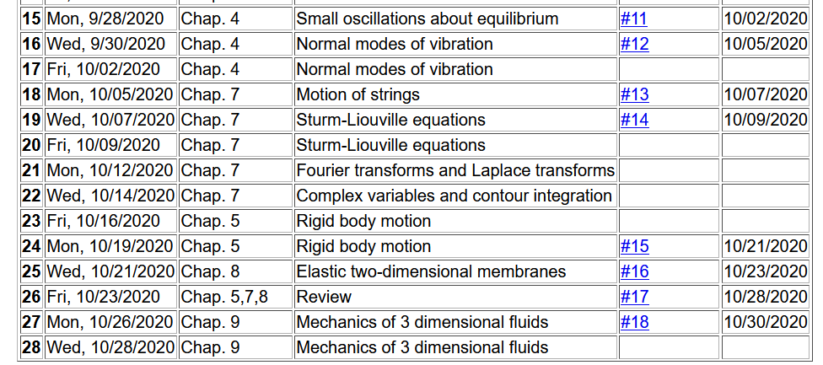
Notes:
Homework 18 is due Friday.

Slide 3
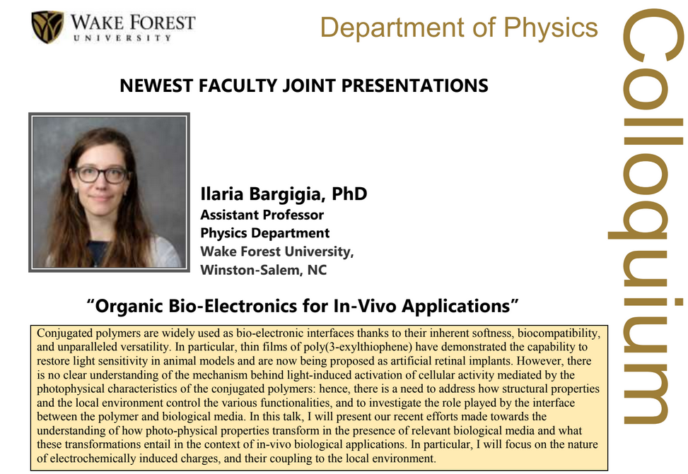
Thursday Oct. 29, 2020 at 4 PM
Notes:
Our colloquium for this week features our three newest faculty members presenting snapshots of their research programs.

Slide 4
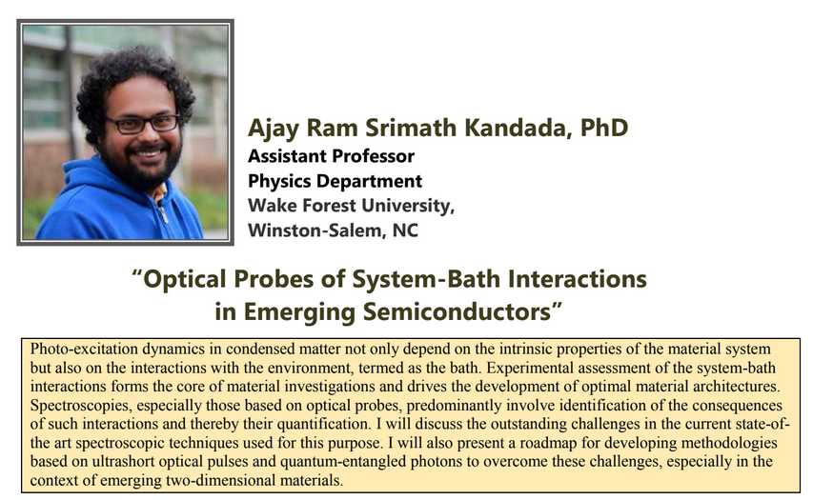

Slide 5
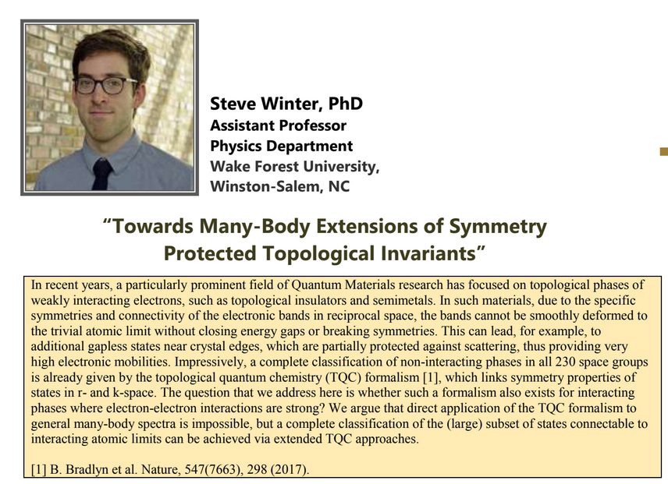

Slide 6
Newton’s equations for fluids
  Use Euler formulation; properties described in terms of
  stationary spatial grid
t’
t
Notes:
Resuming our discussion of Newton’s equations for fluids. For reference, this approach is named for Euler and is based on the continuous fluid being represented within an infinitesimal volume.

Slide 7
Euler analysis -- continued
Example:
Notes:
While the infinitesimal volume moves from t to t’, the spatial position moves from r to r+v δt

Slide 8
velocity potential
Notes:
Another aspect of the fluid is the continuity equation. This simplifies to a velocity field which has zero divergence.
For irrotational flow the velocity field has zero curl and therefore can be written in terms of the velocity potential. Irrotational flow of an incompressible fluid satisfies the Laplace equation.

Slide 9
Example – uniform flow
b
a
z
Notes:
Consider an example of irrotational flow of an incompressible fluid. In this case the fluid is flowing uniformly along the z axis.

Slide 10
Example – flow around a long cylinder (oriented in the Y direction)
^
X
^
v₀ Z
r=a
^
θ
v₀ Z
^
Z
Notes:
Now imagine the there is a log that distorts the flow. Here the long axis of the log is in the direction perpendicular to the screen. At the boundary of the log, the radial velocity is 0.

Slide 11
Notes:
Setting up and solving the boundary value problem.

Slide 12
Notes:
Some details.

Slide 13
^
X
^
v₀ Z
r=a
^
θ
v₀ Z
^
Z
Notes:
Full solution and simplified behavior far from the log.

Slide 14
Now consider the case of your homework problem --

Slide 15
Spherical system continued:
(Continue analysis for homework)

Slide 16
Solution of Euler’s equation for fluids
Notes:
Consider a more complicated situation where there is a pressure gradient and applied potential. Specializing to the case of irrotational flow and arriving at the Bernoulli equation.

Slide 17
Bernoulli’s integral of Euler’s equation for constant ρ
For incompressible fluid

Slide 18
Solution of Euler’s equation for fluids -- isentropic
Notes:
Now consider generalizing this result to a possibly compressible fluid under the condition of zero heat transfer (isentropic).

Slide 19
Solution of Euler’s equation for fluids – isentropic (continued)
Notes:
Here we need to introduce the so called first law of thermodynamics. This condition finds a general expression for ratio of the pressure and density in terms of the density derivative of the internal energy density.

Slide 20
Solution of Euler’s equation for fluids – isentropic (continued)
Is this useful?
a. Yes
b. No
Notes:
This can be rearranged in terms of the gradient of the pressure divided by the density.

Slide 21
Solution of Euler’s equation for fluids – isentropic (continued)
Notes:
Finally we arrive at a Bernoulli relation for irrotational flow of an isentropic material.

Slide 22
Summary of Bernoulli’s results
For incompressible fluid
For isentropic fluid with internal energy density ε
Notes:
Summary of results.

