Slide 1
PHY 711 Classical Mechanics and Mathematical Methods
10-10:50 AM MWF online or (occasionally) in Olin 103
Plan for Lecture 29 -- Chap. 9 in F & W
Introduction to hydrodynamics
Newton’s laws for fluids and the continuity equation
Approximate solutions in the linear limit
Notes:
In this lecture, we will continue our discussion of hydrodynamics which is presented in Chapter 9 of your textbook. The focus will be on treating the equations in the linear regime.

Slide 2
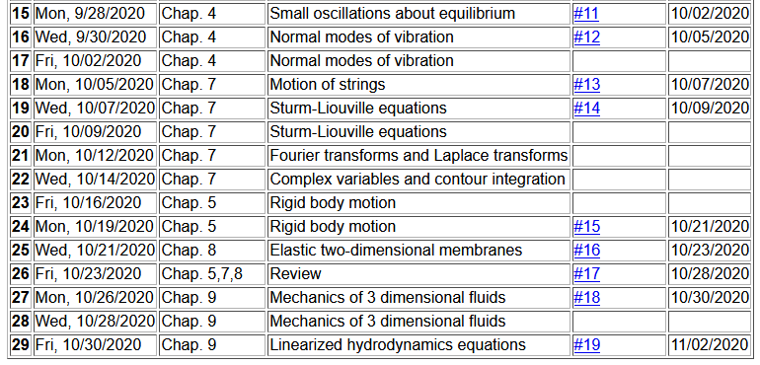
Notes:
Updated schedule

Slide 4
Recall the basic equations of hydrodynamics
+ relationships among the variables due to principles of thermodynamics due to the particular fluid (In fact, we will focus on an ideal gas.)
Notes:
Review of the basic equations of hydrodynamics.

Slide 5
Now consider the fluid to be air near equilibrium
Notes:
Now consider air as the fluid near equilibrium with small fluctuations represented by the delta notation

Slide 6
Notes:
Coupled equations.

Slide 7
Notes:
Decoupling the equations in the velocity potential and the density fluctuation.

Slide 8
Notes:
The decoupled equation is a wave equation in the velocity potential, density fluctuation, and pressure fluctuation variables.

Slide 9
Analysis of wave velocity in an ideal gas:
Notes:
Estimating the wave velocity for air assuming that it is an ideal gas.

Slide 10
Notes:
Using the ideal gas law with f representing the degrees of freedom. It is convenient to replace the f with the gamma factor which can be measured experimentally.

Slide 11
Digression
 | f | γ
Spherical atom | 3 | 1.66667
Diatomic molecule | 5 | 1.40000

Slide 12
Notes:
Using the ideal gas law under isentropic conditions to derive the speed of sound.

Slide 13
Notes:
Another analysis of the speed of sound.

Slide 14
Notes:
Some details of the analysis reveal that beyond the linear approximation, the velocity of sound is highly non-linear.

