Slide 1
PHY 711 Classical Mechanics and Mathematical Methods
10-10:50 AM MWF Online or (occasionally) in Olin 103
Discussion notes for Lecture 2
Two particle interactions
and scattering theory
Notes:
In this lecture, we will review the basic physics of two interacting particles. When the particles are not in a bound orbit, their motion may be assessed in terms of scattering. Scattering is a very powerful analysis tool that often allows for the comparison of theory and experiment.

Slide 2
Schedule for weekly one-on-one meetings
Nick – 11 AM Monday
Tim – 9 AM Tuesday
Zhi – 9 PM Tuesday
Jeanette – 11 AM Friday
Derek – 12 PM Friday
Bamidele –

Slide 3
Your questions
From Nick –
From assignment one: Can you explain the motivation of the function we plotted?
If particle 1 dominates the motion in our scattering problems, are we assuming (for now at least) that particle 2 has no velocity?
What does closest approach mean?
What exactly is the scattering parameter, b?
What's blue and what's green in the figure on slide 8?
For assignment 2: Is E=1/2m1v1^2 + V(r) and where does b come into play?
From Tim –
I am unclear as to why the quantity vanishes when the force Fji lies along ri-rj as in the equation(1.2). (from page 6)

Slide 4
Your questions – continued
From Derek
Slide 17 mentions that for quantum mechanical hard spheres at low energy the cross sectional area is 4 times as large and I was wondering why that is the case and what happens to the cross sectional area at higher energies.
From Bamidele
Slide 6, when we say M2>>M1, I expect that M2 dominates the motion not M1 (ie m1 is negligible). How's this? Or am I thinking of it in the wrong way?
What's the significance of using Hard spheres as an example? Are they descriptive of most scattering experiments?

Slide 5
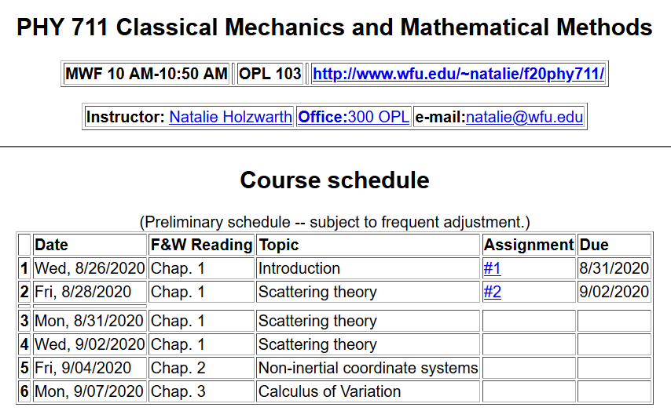
Notes:
This is an image of the webpage with the schedule and the homework assignment.

Slide 6
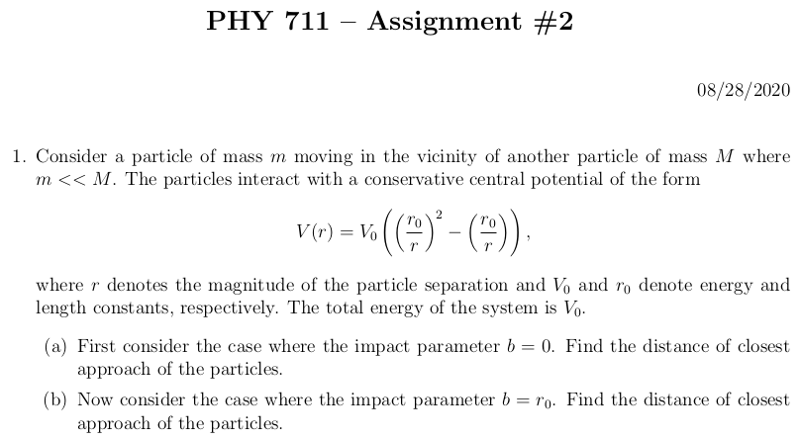
Notes:
This assignment reviews some of the basic concepts of conservative potentials, conservation of energy, and conservation of momentum. The potential form is not physically motivated, but the solutions can be determined by simple analysis, and the qualitative results are illustrative of the particle interactions.

Slide 7
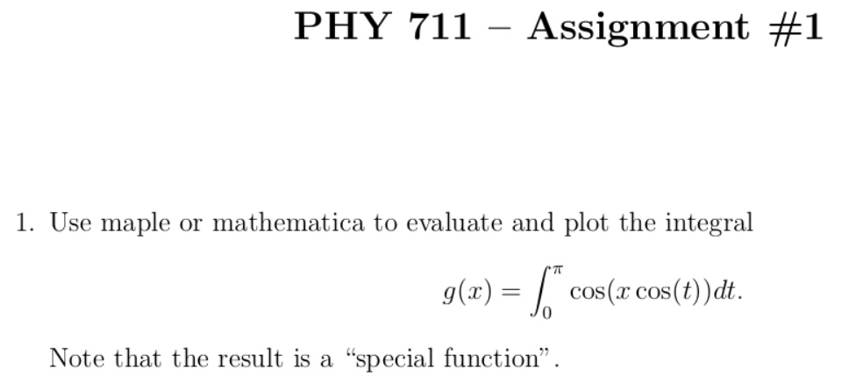
From your questions -- From assignment one: Can you explain the motivation of the function we plotted?
Comment -- My thought was to motivate the use of powerful modern tools of algebraic manipulation software which encapsulates centuries of detailed work by brilliant mathematicians. In this case, the answer is a Bessel function which will come up in this class and perhaps your other work. For more information about special functions see the website –
https://dlmf.nist.gov/

Slide 8
Comment on quiz questions
1.
3.
Notes:
These are solutions to the “assessment” exercise. It will help us figure out which mathematical methods should be usefully reviewed in this class. Most of you had particular trouble with the geometric series. It may be one of those things that you will want to remember to look up when you need it, rather than an important concept.

Slide 9
First consider fundamental picture of particle interactions
Classical mechanics of a conservative 2-particle system.
1
2
r₁
r₂
In general, we will assume that V(r)=V(r) (a central potential).
Notes:
First consider the basic particle interactions which govern their motion.

Slide 10
Your questions -- I am unclear as to why the quantity vanishes when the force Fji lies along ri-rj as in the equation(1.2). (from page 6)
Comments – I believe that this is a reference to the textbook’s footnote on page 6 which makes an important point that we have so far glossed over. In the previous slide we assumed a central potential – V(r) which depends only on the distance of the two particles and has no directional dependence. This often happens in nature and when it does, angular momentum is a constant of the motion because the interaction force on the system applies no torque. We assume this is the case for our derivations in this chapter.

Slide 11
Energy is conserved:
1
2
r₁
r₂
For a central potential V(r)=V(r), angular momentum is conserved.
For the moment we also make the simplifying assumption that m₂>>m₁ so that particle 1 dominates the motion.
Notes:
The last assumption is being made for convenience. We will consider the center of mass and relative motion much more carefully later.

Slide 12
Your questions -- If particle 1 dominates the motion in our scattering problems, are we assuming (for now at least) that particle 2 has no velocity?
Slide 6, when we say M2>>M1, I expect that M2 dominates the motion not M1 (ie m1 is negligible). How's this? Or am I thinking of it in the wrong way?
Comment -- Again, apologies for unwarranted leaps on my part. In order to keep things simple for now, we are thinking that particle 2 is stationary as the “target” particle while particle 1 is doing the scattering. In the reference frame that particle 2 is initially stationary, it is a good approximation to assume that particle 2 remains stationary after interacting with particle 1 if particle 2 is very massive because the total momentum must be conserved.

Slide 13
Typical two-particle interactions –
Notes:
These represent typical particle interactions. Only the Coulomb or gravitational forms are precisely found in nature. The others serve as convenient models.

Slide 14
Your question -- What's the significance of using Hard spheres as an example? Are they descriptive of most scattering experiments?
Comment – If we were face to face, I would have my box of marbles. Another example of hard sphere motion would be billiard balls or hockey pucks. In reality, internal spin also needs to be taken into account. The hard sphere model is mathematically convenient, and can be an approximation to some particle interactions.

Slide 15
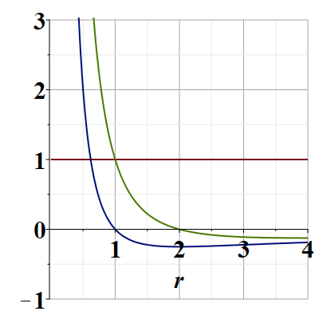
Representative plot of V(r)
V(r)
E/V₀
Note that particles are not bound; can reach infinite separation
Distances of closest approach
Notes:
Potential energy diagram showing important aspects of the particle trajectory.

Slide 16
Your question -- What's blue and what's green in the figure on slide 8?
Comment – Again, apologies for unwarranted leaps. Here some more complete comments.
r(t₁)
θ(t₁)
r(t₂)

Slide 17
Comments continued --
V_{eff}(r)

Slide 18
Which of the following are true:
The particle moves in a plane.
For any interparticle potential the trajectory can be determined/calculated.
Only for a few special interparticle potential forms can the trajectory be determined.
Why should we care about this?
We shouldn’t really care.
It is only of academic interest
It is of academic interest but can be measured.
Many experiments can be analyzed in terms of the particle trajectory.
Notes:
What do you think about these?

Slide 19
Scattering theory:
detector
Notes:
This is the ideal configuration of a scattering experiment.

Slide 20
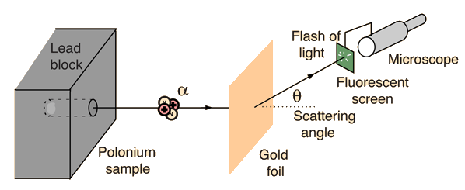
Example: Diagram of Rutherford scattering experiment
http://hyperphysics.phy-astr.gsu.edu/hbase/rutsca.html
Notes:
This illustrates the setup of the famous Rutherford scattering experiment.

Slide 21
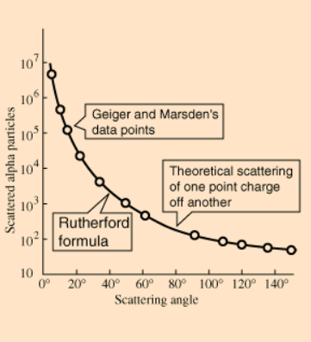
Graph of data from scattering experiment
From website: http://hyperphysics.phy-astr.gsu.edu/hbase/Nuclear/rutsca2.html
Notes:
Reconstruction experimental data from the Rutherford experiment.

Slide 22
Standardization of scattering experiments --
Impact parameter: b
b
Figure from Marion & Thorton, Classical Dynamics
Notes:
Some details of scattering geometry and analysis.

Slide 23
Note: The notion of cross section is common to many areas of physics including classical mechanics, quantum mechanics, optics, etc. Only in the classical mechanics can we calculate it from a knowledge of the particle trajectory as it relates to the scattering geometry.
b
Figure from Marion & Thorton, Classical Dynamics
Note: We are assuming that the process is isotropic in ϕ
Notes:
More details.

Slide 24
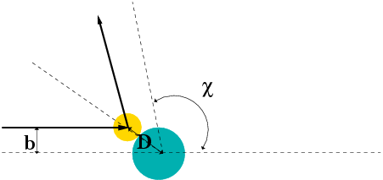
Simple example – collision of hard spheres having mutual radius D; very large target mass
Microscopic view:
Notes:
Illustration of the analysis for the scattering of a hard sphere on a massive hard sphere.

Slide 25
Simple example – collision of hard spheres -- continued
Hard sphere:
Notes:
Total cross section versus partical cross section.

Slide 26
More details of hard sphere scattering –
Hidden in the analysis are assumptions about the scattering process such as:
No external forces ➔ linear momentum is conserved
No dissipative phenomena ➔ energy is conserved
No torque on the system ➔ angular momentum is conserved
Target particle is much more massive than scattering particle
Other assumptions??
Note that for quantum mechanical hard spheres at low energy the total cross section is 4 times as large.
Notes:
Some questions and comments. The discussion of scattering theory will be continued next time.

Slide 27
Your question -- Slide 17 mentions that for quantum mechanical hard spheres at low energy the cross sectional area is 4 times as large and I was wondering why that is the case and what happens to the cross sectional area at higher energies.
Comment – A qualitative answer is that in quantum mechanics at low energy there are interference effects that cause the cross section to be larger. At higher energies, classical and quantum mechanics become more similar.

