Slide 1
PHY 711 Classical Mechanics and Mathematical Methods
10-10:50 AM MWF online or (occasionally) in Olin 103
Discussion for Lecture 30 -- Chap. 9 of F&W
Wave equation for sound in linear approximation
Wave equations for sound
Standing wave solutions
Traveling wave solutions
Notes:
In this lecture, we will consider some solutions to the linear sound wave equations.

Slide 2
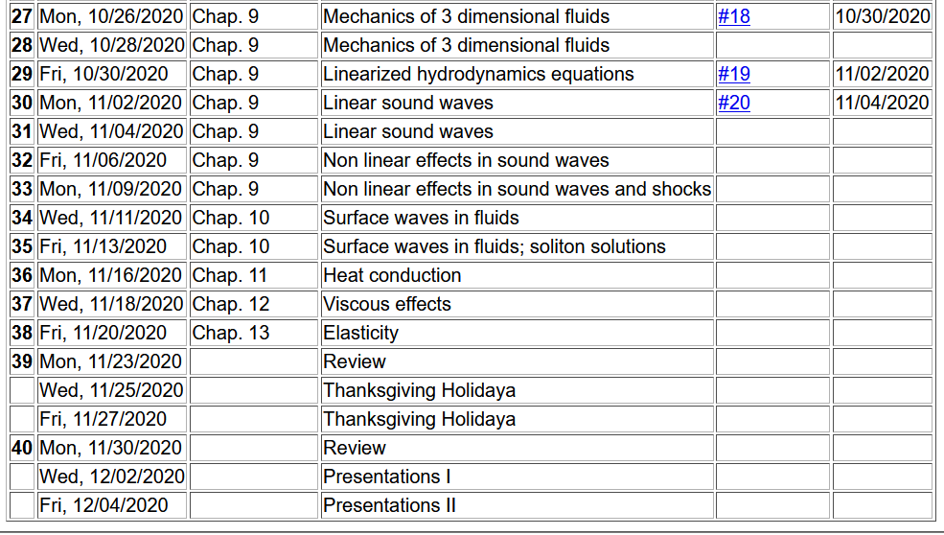
Tentative schedule --
No HW; work on “mini-projects”.
Notes:
Here is a tentative schedule for the next several weeks.

Slide 3
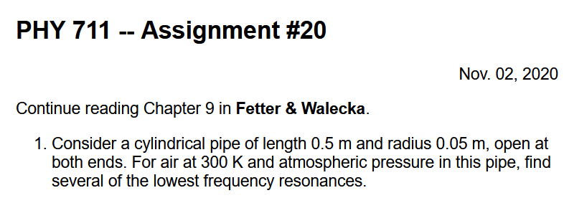
Notes:
Homework problem based on today’s lecture.

Slide 4
Schedule for weekly one-on-one meetings
Nick – 11 AM Monday (EST)
Tim – 9 AM Tuesday
Gao – 9 PM Tuesday
Tim – 11 AM Wednesday
Jeanette – 11 AM Friday
Derek – 12 PM Friday

Slide 5
Your questions –
From Gao –
The open-open pipe boundary conditions [were given in the lecture]. But what physical mechanism leads to this kind of condition?
Can wave velocity in an ideal gas only be the speed of sound, or can be other speeds?

Slide 6
Review –
Hydrodynamic equations for isentropic air + linearization about equilibrium → wave equation for air (sound waves)
Which of the following things correctly describe the wave equation for sound in air and the wave equation for elastic media?
The wave velocity is different for sound in air and waves in elastic media.
The wave motion in elastic media can be either transverse or longitudinal.
The wave motion for sound in air can be either transverse or longitudinal.

Slide 7
Notes:
Review of the equations we derived last time.

Slide 8
Your question --Can wave velocity in an ideal gas only be the speed of sound, or can [there] be other speeds?
Comment -- The term “speed of sound” refers to the linear approximation to the hydrodynamic equations for an ideal gas. We also assumed isoentropic conditions. In this case, only longitudinal waves are possible. For other types of media other “sound” speeds are possible, particularly, longitudinal and transverse waves often have different speeds.

Slide 9
Solutions to wave equation:
Notes:
In general, we will be interested in time harmonic solutions to the wave equation, where omega denotes the pure frequency of the wave.

Slide 10
Time harmonic standing waves in a pipe
a
L
Notes:
For example, consider a pipe of length L and radius a. In this pipe, we are interested in the behavior of the air. Should you have such a piper at home, put your ear close to one end. What do you hear?

Slide 11
Notes:
Here we consider the equations of linear air within the paper. Cylindrical coordinates are the natural analysis tools for this case.

Slide 12
Notes:
The equation is separable in the radial, angular, z, and time variables. Because of the cylindrical geometry, the angular part takes the form of exp(I m phi), where m has to be an integer. We also are motivated to assume that the Z(z) function has a sinusoidal form with an unknown constant alpha. Finally, the equation for the radial equation now takes a familiar form.

Slide 13
Notes:
With certain assumptions, we can show that the radial solutions for the air motion, are Bessel functions of order m.

Slide 14
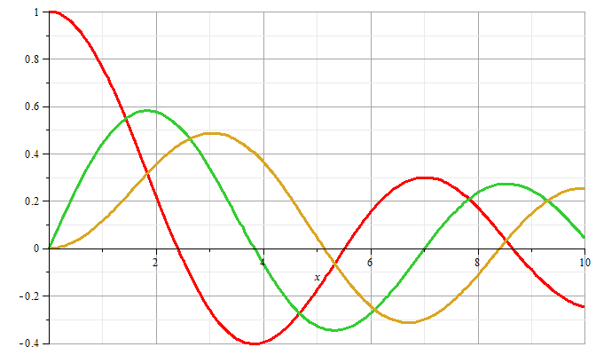
m=0
m=1
m=2
Notes:
Some plots of Bessel functions.

Slide 15
Now recall the boundary conditions
a
L
Notes:
Now consider the boundary conditions for the sound wave within the pipe, focusing on the radial direction.

Slide 16
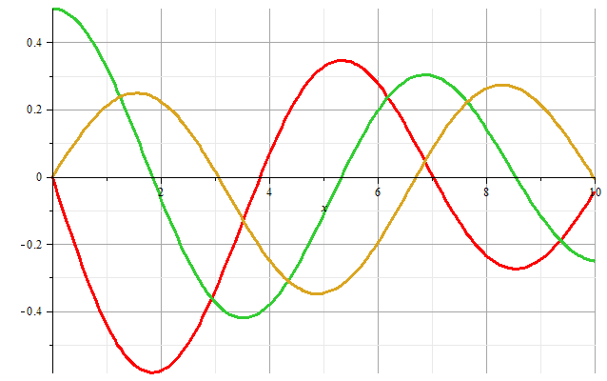
m=1
m=2
m=0
Zeros of derivatives: m=0: 0.00000, 3.83171, 7.01559
m=1: 1.84118, 5.33144, 8.53632
m=2: 3.05424, 6.70613, 9.96947
Notes:
Zeroes of the derivatives of Bessel functions.

Slide 17
Boundary condition for z=0, z=L:
Notes:
We also need to consider the boundary conditions for the air motion in the z direction where the paper can be either open or closed. For the open, open pipe, we then find the resonant wavevectors.

Slide 18
Example
Notes:
More details.

Slide 19
Alternate boundary condition for z=0, z=L:
Notes:
Now consider other boundary conditions and their resonances.

Slide 20
The above analysis pertains to resonant air waves within a cylindrical pipe. As previously mentioned, you can hear these resonances if you put your ear close to such a pipe. The same phenomenon is the basis of several musical instruments such as organ pipes, recorders, flutes, clarinets, oboes, etc.
Question – what about a trumpet, trombone, French horn, etc?
a. Same idea?
b. Totally different?
But for musical instruments, you do not want to put your ear next to the device – additional considerations must apply. Basically, you want to couple these standing waves to produce traveling waves.

Slide 21
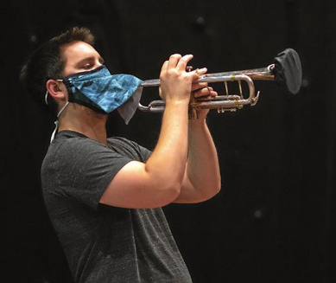
Modifications needed for the pandemic --
Image from the Winston-Salem Journal 11/1/2020

Slide 22
Your questions –
From Gao –
The open-open pipe boundary conditions [were given in the lecture]. But what physical mechanism leads to this kind of condition?
Can wave velocity in an ideal gas only be the speed of sound, or can be other speeds?
Comment --
1. Open pipe boundary condition
air in pipe
open ends in contact with atmospheric pressure

Slide 23
More relationships

Slide 24
Simple model of a sound amplifier --
Wave equation with source:
z
y
x
Notes:
This is what we will consider on Wednesday.

