Slide 1
PHY 711 Classical Mechanics and Mathematical Methods
10-10:50 AM MWF online or (occasionally) in Olin 103
Plan for Lecture 30 -- Chap. 9 of F&W
Wave equation for sound in linear approximation
Wave equations for sound
Standing wave solutions
Traveling wave solutions
Notes:
In this lecture, we will consider some solutions to the linear sound wave equations.

Slide 2
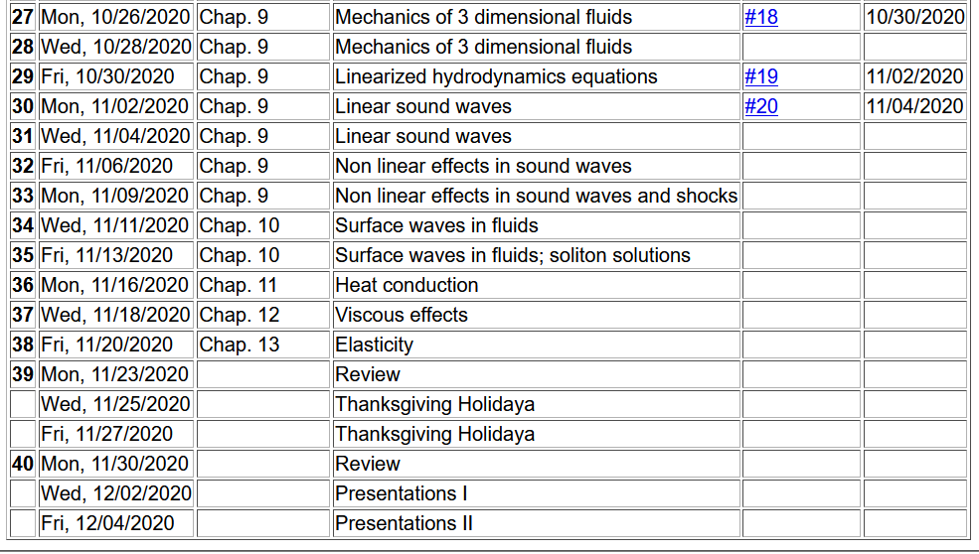
Tentative schedule --
Notes:
Here is a tentative schedule for the next several weeks.

Slide 3
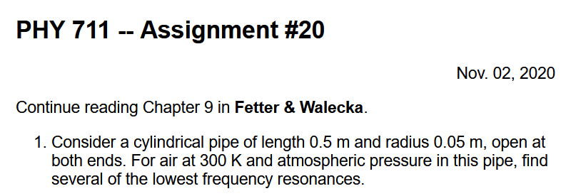
Notes:
Homework problem based on today’s lecture.

Slide 4
Notes:
Review of the equations we derived last time.

Slide 5
Solutions to wave equation:
Notes:
In general, we will be interested in time harmonic solutions to the wave equation, where omega denotes the pure frequency of the wave.

Slide 6
Time harmonic standing waves in a pipe
a
L
Notes:
For example, consider a pipe of length L and radius a. In this pipe, we are interested in the behavior of the air. Should you have such a piper at home, put your ear close to one end. What do you hear?

Slide 7
Notes:
Here we consider the equations of linear air within the paper. Cylindrical coordinates are the natural analysis tools for this case.

Slide 8
Notes:
The equation is separable in the radial, angular, z, and time variables. Because of the cylindrical geometry, the angular part takes the form of exp(I m phi), where m has to be an integer. We also are motivated to assume that the Z(z) function has a sinusoidal form with an unknown constant alpha. Finally, the equation for the radial equation now takes a familiar form.

Slide 9
Notes:
With certain assumptions, we can show that the radial solutions for the air motion, are Bessel functions of order m.

Slide 10
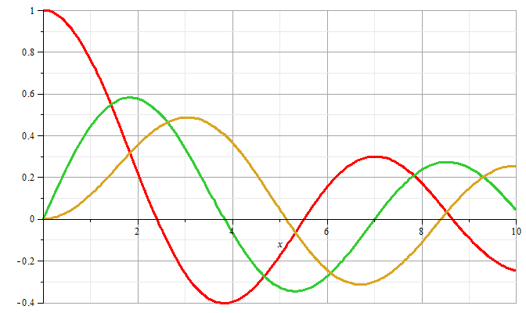
m=0
m=1
m=2
Notes:
Some plots of Bessel functions.

Slide 11
Now recall the boundary conditions
a
L
Notes:
Now consider the boundary conditions for the sound wave within the pipe, focusing on the radial direction.

Slide 12
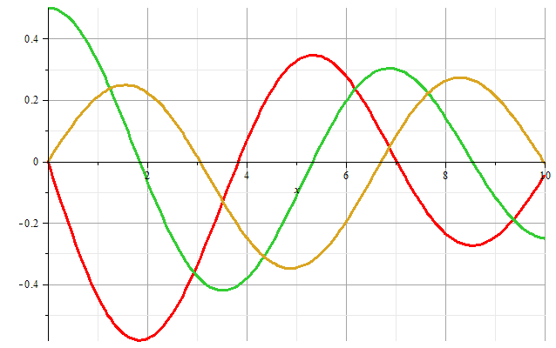
m=1
m=2
m=0
Zeros of derivatives: m=0: 0.00000, 3.83171, 7.01559
m=1: 1.84118, 5.33144, 8.53632
m=2: 3.05424, 6.70613, 9.96947
Notes:
Zeroes of the derivatives of Bessel functions.

Slide 13
Boundary condition for z=0, z=L:
Notes:
We also need to consider the boundary conditions for the air motion in the z direction where the paper can be either open or closed. For the open, open pipe, we then find the resonant wavevectors.

Slide 14
Example
Notes:
More details.

Slide 15
Alternate boundary condition for z=0, z=L:
Notes:
Now consider other boundary conditions and their resonances.

Slide 16
The above analysis pertains to resonant air waves within a cylindrical pipe. As previously mentioned, you can hear these resonances if you put your ear close to such a pipe. The same phenomenon is the basis of several musical instruments such as organ pipes, recorders, flutes, clarinets, oboes, etc.
Question – what about a trumpet, trombone, French horn, etc?
a. Same idea?
b. Totally different?
But for musical instruments, you do not want to put your ear next to the device – additional considerations must apply. Basically, you want to couple these standing waves to produce traveling waves.

Slide 17
Simple model of a sound amplifier --
Wave equation with source:
z
y
x
Notes:
This is what we will consider on Wednesday.

