Slide 1
PHY 711 Classical Mechanics and Mathematical Methods
10-10:50 AM MWF online or (occasionally) in Olin 103
Discussion for Lecture 32: Chap. 9 of F&W
Sound generation and scattering;
non-linear effects
Sound generation
Sound scattering
Introduction to non-linear effects
Notes:
In this lecture, we will consider traveling wave solutions to the sound wave equations.

Slide 2
Schedule for weekly one-on-one meetings
(EST)
Nick – 11 AM Monday
Tim – 9 AM Tuesday
Gao – 9 PM Tuesday
Jeanette – 11 AM Friday
Derek – 12 PM Friday

Slide 3
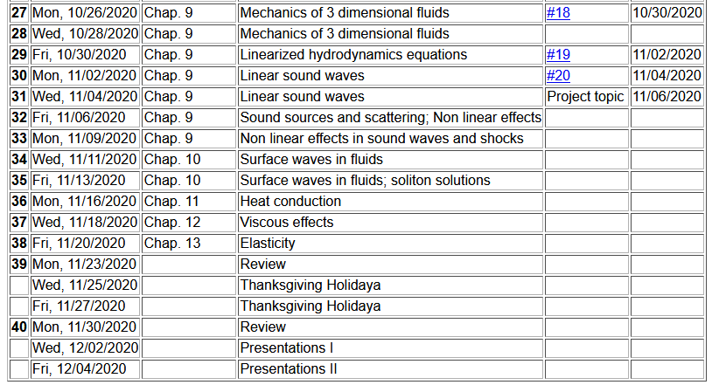
Notes:
Schedule.

Slide 4
Your questions –
From Nick –
1. Can you cover what the extra boundary conditions are representing?
2. Also what is the deal with the bar notation on the r,z? Why not say r+r’? 3. Lastly, can you go over the approximation for |r-r'|? I don't quite follow that.
From Gao –
1. Does u=c+v stands for actual wave velocity in nonlinear media?

Slide 5
Recap: Wave equation with source:
Notes:
Now think of wave equation with a source. The Green’s function is a very powerful tool for solving these problems. We will use similar techniques in solving the wave equation for electromagnetic waves.

Slide 6
Wave equation with source -- continued:
Notes:
Result that we will derive.

Slide 7
Reviewing some of the highlights from last time --
Derivation of Green’s function for wave equation -- continued
Notes:
Spatial equation for Fourier amplitudes.

Slide 8
In our case --
From Green’s theorem presented last time --
Fourier transform of forcing term.
extra contributions from boundary
Notes:
Derivation continued.

Slide 9
Your question -- Can you cover what the extra boundary conditions are representing?
Comment – The Green’s theorem that we discussed last time is based on the properties of the divergence theorem
Note: The surface term is important when the analysis is performed in a confining volume. When the analysis involves an infinite volume and A vanishes at infinity, the surface term does not contribute.
A

Slide 10
Wave equation with source:
z
y
x
Notes:
Now consider a simplified model of a sound amplifier where the red cylinder moves up and down in the z direction at a particular frequency omega.

Slide 11
Treatment of boundary values for time-harmonic force:
Here our analysis volume is the half space z>0.
Notes:
In this case, we need to use a modified Green’s function to satisfy the boundary condition at z=0.

Slide 12
Some more details --
Need this term to vanish at z’=0

Slide 14
Notes:
Some details.

Slide 15
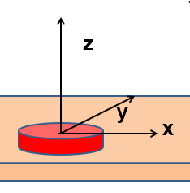
r
θ
Notes:
Changing to more convenient coordinates. Preparing to evaluate the expression far from the moving piston.

Slide 16
Some details --

Slide 17
From integral from of Bessel functions.
Another Bessel function identity.
Analytic result for r→∞
Notes:
Approximate solution continued. In this approximation, the integral can be evaluated in terms of Bessel functions.

Slide 18
Notes:
Estimating the power of the sound wave in this asymptotic regime.

Slide 19
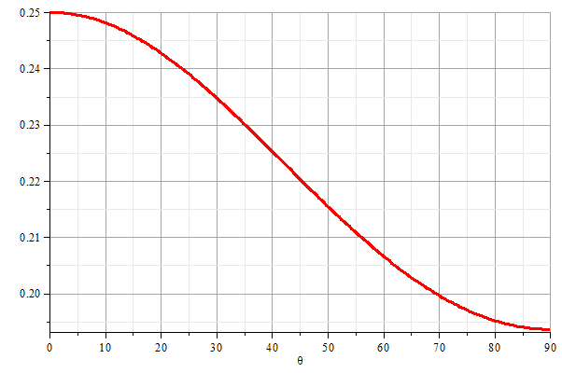
z
θ
y
x
Notes:
Graph of the power as a function of the polar angle theta.

Slide 20
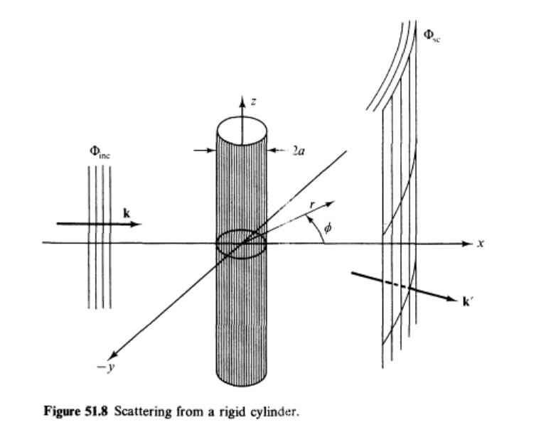
Scattering of sound waves –
for example, from a rigid cylinder
Figure from Fetter and Walecka pg. 337
Notes:
Now consider the case of a plane wave of sound, scattering off of a cylindrical object. Can you think of a physical situation for this model?

Slide 21
Example of cylindrical scattering objects --
Suppose a trumpeter is playing near the columns. Maximal scattering occurs when
a. Facing toward the column b. Facing away from the column.

Slide 22
Scattering of sound waves –
for example, from a rigid cylinder
Notes:
Analysis of the scattering wave using cylindrical coordinates.

Slide 23
Notes:
In this case we expect a cylindrical wave that can be represented in terms of Bessel and Neumann functions, or more conveniently in terms of Hankel functions H. Satisfying the boundary values on the surface of the scattering cylinder, we find the coefficients of the expression.

Slide 24
Notes:
Using the asymptotic form of the Hankel functions we can analyze the results further.

Slide 25
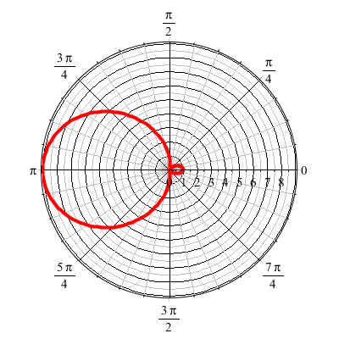
For ka << 1
Note: As explained in the textbook, this “cross section” has the units of length, so that it could be interpreted as a scattering width because of the cylindrical geometry.
Notes:
Defining the appropriate scattering cross section, we can analyze the results further. For ka<<1 (long wavelengths, low frequencies) we find that most of the sound is scattered backwards from the propagation direction.

Slide 26
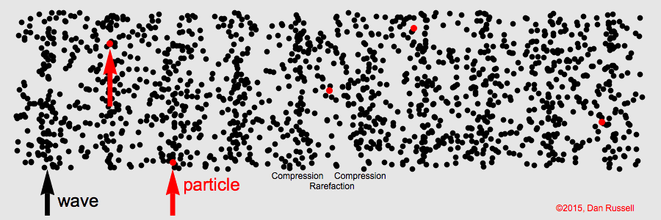
Visualization of longitudinal wave motion
From the website:
https://www.acs.psu.edu/drussell/Demos/waves/wavemotion.html
Now consider some non-linear effects

Slide 27
Effects of nonlinearities in fluid equations
-- one dimensional case
Notes:
Review of basic equations, specializing in one spatial dimension.

Slide 28
Notes:
Decoupling the variables.

Slide 29
Notes:
More analysis.

Slide 30
Notes:
Further derivations.

Slide 31
Notes:
Using adiabatic relationships.

Slide 32
Notes:
Analysis of fluid velocity from a knowledge of the wave velocity.

Slide 33
Traveling wave solution:
Notes:
Analysis for a traveling wave.

Slide 34
Traveling wave solution -- continued:
Notes:
Checking the linear result

Slide 35
Traveling wave solution -- full non-linear case:
w
Notes:
Analysis of how to visualize the traveling wave solution.

Slide 36
Visualization continued:
Notes:
More details.

Slide 37
Summary
Notes:
Summary.

Slide 38
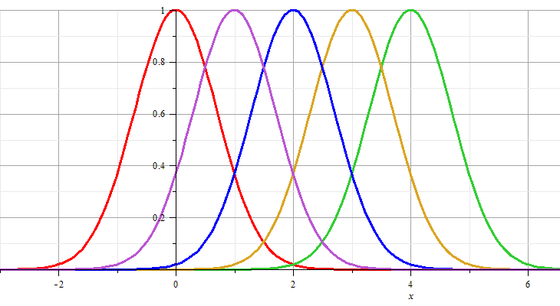
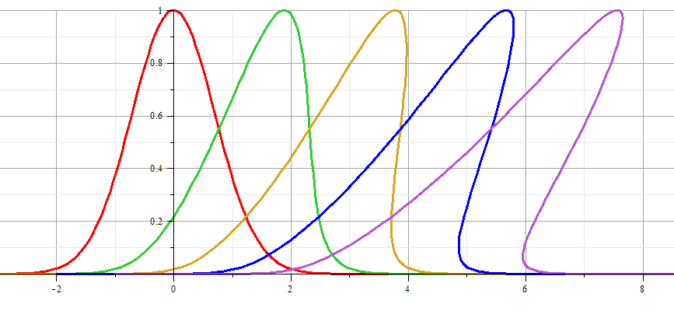
Linear wave:
Non-linear wave:
Notes:
Example visualization.

